Slide 1


www.pmadata.org/stlr
We invite you to use and adapt PMA STLR tools!
Whatever tool you discover and intend to try out, you will need to adapt these tools to
your context. This may include:
Changing questionnaire question text: Some tools contain questions from our questionnaires (publicly available here), along with their numbering. Note that, in some cases, question numbering has changed across phases, but any questions cited in a tool use consistent numbering within that tool.
Considering appropriate pronouns: We use female pronouns quite often, as PMA worked with female enumerators – and as a bonus, we are happy to use a feminine pronoun by default for a change!
TIP: Use our hashtag system!
As we used these tools across various country contexts, we developed a simple system of using hashtags as placeholders for information that will need to be updated based on the country, context, culture, and program.
  For example, information in a tool that was country-specific is noted with the hashtag placeholder, #countryspecific – or possibly an even more specific placeholder like #districtlevel or #localpartner.
Information that required a change in date is noted with hashtags such as #todaysdate or #lastyear.
These hashtags allow those adapting the tool to use the Find&Replace function to quickly identify and update all instances of a hashtag within seconds.

Slide 2


Understanding the questionnaire in Open Data Kit
This presentation explores key functions of an electronic questionnaire in Open Data Kit (ODK), including prefills, loops, error messages, and filters/skips. Participants will be able to conceptualize and demystify these behind-the-scenes functions through metaphors and examples, which can be particularly helpful for those who are new to computer-assisted personal interviews (CAPI) and/or less comfortable with technology.
When adopting, adapting, and sharing this tool, please use this suggested citation:
  “Understanding the questionnaire in ODK”, created by PMA (Performance Monitoring for Action) with Sarah Nehrling. Released June 2024. CC BY-NC 4.0.

Slide 3

Understanding the questionnaire in ODK

Slide 4



Slide 5



Slide 6
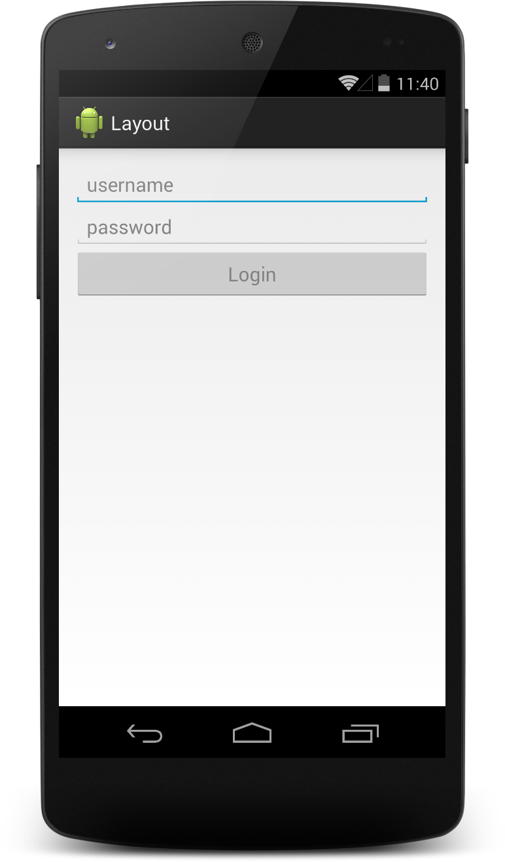
The magnificent electronic questionnaire!
Collection of new types of data
  GPS coordinates
  Date/time stamp
  Photos
Less work for enumerators
  Integrated skip patterns
  Carrying over of relevant information to later questions
  Integrated logical checks and constraints
  A nearly endless supply of questionnaires available
Less materials, work, and time required for data entry
  No paper questionnaires to transport to data entry agents
  No separate data entry agents or equipment required

Slide 7
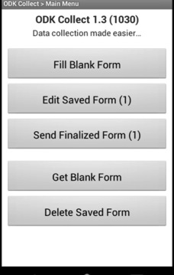
How does an ODK
electronic questionnaire
function?

Slide 8
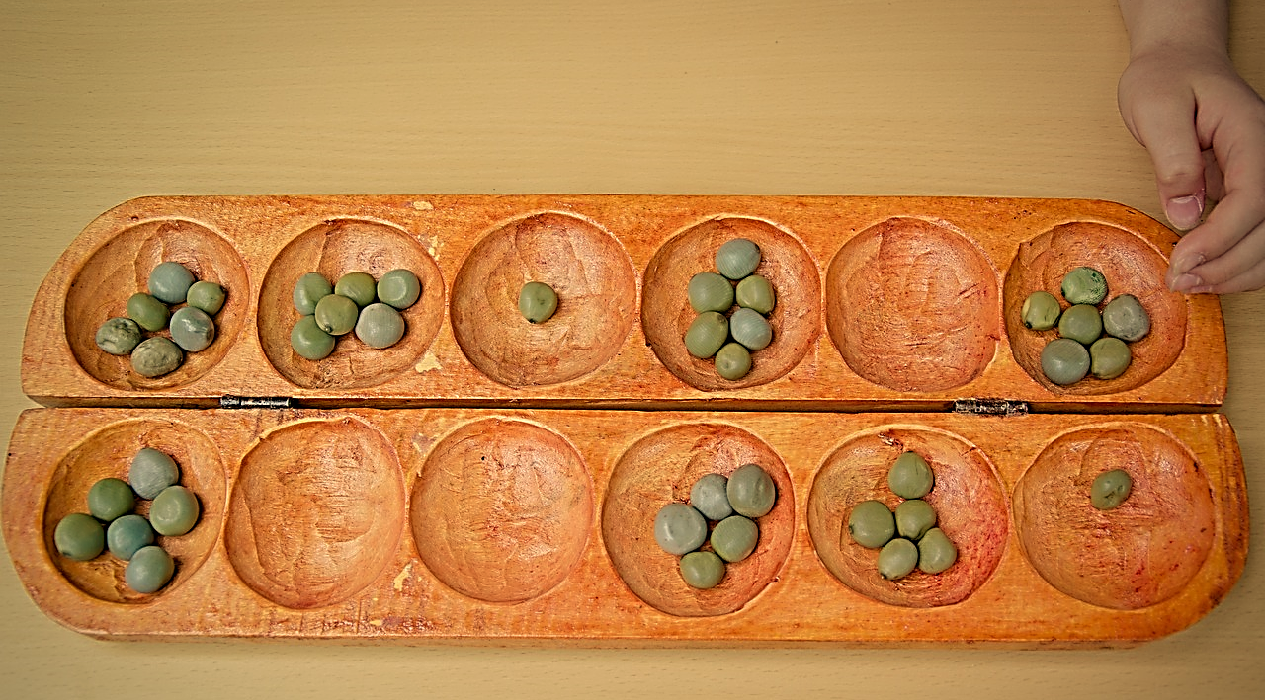
Prefills
Notes:
In a paper questionnaire, enumerators must remember previous responses to carry that information forward to later questions where this information may be relevant.
In an electronic questionnaire, relevant responses from previous questions can be automatically carried forward and injected into question text or response sets.

Slide 9
Prefills
Section 1: Household Roster
101. Name of HH member/visitor
Funmi
Funmi
102. What is [NAME] ’s relationship to the head of the household?

Slide 10
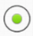
Prefills and Internal Calculations
Section 4: Water, Sanitation, and Hygiene
Piped Water: Piped into
dwelling/indoor
Piped Water: Piped into
dwelling/indoor
Piped Water: Piped into
dwelling/indoor
Water from Spring: Unprotected
Spring
Rainwater
Tanker Truck
Cart or Bicycle with Small Tank
Surface water (River / Dam /
Lake / Pond / Stream / Canal /
Irrigation Channel)
Bottled Water
Sachet Water
No response
402. Which of the following water sources does your household use on a regular basis for any part of the year for any purpose?
Read out all types and check all that are used. Scroll to the bottom to see all choices.
Piped Water: Piped into
dwelling/indoor
Piped Water; Piped
to yard/plot
Piped Water: public
tap/standpipe
Tube well or borehole
Dug Well: Protected Well
Dug Well: Unprotected Well
Water from Spring: Protected Spring
Dug Well: Protected Well
Dug Well: Protected Well
Dug Well: Protected Well
Sachet Water
Sachet Water
Sachet Water
403. What is the main source of drinking water for members of your household?
Selections from 402: ${source_labels}
Read out selections from 402 only.
404. What is the main source of water used by your household for other purposes such as cooking and handwashing?
Selections from 402: ${source_labels}
Read out selections from 402 only.
Questions 405 to 408 will be repeated ${number_of_sources} times, once for each water source selected in 402. These sources include:${source_labels}
3

Slide 11
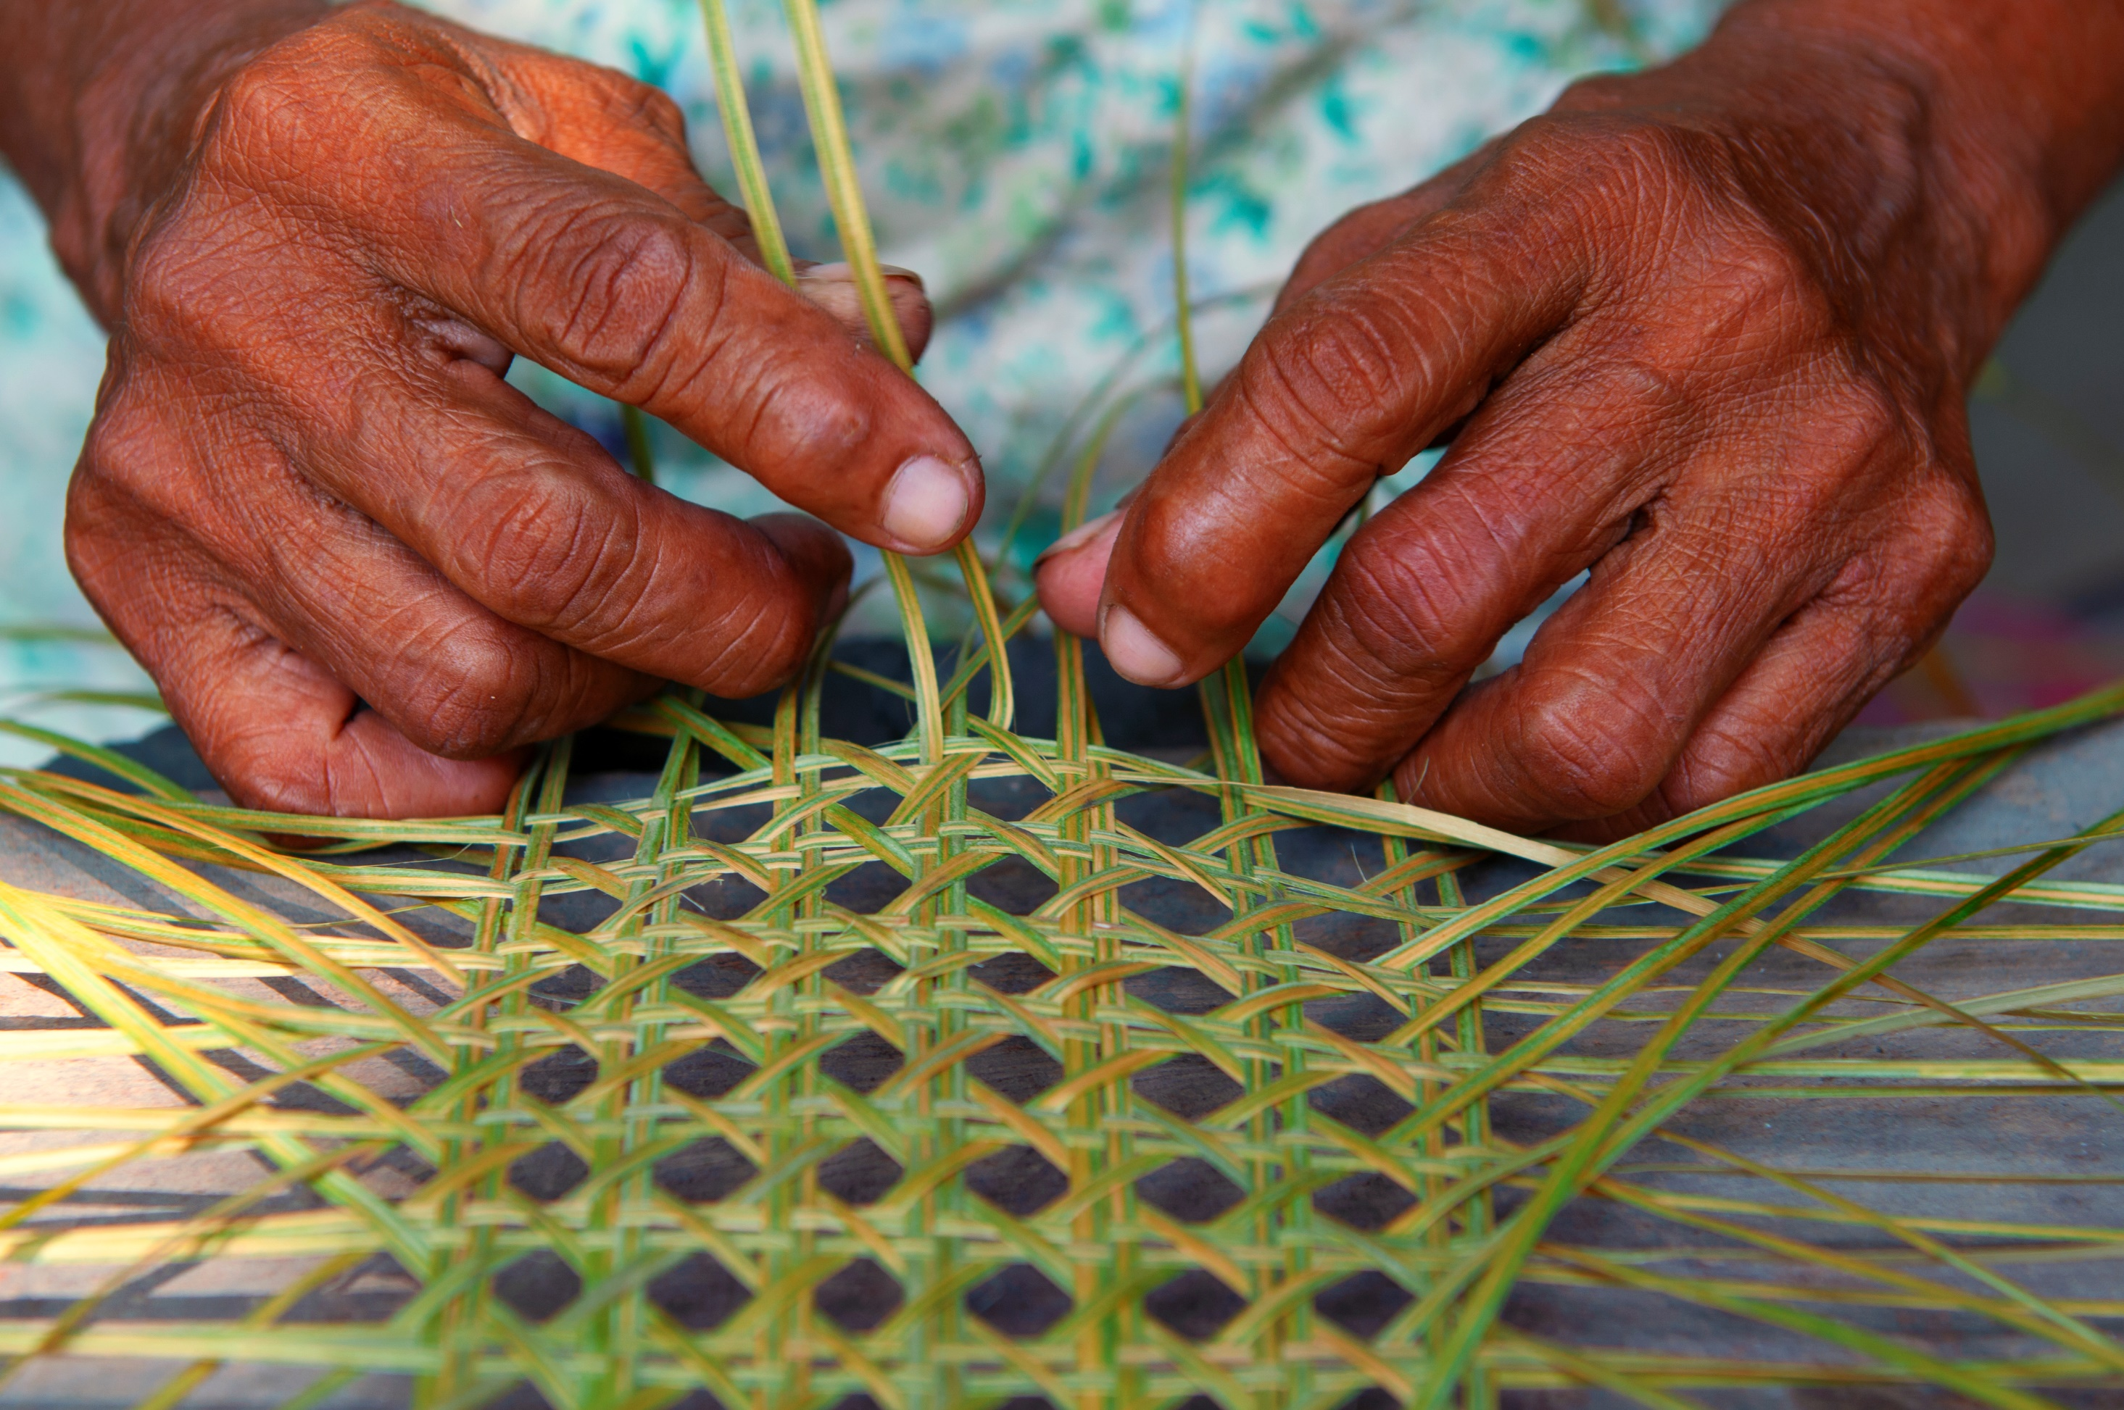
Loops
Notes:
In a paper questionnaire, enumerators often fill out “tables” of information for different members of the household. Each household member represents a line in the table, and each question to ask that member is shown in a column of the table.
In an electronic questionnaire, loops are programmed so that you list a member of the household, and then you are asked a series of questions about that first member. Then you list the second member and are asked the same questions about this second member. And so on until the last member listed.

Slide 12


Loops
Section 1: Household Roster
101. Name of HH member/visitor | Funmi | Segun
102. What is [NAME] ’s relationship to the head of household?
103. Is [NAME] male or female?
104. How old was [NAME] at their last birthday?
105. What is [NAME] ’s marital status?
106. Does [NAME] currently live here?
107. Did [NAME] stay here last night?
LCL_101. What is the religion of [NAME] ?
LCL_102. What is the ethnicity of [NAME] ?
Funmi
Funmi
Funmi
Funmi
Funmi
Funmi
Funmi
Funmi
This person is eligible to participate in the Female Questionnaire.
108. Are there any other usual members of our household or persons who slept in the house last night?
Yes
There are other household members. Proceed to the next screen and select “Add a group”.

Slide 13



Loops
Section 1: Household Roster
101. Name of HH member/visitor | Funmi | Segun
102. What is [NAME] ’s relationship to the head of household?
103. Is [NAME] male or female?
104. How old was [NAME] at their last birthday?
105. What is [NAME] ’s marital status?
106. Does [NAME] currently live here?
107. Did [NAME] stay here last night?
LCL_101. What is the religion of [NAME] ?
LCL_102. What is the ethnicity of [NAME] ?
Segun
Segun
Segun
Segun
Segun
Segun
Segun
Segun
This person is NOT eligible to participate in the Female Questionnaire.
108. Are there any other usual members of our household or persons who slept in the house last night?
Yes
Yes
There are other household members. Proceed to the next screen and select “Add a group”.

Slide 14




Loops
Section 1: Household Roster
101. Name of HH member/visitor | Funmi | Segun | Victoria
102. What is [NAME] ’s relationship to the head of household?
103. Is [NAME] male or female?
104. How old was [NAME] at their last birthday?
105. What is [NAME] ’s marital status?
106. Does [NAME] currently live here?
107. Did [NAME] stay here last night?
LCL_101. What is the religion of [NAME] ?
LCL_102. What is the ethnicity of [NAME] ?
Victoria
Victoria
Victoria
Victoria
Victoria
Victoria
Victoria
Victoria
This person is NOT eligible to participate in the Female Questionnaire.
108. Are there any other usual members of our household or persons who slept in the house last night?
Yes
Yes
No
There are NO other household members. Proceed to the next screen and select “Do NOT add a group”.

Slide 15
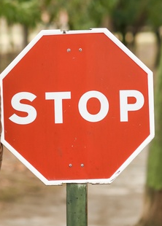

Error Messages

Slide 16
Error Messages
Incoherence
402. Which of the following water sources does your household use on a regular basis for any part of the year for any purpose?
Piped Water: Piped into dwelling/indoor
Piped Water; Piped
to yard/plot
Piped Water: public tap/standpipe
Tube well or borehole
Dug Well: Protected Well
Dug Well: Unprotected Well
Water from Spring: Protected Spring
Water from Spring: Unprotected Spring
Rainwater
Tanker Truck
Cart or Bicycle with Small Tank
Surface water (River / Dam /
Lake / Pond / Stream / Canal /
Irrigation Channel)
Bottled Water
Sachet Water
No response
You cannot select “No response” if you have already checked another response.
Notes:
In a paper questionnaire, enumerators must read and respect the constraints and conditions on each question. They must also remember and control for incoherencies in responses.
In an electronic questionnaire, constraints and error messages will alert and, sometimes, not allow for responses that do not meet the constraints or conditions or are incoherent with past responses.

Slide 17
Error Messages
Non-respect of conditions
106. Does [NAME] usually live here?
107. Did [NAME] stay here last night?
NO
NO
Error: The members who are listed in the roster should live regularly in the household or should have spent the night before in the household. Please go back to remove this member from the household.

Slide 18
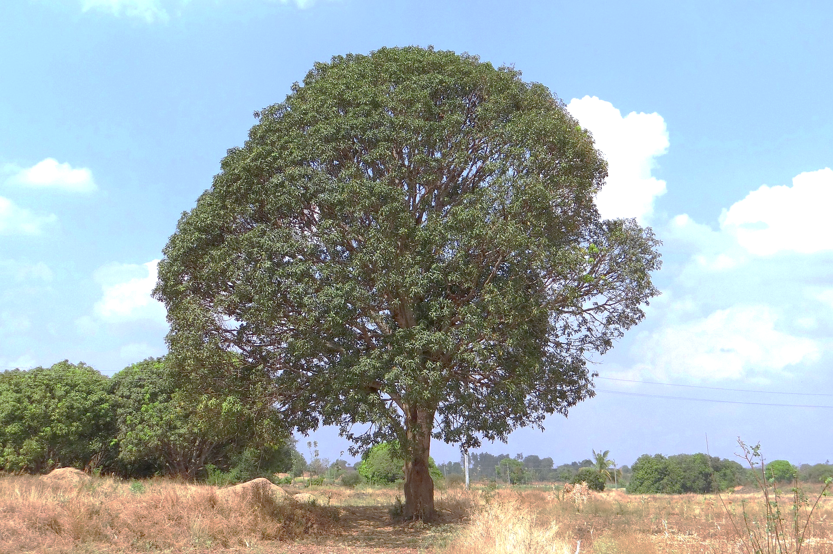
Filters & Skips
Notes:
In a paper questionnaire, enumerators must manually follow skip patterns and relevancy statements to understand which questions to skip and which other questions apply based on the respondent’s situation and previous responses.
In an electronic questionnaire, skips are programmed and automatically bring you to the next relevant question based on previous responses.

Slide 19
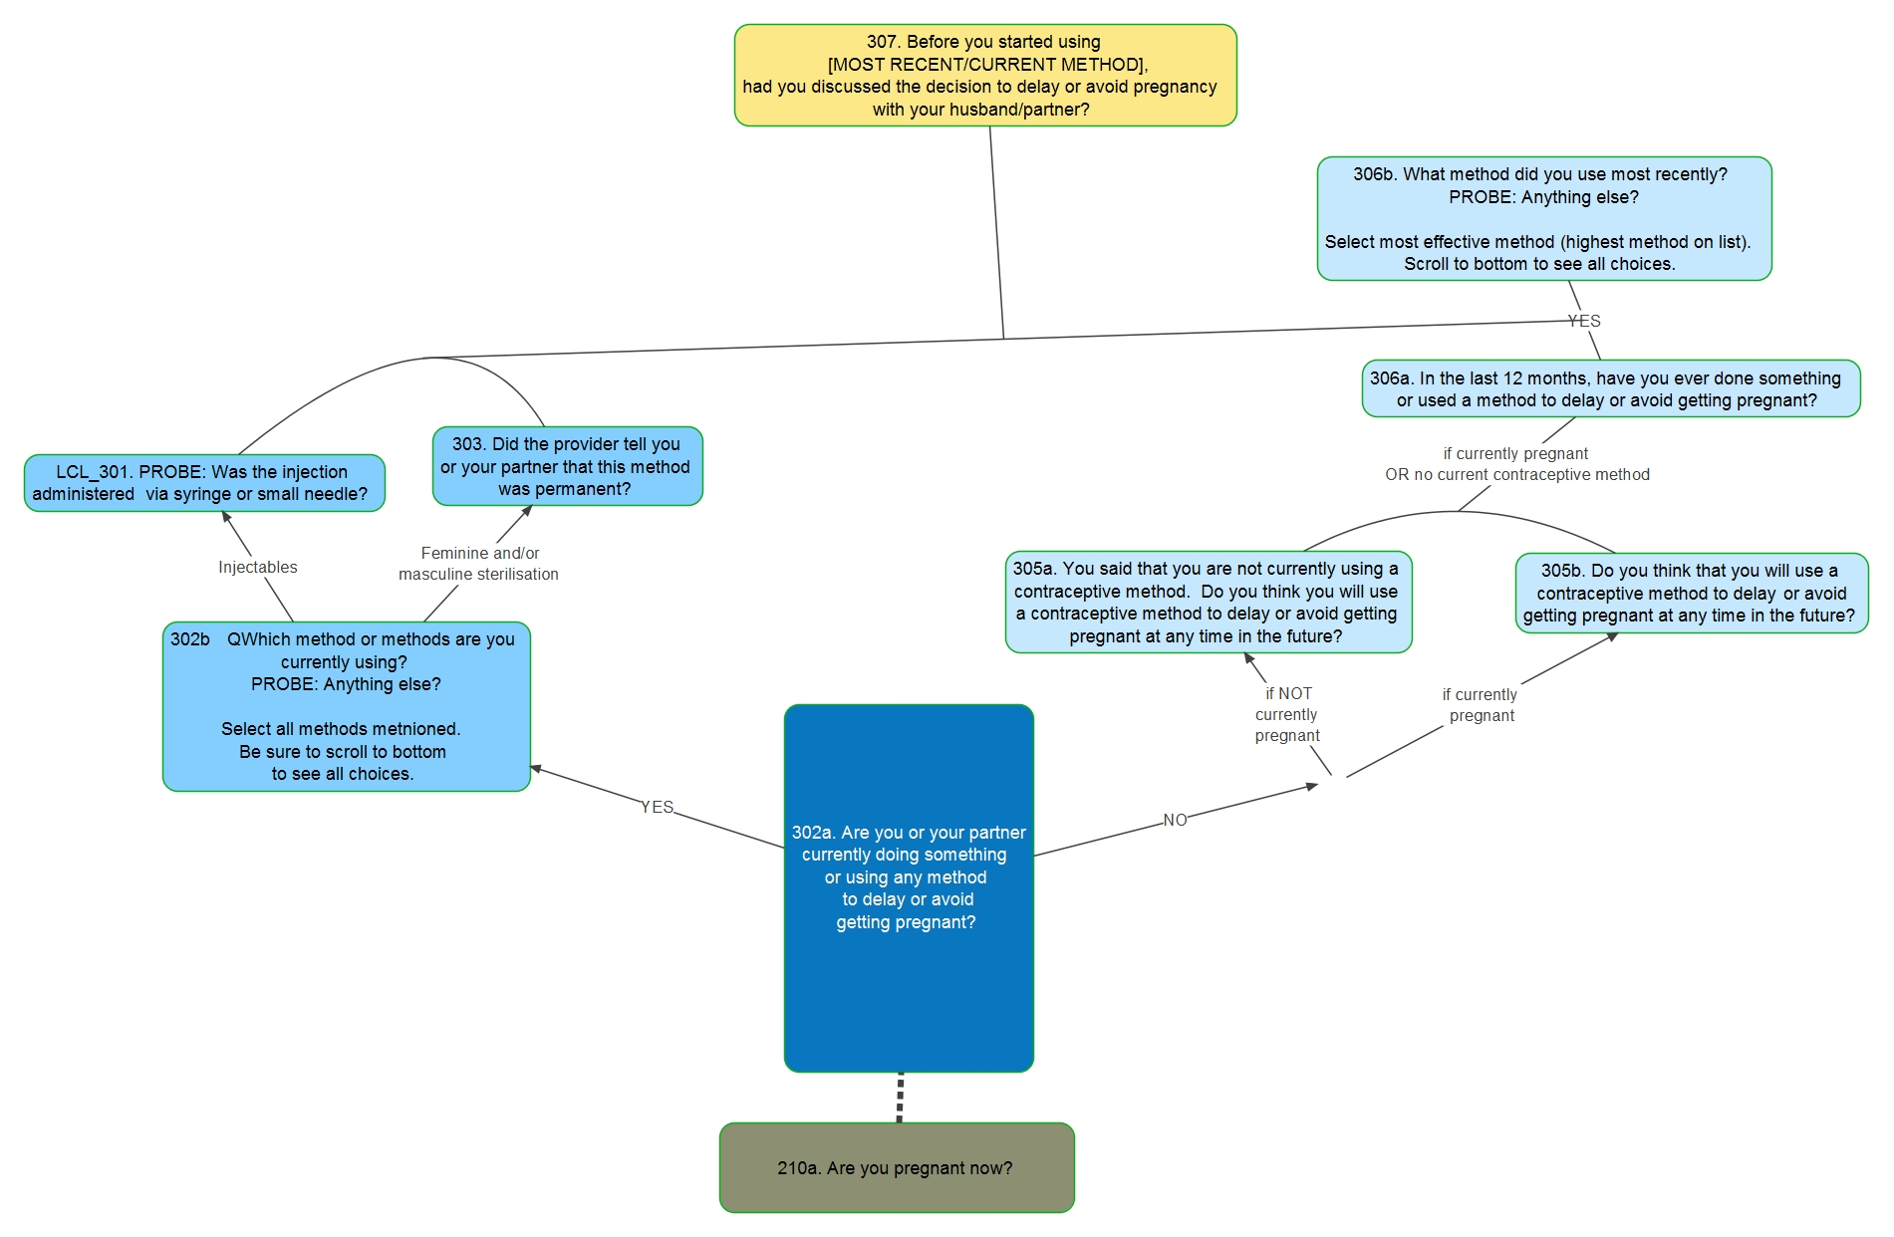
Filters
Notes:
Filters - with a "climb the mango tree" of how responses branch out to different questions and then possibly come back together; can use tape on ground to draw out mango tree and branches, and then "walk" the participants through the branches
Example to use: the path you take if you're a non-user, if you're currently using a method, if you've used a method in the past 12 months; then branch together for a series of questions on counseling and service provision around their last visit (for current user or used in past 12 months)

Slide 20
Image sources:
Slide 3, 4 (right), 7, 10, & 17: Microsoft 365 stock images
Slide 4 (left): Pile of documentation files by Scopio from Noun Project (CC BY-NC-ND 2.0)
Slide 7: https://www.pikist.com/free-photo-xpekh
Slide 14 (left): Man leaning against stop sign in park by Javier Sanchez Mingorance from Noun Project (CC BY-NC-ND 2.0)
Slide 14 (right): “Do Not Enter” sign in Malta by Avel Shah from Noun Project (CC BY-NC-ND 2.0)
Slide 16: https://www.pikist.com/free-photo-xnoqo#google_vignette

