Slide 1


www.pmadata.org/stlr
We invite you to use and adapt PMA STLR tools!
Whatever tool you discover and intend to try out, you will need to adapt these tools to
your context. This may include:
Changing questionnaire question text: Some tools contain questions from our questionnaires (publicly available here), along with their numbering. Note that, in some cases, question numbering has changed across phases, but any questions cited in a tool use consistent numbering within that tool.
Considering appropriate pronouns: We use female pronouns quite often, as PMA worked with female enumerators – and as a bonus, we are happy to use a feminine pronoun by default for a change!
TIP: Use our hashtag system!
As we used these tools across various country contexts, we developed a simple system of using hashtags as placeholders for information that will need to be updated based on the country, context, culture, and program.
  For example, information in a tool that was country-specific is noted with the hashtag placeholder, #countryspecific – or possibly an even more specific placeholder like #districtlevel or #localpartner.
Information that required a change in date is noted with hashtags such as #todaysdate or #lastyear.
These hashtags allow those adapting the tool to use the Find&Replace function to quickly identify and update all instances of a hashtag within seconds.

Slide 2

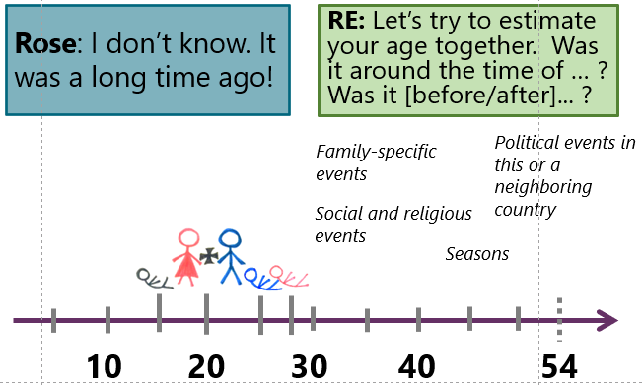
Top Resident
Enumerator Errors
This presentation reviews common enumerator errors related to data collection in family planning surveys. From age heaping to the dreaded double-submission dilemma, we've got the scoop on all the pitfalls to avoid. Plus, get up close and personal with specific challenges in family planning data collection, like identifying user contraceptive methods with precision.
When adopting, adapting, and sharing this tool, please use this suggested citation:
“Top Resident Enumerator Errors”, created by PMA (Performance Monitoring for Action) with Sarah Nehrling. Released June 2024. CC BY-NC 4.0

Slide 3

Top Resident Enumerator Errors
Review of some common errors that can occur in family planning surveys
Notes:
Note that there are activities in the Notes sections of this presentation that you can do throughout the presentation

Slide 4
How to use this PowerPoint
This PowerPoint can be used:
  As fodder for existing PPTs
  As a review activity
Its main objective is to ensure that certain common errors are explained and that the correct approaches, needed to avoid these common errors, are fully understood by the REs.

Slide 5
Error Type:
Uninformed Estimates
Notes:
Skipping questions and trying to estimate the answer. We can’t actually identify this in the dataset, but … often times for the age at first sex question, the REs will guess based on the age at marriage. This is really unacceptable, even if its understandable and the REs need way more training and practice on how to ask sensitive and difficult questions. In every country, we see age at first sex is before age at first marriage even though everyone insists that pre-marital sex never happens. Obviously that isn’t true, but we don’t know how much of the difference is because pre-marital sex does happen versus how much of the difference is the REs estimating age instead of asking the question.
Not probing for dates. We have way too many don’t know for dates, especially date of birth and date started using. Yes, its probably difficult for women to report with accuracy in what month they started using a method, but at least the REs need to probe on seasons or holidays or events. Something that can narrow down the month and year of events.
Date of birth and age. This is probably the question that trips the most errors. The age of the woman and her birthday are constrained to be similar and the REs have a lot of trouble getting this right. I think for some of them they just start putting in dates until it matches with the age. But they really need to be confirming the age and the date of birth to the extent possible instead of just making the screens match so they can move forward.

Slide 6
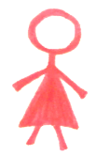





Rose: I don’t know. It was a long time ago!
FQ 320. How old were you when you first used a method to delay or avoid getting pregnant?
The respondent said she was 54 years old at her last birthday.
Enter the age in years.
RE: Let’s try to estimate your age together. Was it around the time of … ? Was it [before/after]... ?
Political events in this or a neighboring country
Family-specific events
Seasons
Social and religious events
10
20
30
40
54
Notes:
FACILITATOR: Explain the scenario, lightly sketched out in icons, what we know about the woman already from past exchanges during this interview: She had a stillbirth when she was about 15, got married around 20, had a baby boy at about 25 and a baby girl at about 28 years old. (She is 54 years old today.)
Then play the part of the respondent, Rose, and respond to various Res’ prompts, guided by the listed categories.
From the GUIDE:
Use well-known dates as references: Often, a respondent remembers big events that happened around the date or age in question. If you know the years, and even approximate months, of common big events, ask if the life event in question happened around, and then before or after, the big events. Sometimes, you may ask how many times an annual event happened since the life event in question. (Example: How many Ramadan months have passed since the birth of your son?) In most cases, you will first try to narrow down the approximate year, and then start to ask questions to estimate the month. Reference events can include:
Family-specific events: Birth or death of another household member; moving from one location to another
Seasons: dry or rainy, cold or hot, planting or harvest, beginning or end of academic year (for estimating months); extreme flooding or drought (for estimating years)
Political events in this or a neighboring country: National independence day; other major changes in territories or governance; presidential or legislative elections; election, arrest, or death of a political leader; creation or dissolution of a political party; large protests, unrest, or war; introduction of major laws; economic crises
Social and religious events: Football matches and tournaments; large festivals; national census; religious holidays (*be careful: Muslim holidays shift back about 10 days every year so are not always at the same time of year); epidemics; famine

Slide 7

Ugoulo: I don’t know.
FQ 401a. How old were you when you first had sexual intercourse?
Please record the date of the first live birth. Date should be found by calculating forward or backward from memorable events if needed.
Current age: 24
Number of live births: 1
Enter the age in years.
RE: I’m sure you didn’t have sex before marriage, right?
RE: That’s alright, it was surely a long time ago. I’ll just enter “don’t know”.
RE: Were you promiscuous during your school days?
RE: If you don’t want to talk about it, that’s ok.
RE [to herself]: She wouldn’t be having sex before 17. She comes from a good family.
RE : …
17
3 years
20
24
Notes:
FACILITATOR: Post each response, have it crossed out, and ask the REs to explain WHY it is not an acceptable response in this situation. Finally, at the blank response box, ask REs to give the best responses to the respondent’s “I don’t know”.
TIP: Ask if she knows how old she was when she got married. If so, start with the age at which the woman was married, and then count the time between her marriage and the birth of her first child.

Slide 8

FQ 101. In what month and year were you born?
The age in the household roster is [AGE].
Month: Year:
FQ 102. How old were you at your last birthday?
Age:
How does age calculation change based on the month of birth?
Think about a baby. Until it has lived for 12 months, we do not consider it to be 1 year old.
May 2023
May 2024
1 year
Sep 2023
(May 2023 + 4 months)
May 2024
<1 year
Notes:
In the example on the slide, the starting date is May 2023 – facilitator can update this example date to month of presentation

Slide 9
FQ 101. In what month and year were you born?
The age in the household roster is [AGE].
Month: Year:
FQ 102. How old were you at your last birthday?
Age:
Has her birthday already come this calendar year?
YES
NO
February 1997
December 1997
0
23
0
23
Subtract the birth year from this year.
Subtract the birth year from this year,
and then subtract 1 more.
[March] 2024
- [February] 1997
27 years [and just a few months]
[March] 2024
- [December] 1997
27 – 1 = 26 years [and quite a few months]
Notes:
Note to update to current month and year

Slide 10
Error Type:
Age Heaping
Notes:
Shifting ages so women are no longer eligible.
Shifting women to age 14 or 50 will make them ineligible for the survey. Often this is difficult (although not impossible) to identify at the RE level, but it is very obvious at the population level since the data may show 2 or 3 times as many 14- and 50-year-olds as 15- and 49-year-olds. Sometimes the REs shift women and sometimes the women shift themselves so they don’t have to participate. Helping them develop and rehearse their intro scripts so people understand the purpose and importance of the study will probably help with that.

Slide 11


Marie: I don’t remember exactly, but she has been in school since my youngest was born, and he is 7 years old now!
HQ 104. How old was [Ellie] at their last birthday?
RE [to herself]: Since children enter school at 7 years old, then 7+7=14. She is 14 years old, and ineligible for the FQ.
RE: Did she enter school at the normal age, or was it before or after that age?
RE: Let’s try to estimate her age together. Was it around the time of … ? Was it [before/after]... ?
?
Family-specific events
?
Seasons
Political events in this or a neighboring country
7
Social and religious events
10
Notes:
FACILITATOR: Play the part of the respondent, Marie, and respond to various REs’ prompts, guided by the listed categories. Remember that, especially in cases like this one where eligibility is being determined, the MONTH of birth is very important.
From the GUIDE:
Use well-known dates as references: Often, a respondent remembers big events that happened around the date or age in question. If you know the years, and even approximate months, of common big events, ask if the life event in question happened around, and then before or after, the big events. Sometimes, you may ask how many times an annual event happened since the life event in question. (Example: How many Ramadan months have passed since the birth of your son?) In most cases, you will first try to narrow down the approximate year, and then start to ask questions to estimate the month. Reference events can include:
Family-specific events: Birth or death of another household member; moving from one location to another
Seasons: Dry or rainy, cold or hot, planting or harvest, beginning or end of academic year (for estimating months); extreme flooding or drought (for estimating years)
Political events in this or a neighboring country: National independence day; other major changes in territories or governance; presidential or legislative elections; election, arrest, or death of a political leader; creation or dissolution of a political party; large protests, unrest, or war; introduction of major laws; economic crises
Social and religious events: Football matches and tournaments; large festivals; national census; religious holidays (*be careful: Muslim holidays shift back about 10 days every year so are not always at the same time of year); epidemics; famine

Slide 12
Error Type:
Multiple Forms for one Household

Slide 13






1st Visit (HQ) =
Fill Blank Form
2nd Visit (HQ) =
Edit Saved Form (x)
3rd Visit (HQ) =
Edit Saved Form (x)
1st Visit (FQ) =
Edit Saved Form (x)
2nd Visit (FQ) =
Edit Saved Form (x)
3rd Visit (FQ) =
Edit Saved Form (x)
Notes:
FACILITATOR: The idea is to explain, with visuals, that we only “Fill Blank Form” (= unlock the household) ONE TIME. From that time on, we do not need to create any more new forms for the household. Instead, we “Edit Saved Form” during all subsequent visits; we figuratively “leave the door unlocked”.
*** The three pink stick figures represent the Female Questionnaire forms that were created during the Household Questionnaire – when the Household Roster was being filled out.

Slide 14
Error Type:
Multiple Forms of Contraceptive Use
Notes:
Multiple forms of contraceptive use.
Of course women can use multiple methods. But sometimes the REs select things like implant and IUD. Or female sterilization and IUD, responses that just don’t make a lot of sense together. It isn’t that common, but an exercise reinforcing different ways to refer to the method beyond the technical terms and making sure the REs understand which methods might make sense to use together (basically condom and anything else).

Slide 15
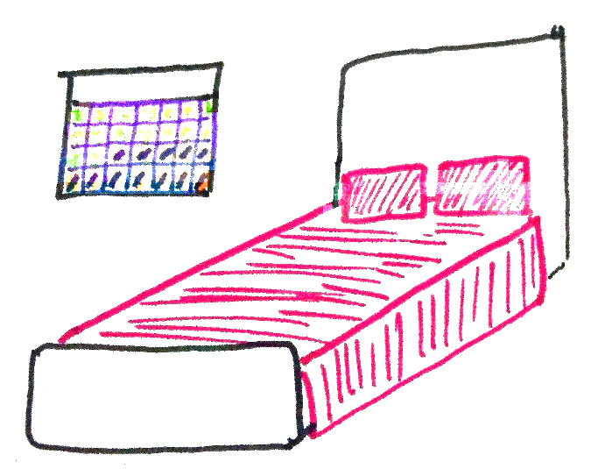




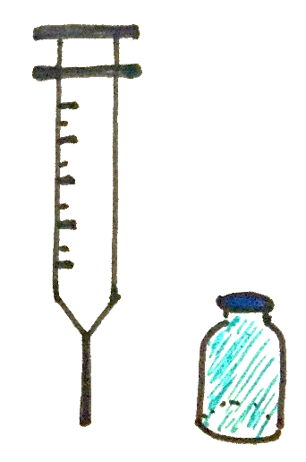
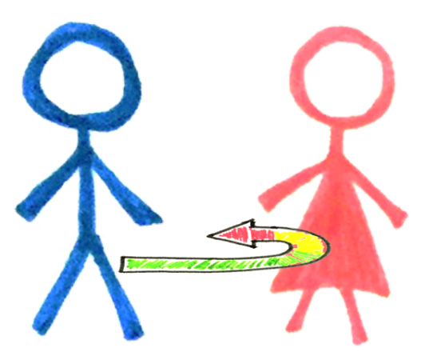
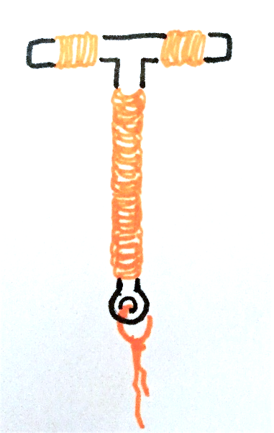

Does this contraceptive combination make sense? Why or why not?
Notes:
FACILITATOR: Ask REs to decide if each combination of methods makes sense to them – specifically, 1) if it is possible and why or why not, 2) if it is a probable combination and why or why not.
Note: Bottom right-hand box depicts the withdrawal method (coitus interruptus) and an IUD.

Slide 16


Does this contraceptive combination make sense? Why or why not?
Notes:
FACILITATOR: A point can be made here that it is possible and probable for condoms to be used with other methods.

