Slide 1


www.pmadata.org/stlr
We invite you to use and adapt PMA STLR tools!
Whatever tool you discover and intend to try out, you will need to adapt these tools to
your context. This may include:
Changing questionnaire question text: Some tools contain questions from our questionnaires (publicly available here), along with their numbering. Note that, in some cases, question numbering has changed across phases, but any questions cited in a tool use consistent numbering within that tool.
Considering appropriate pronouns: We use female pronouns quite often, as PMA worked with female enumerators – and as a bonus, we are happy to use a feminine pronoun by default for a change!
TIP: Use our hashtag system!
As we used these tools across various country contexts, we developed a simple system of using hashtags as placeholders for information that will need to be updated based on the country, context, culture, and program.
  For example, information in a tool that was country-specific is noted with the hashtag placeholder, #countryspecific – or possibly an even more specific placeholder like #districtlevel or #localpartner.
Information that required a change in date is noted with hashtags such as #todaysdate or #lastyear.
These hashtags allow those adapting the tool to use the Find&Replace function to quickly identify and update all instances of a hashtag within seconds.

Slide 2

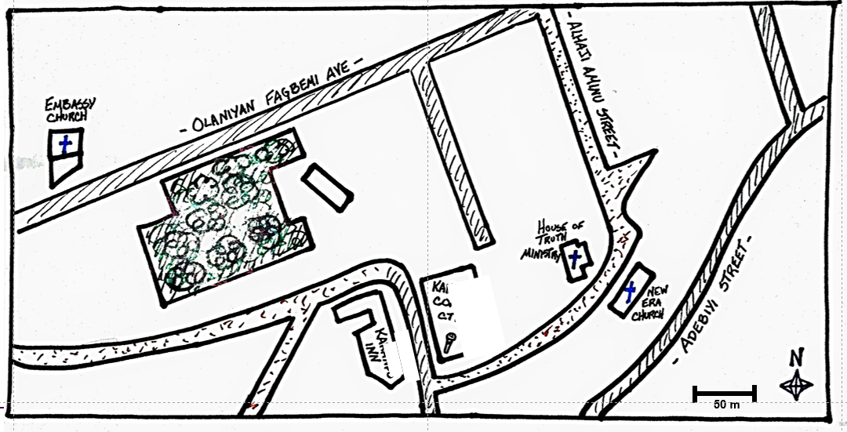
Introduction to Orienteering
This presentation explains how to read and navigate from a paper map, an often-overlooked skill for enumerators and supervisors that can save them considerable time and frustration. The explanation of the navigation process concludes in an outside practice scenario.
When adopting, adapting, and sharing this tool, please use this suggested citation:
“Introduction to Orienteering”, created by PMA (Performance Monitoring for Action) with Sarah Nehrling. Released June 2024. CC BY-NC 4.0.

Slide 3
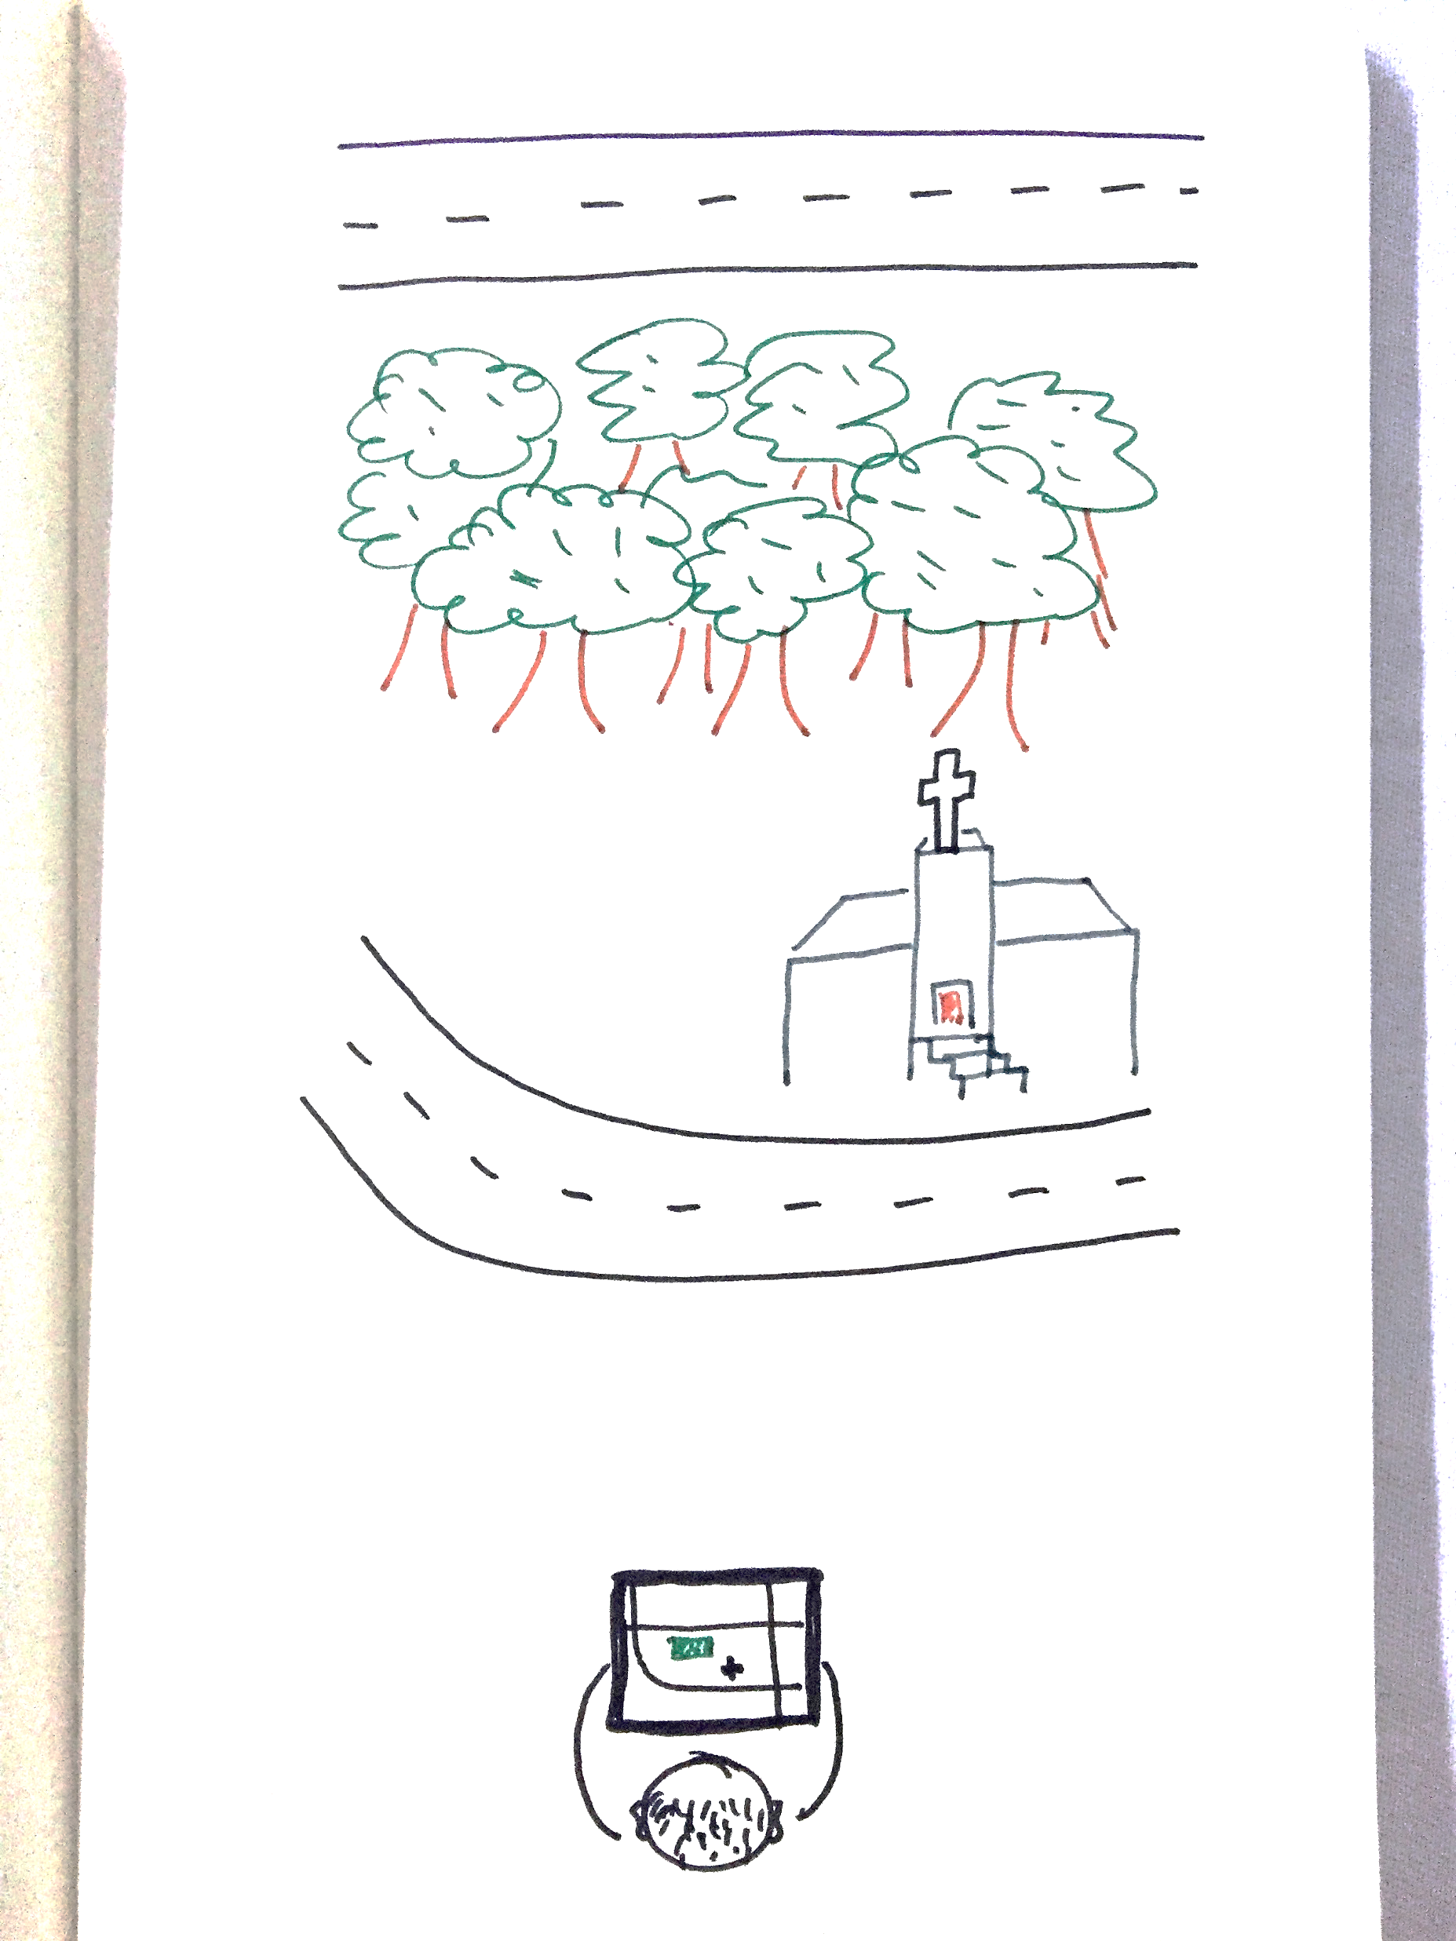
Introduction to Orienteering
How to Read and Navigate from a Paper Map

Slide 4

I don’t need to learn this!
I always get where I’m going…
But how much TIME, ENERGY, and GOODWILL do you waste in the process?
We’d rather you save these valuable resources for conducting interviews. ☺
Notes:
IF USEFUL: Tell a story about a time someone got lost, turned around, because of a map. How much time was wasted? How much extra walking did that person do? How much asking “Are you [x]?” to the wrong household, or asking every stranger s/he met every 5 meters?

Slide 5

So let’s save some time later by taking some time now to learn about
How to read and navigate from a paper map!

Slide 6

FIRST, Orient the map
Find the north.
  ***hints on how to do so in the following slides
Turn the map, keeping it parallel to the ground, until the north of the map and the true north are in the same direction.
Observe around you – the elements that you find on the map, such as the road, a landmark, or something else – to be sure that the reality aligns with the oriented map.

Slide 7
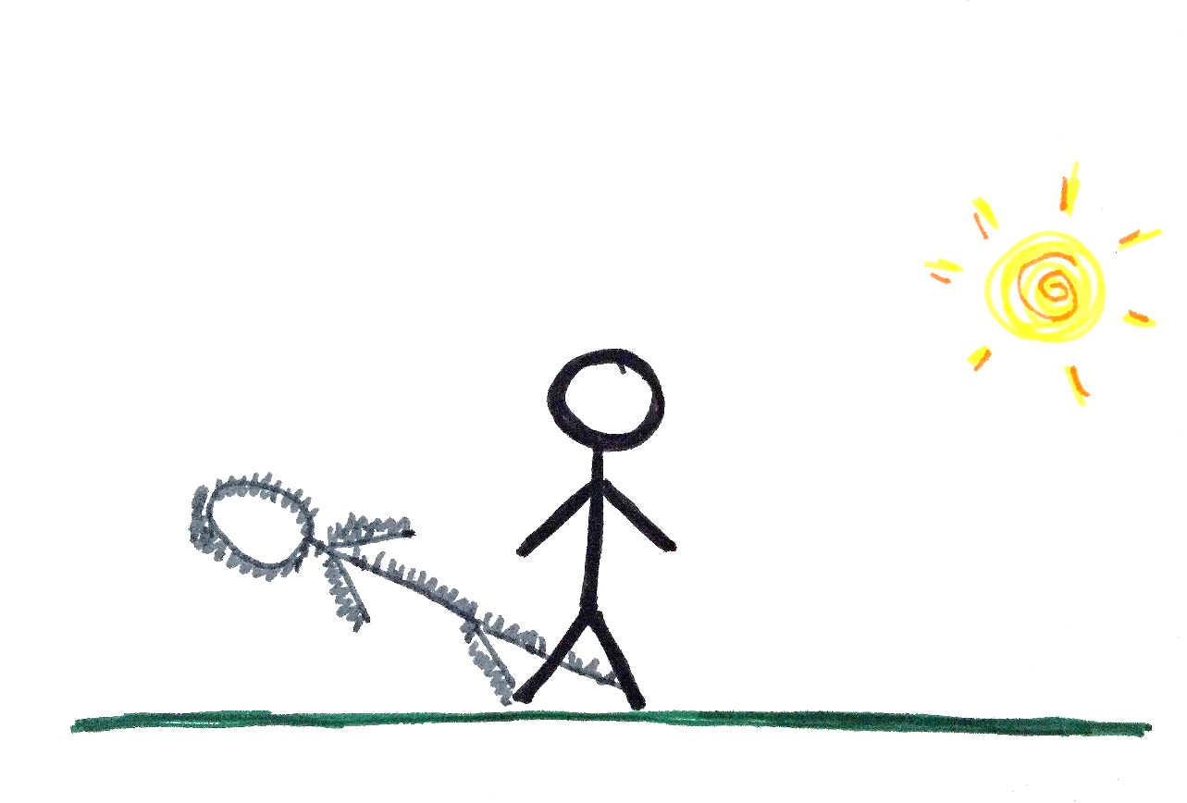
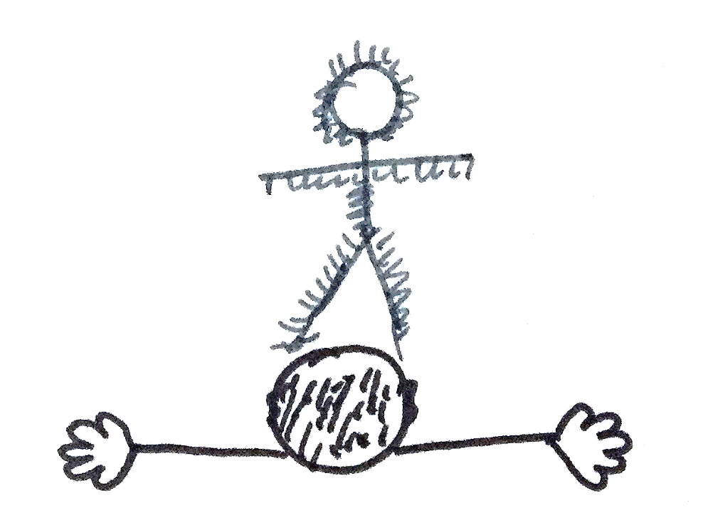
Find the North – IN THE MORNING
1
2
R
North
Face your shadow, with your arms outstretched on either side of you.
  It is your RIGHT hand that indicates the NORTH.
Observe where your shadow falls.

Slide 8

Find the North – IN THE AFTERNOON
1
2
North
L
Face your shadow, with your arms outstretched on either side of you.
  It is your LEFT hand that indicates the NORTH.
Observe where your shadow falls.

Slide 9
What if it’s a cloudy day? Or about midday?
Options
Use a compass to find North; then turn your map so the top edge is facing North – often an app on your phone
  ***Instructions on compass use in the following slides
Ask someone for directions toward a landmark on your map; based on these directions, turn your map to be sure that the reality aligns with the oriented map
  ***Example in the following slides
…?

Slide 10
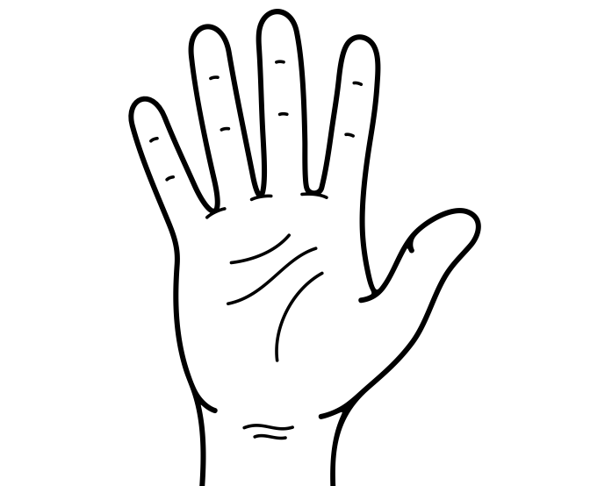
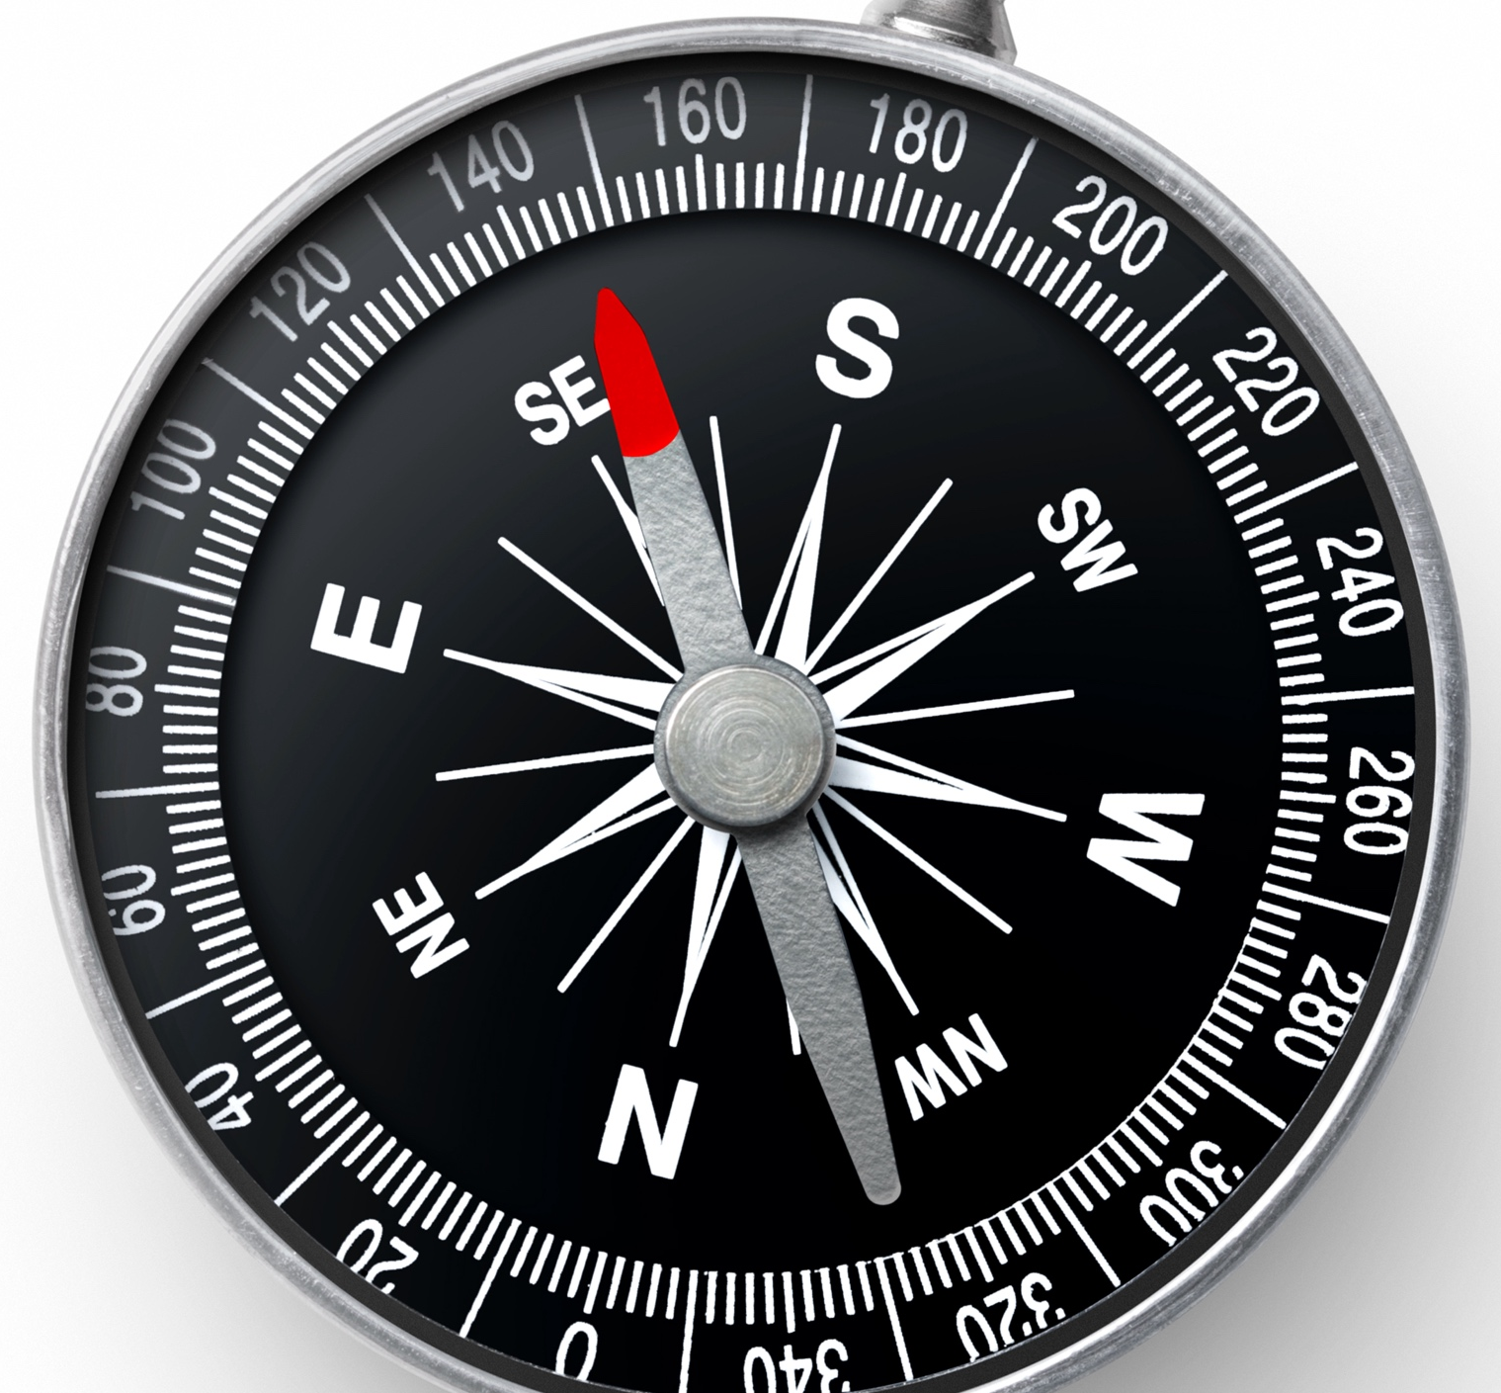
About Option 1: How to use a compass (physical and digital)
Put the compass in your open palm, with the “N” facing forward.
Keep the compass very FLAT in your palm, parallel with the ground.
    Test this: When you turn even slightly to the right and left, the needle should move freely. If it is tilted, hitting the glass or casing, not moving, then you are not holding to compass flat.
Look at the [red] needle; it is pointing NORTH. It will always point north. Turn yourself until the [red] needle pointing north aligns with the “N” on the compass. Now the fingers of the hand holding the compass are also pointing north.

Slide 11
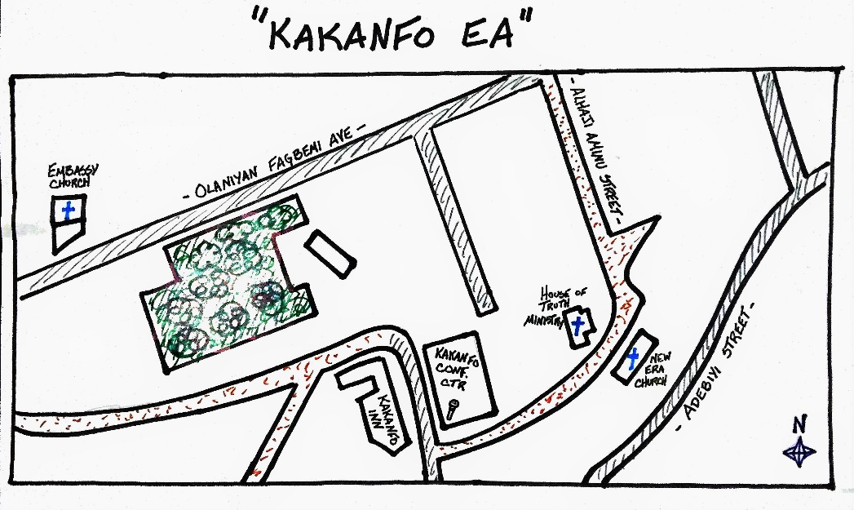

About Option 2: Ask someone
Excuse me, can you tell me where the Embassy Church is?
Yes – it’s down this road on the right, after the forest.
Notes:
Show how to turn the map so that what the person is telling you is now accurate based on the way that you see the map. When helpful, use an object like a marker as a “person” to walk through the map.

Slide 12

THEN, Find where you are now
Move around and look for landmarks around you. Where are they on the map? Where are there from what you see?
Walk until you are in front of a major landmark. When you arrive, if necessary, reorient the map. (You always want to try to keep the North pointing North.)
Confirm that this is the correct landmark by
      Retracing on the map the steps you took to get here; is this logical?
      Looking for any signs denoting the landmark
      Asking someone, “What is this?”
Notes:
TIP: Bring or create a doll and put stickers/tape on each hand to mark them as right (R) and left (L). Put the doll ON the projection screen or the paper map, the doll’s eyes facing forward, and make the doll walk as you narrate what she is doing (“Ms. Sanoko [the doll] is facing the road. Then she turns left [indicating with her “L” hand] and she walks [as you move the doll on the line representing the road as if she were walking].”)

Slide 13
FINALLY, “Walk” on the map
Imagine you were walking on the map itself. Decide where you want to go and walk your fingers through this route on the map.
Now, truly walk to that point, following the same route laid out by your fingers and continuing to trace this route on the map as you move.
First, I go forward toward the church. Then I turn left and follow the curvy road until the intersection.
Notes:
TIP: Bring or create a doll and put stickers/tape on each hand to mark them as right (R) and left (L). Put the doll ON the projection screen or the paper map, the doll’s eyes facing forward, and make the doll walk as you narrate what she is doing (“Ms. Sanoko [the doll] is facing the road. Then she turns left [indicating with her “L” hand] and she walks [as you move the doll on the line representing the road as if she were walking].”)

Slide 14
Notes:
FACILITATOR: This slide and the following are meant to help you create a “map” of your training room. You can move around the chairs, the stage, the tables, the projection screen, etc., to reflect the set-up of your training room. Then, ask questions about:
What represents which object in the map
How to orient this map
How to describe getting to the door
…
TIP: Bring or create a doll and put stickers/tape on each hand to mark them as right (R) and left (L). Put the doll ON the projection screen or the paper map, the doll’s eyes facing forward, and make the doll walk as you narrate what she is doing (“Ms. Sanoko [the doll] is facing the road. Then she turns left [indicating with her “L” hand] and she walks [as you move the doll on the line representing the road as if she were walking].”)

Slide 15
Notes:
FACILITATOR: This slide and the previous are meant to help you create a “map” of your training room. You can move around the chairs, the stage, the tables, the projection screen, etc., to reflect the set-up of your training room. Then, ask questions about:
What represents which object in the map
How to orient this map
How to describe getting to the door
…
TIP: Bring or create a doll and put stickers/tape on each hand to mark them as right (R) and left (L). Put the doll ON the projection screen or the paper map, the doll’s eyes facing forward, and make the doll walk as you narrate what she is doing (“Ms. Sanoko [the doll] is facing the road. Then she turns left [indicating with her “L” hand] and she walks [as you move the doll on the line representing the road as if she were walking].”)

Slide 16

What about distance and scale?
Have I gone too far? Am I even close?

Slide 17

What about distance and scale?
# of finger-layings
X length represented by scale
approximate distance
Understand Scale on the Map
Look at the map to find the scale. How many meters are represented by one length of the scale?
Measure the scale with your pressed thumb or pressed finger(s), whichever gives the most accurate covering of the scale marking without going too far over or under.
Measure on the map by laying out the thumb or finger(s) as decided, in succession. Multiply the number of times you had to lay out the thumb/finger(s) by the length represented by the scale to get the approximate distance.
Example: My pressed forefinger and middle finger cover the length of the scale. The length of the scale represents 100 meters. To get from the church to M. Yam’s household on the map, I need to lay my forefinger/middle finger combination 8 times. How far away is Mr. Yam’s household from the church?
100 m

Slide 18



Number of steps
÷ 10-meter count
X 10 meters
approximate distance
What about distance and scale?
Understand Distance in the Field
Measure out 10 meters on the ground in a straight line.
Walk this line with casual, regular steps, counting the number of steps. Do this several times and take your average number of steps. Remember this number, your “10-meter count”.
  (Most adults have 9 to 15 steps in 10 meters.)
Measure a distance in the field by counting the number of casual, regular steps. To obtain the distance in meters, first divide this number by your “10-meter count” and then multiply the result by 10.
Example: I average 12 steps per 10 meters, so my “10-meter count” is 12. In a rural area where I am drawing structures on my map, I walk from the edge of one structure to the beginning of another in 48 steps. How far is it from one structure to the next?
10m

Slide 19
Now let’s go outside to practice!
Notes:
FACILITATOR: Instructions and suggestions on the following slide

Slide 20
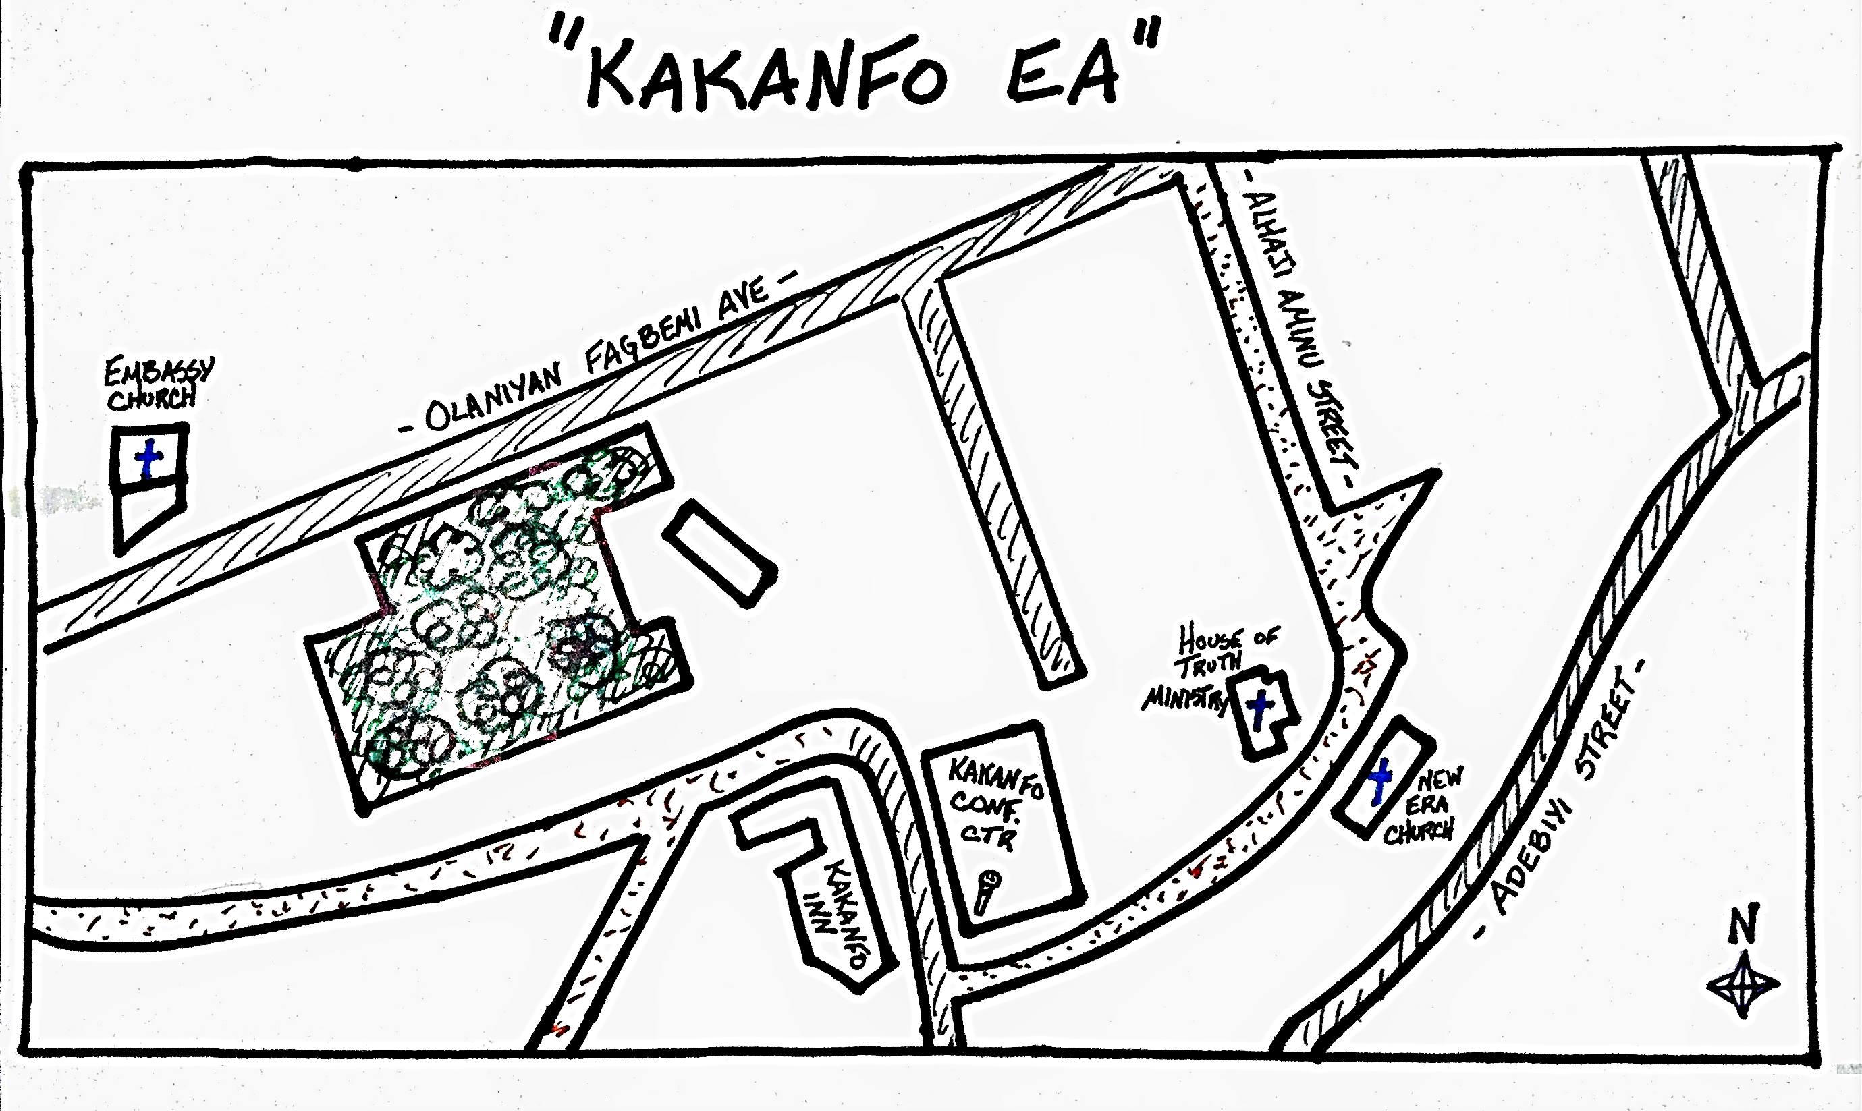
50 m
Notes:
Example of EA map and orientation exercise – feel free to use an existing EA map instead, or to create your own sample EA map that includes the training area.
POTENTIAL MAP QUESTIONS:
Where is north? How do you know? What would you do if there were no sun today?
Where is the [landmark]? How would you explain how to get there?
Where is the [other landmark]? How would you explain how to get there?
Approximately how far is [landmark or intersection]? How did you measure that?
What if I told you to [directions]? Based on these directions, where are you now?
TO CREATE YOUR OWN EA MAP:
Go to Google Maps and take a snapshot of the area around the training center
Print this snapshot and trace the major roads and features in a dark, thick, black marker.
Going to a window with light through it, place a blank piece of paper over the traced snapshot paper and, using the light through the window, trace these major roads and features again, in pencil or black marker.
Add some labels and symbols to your final map. Remember to mark « N » and a scale marker on your map.

Slide 21
Image sources
Slides 3, 10, & 15 : Raising hand by Ates Evren Aydinel from Noun Project (CC BY 3.0)
Slide 9 : Hand and wrist by Oleksandr Panasovskyi from Noun Project (CC BY 3.0)
Slide 9 : Compass icon from the Microsoft 365 stock images
Slide 10 : Man Pointing Right by Gan Khoon Lay from Noun Project (CC BY 3.0)
Slide 16 : Two by Bouwe van der Molen de Noun Project (CC BY 3.0)

