Slide 1
www.pmadata.org/stlr
We invite you to use and adapt PMA STLR tools!
Whatever tool you discover and intend to try out, you will need to adapt these tools to
your context. This may include:
Changing questionnaire question text: Some tools contain questions from our questionnaires (publicly available here), along with their numbering. Note that, in some cases, question numbering has changed across phases, but any questions cited in a tool use consistent numbering within that tool.
Considering appropriate pronouns: We use female pronouns quite often, as PMA worked with female enumerators – and as a bonus, we are happy to use a feminine pronoun by default for a change!
TIP: Use our hashtag system!
As we used these tools across various country contexts, we developed a simple system of using hashtags as placeholders for information that will need to be updated based on the country, context, culture, and program.
For example, information in a tool that was country-specific is noted with the hashtag placeholder, #countryspecific – or possibly an even more specific placeholder like #districtlevel or #localpartner.
Information that required a change in date is noted with hashtags such as #todaysdate or #lastyear.
These hashtags allow those adapting the tool to use the Find&Replace function to quickly identify and update all instances of a hashtag within seconds.

Slide 2
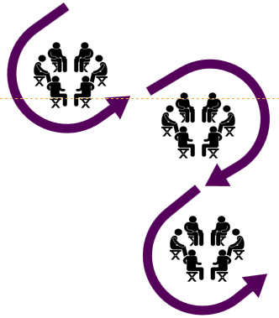
Designing for Small Group Engagement
This presentation offers practical design steps to ensure small group engagement, from initial design and prep through providing instructions and support during enumerator training. Captivate and energize small groups from start to finish!
When adopting, adapting, and sharing this tool, please use this suggested citation:
“Designing for small group engagement”, PMA (Performance Monitoring for Action) with Sarah Nehrling. Released June 2024. CC BY-NC 4.0.

Slide 3
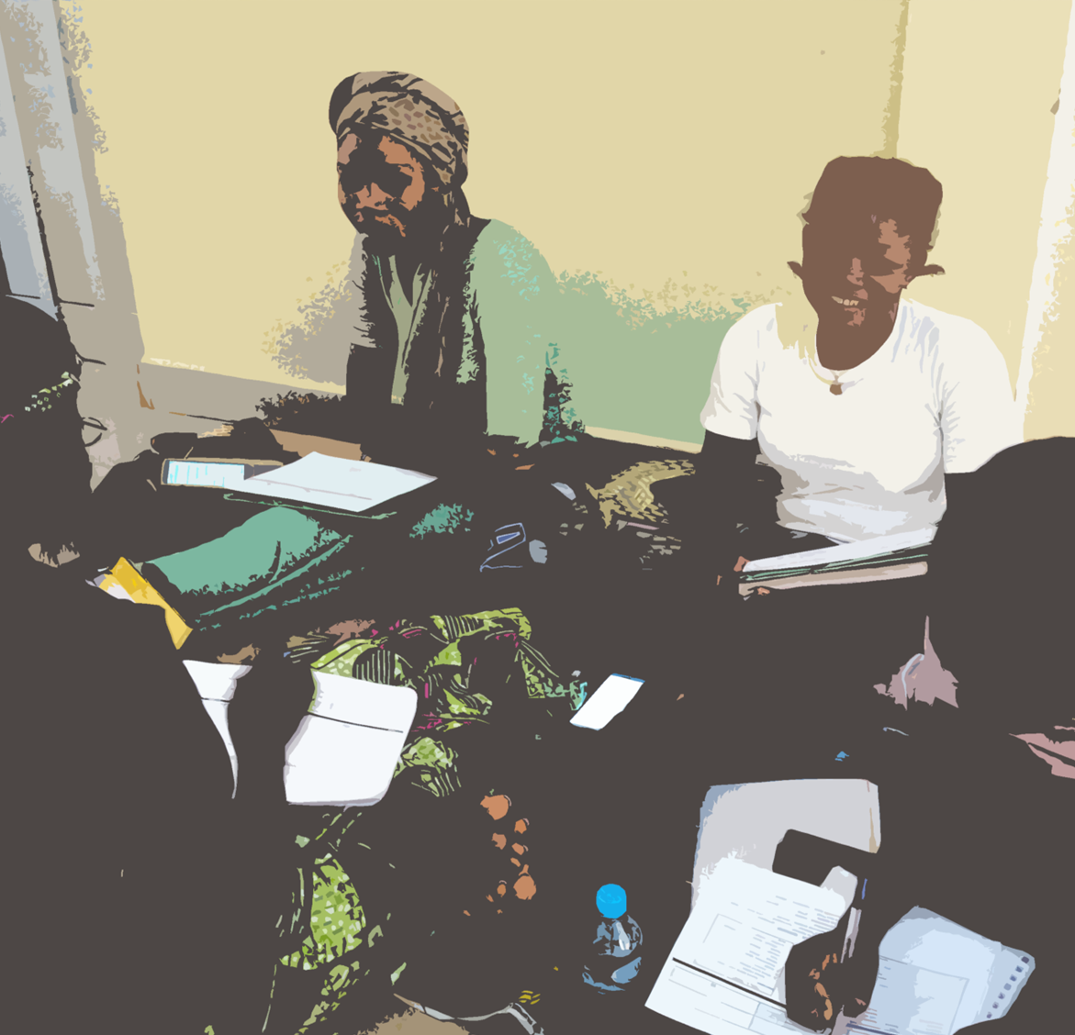
Designing for Small Group Engagement

Slide 4
Why is it challenging to keep participants engaged during small group work?

Slide 5
Engagement relies on design

Slide 6
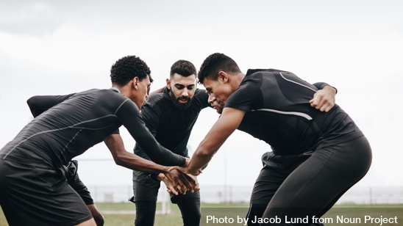
Preparing, Setting Up, and Supporting Group Work
.
Notes:
Photo credit: Soccer players discussing game strategy standing in a huddle on the ground by Jacob Lund Photography from <a href="https://thenounproject.com/photo/soccer-players-discussing-game-strategy-standing-in-a-huddle-on-the-ground-5wmwRb/" target="_blank" title="Soccer players discussing game strategy standing in a huddle on the ground Photo">Noun Project</a> (CC BY-NC-ND 2.0)

Slide 7
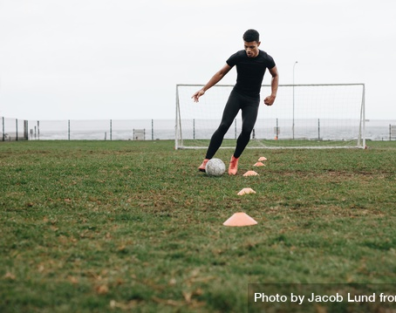
It starts with preparation …
Notes:
Photo credit: Footballer doing cone dribbling drill on field by Jacob Lund Photography from <a href="https://thenounproject.com/photo/footballer-doing-cone-dribbling-drill-on-field-4NKMrb/" target="_blank" title="Footballer doing cone dribbling drill on field Photo">Noun Project</a> (CC BY-NC-ND 2.0)

Slide 8
Challenge: Groups don’t know what to do or why they’re doing it. Design an activity that is clear and well-structured.
Task
Time
Takeaway
What to do and how?
Any materials needed?
Overestimate when designing!

Slide 9
For RE Guide review
Stand-Up Reading
Order the Questions or Sections
Top 5 Challenges
Notes:
Stand-Up Reading: When reading through the Resident Enumerator (RE) Guide, the person reading should stand up when they’re reading and sit down once they’re done. The next person to read should then stand up, read, and sit down. This pattern may be changed by a “leader” who, after a few rounds, signals his turn by something other than standing up (e.g., stretching both arms up, jumping out of the chair, or other big movement), and the next readers then use that new action when it is their turn to read.
Top 5 Challenges: After reading a section of the questionnaire in the RE Guide, the group writes (ideally on a flipchart) the Top 5 Challenges that they can imagine facing while administering this part of the questionnaire. These challenges can be compiled across all groups and addressed in plenary at a break or after the group reading time is done.
Why do this?: Some REs may continue to focus on the challenges that one section will create, even while the group moves into reading the next section. Giving them a space to consider this and write it may help them to focus on the next section.
Order the Questions or Sections: The object of the game is to be the first to put the questions in one section OR the questionnaire section titles in their correct order, without looking at guides or questionnaires. The first person to find the correct order will have to justify his response by telling the “logical story of the questionnaire”, how the [questions or sections] flow together.
Note: This game is meant to test overall understanding of questionnaire content and logical flow. It can be played in small group after each section, using the questions for that section, or after having reviewed half or all of the questionnaire, using the section (and possibly sub-section) titles. Note that there is preparation for this task: you must prepare and print the questions (without numbers) or the section headers (without numbers), with enough copies to have at least 1 or 2 (if competitive) per small group, and then cut them into individual pieces of paper and be ready to quickly distribute these “packets” to the groups at the start of this activity.

Slide 10
For RE Guide review
Stand-Up Reading
Order the Questions or Sections
Top 5 Challenges
Cross-Pollination
Multi-Headed RE
Ranking Alternatives
For interview practice
Notes:
Multi-Headed Resident Enumerator (RE): When interviewing a “respondent”, any participant may tap the person sitting in the RE on the shoulder to then take over the interview, until someone taps them to replace them. Make sure to set up basic ground rules such as: 1) everyone should take turns, no dominating the RE seat; 2) allow the RE to finish their sentence/question/etc., before tapping them; 3) pay close attention so that when it’s your turn, you are adding to the conversation instead of repeating things we have already learned.
Ranking Alternatives: Facilitator gives a situation. Everyone thinks up as many alternative courses of action (or explanations of the situation) as possible. Compile list. In groups, now rank them by preference.
[Experiment with] cross-pollination: Sometimes, a group member may simply be bored with his or her own group. Give a few people a chance to walk around and see other groups during a "cross-pollination" period, where 1 or 2 members of each group can circulate and sit in on other groups' conversations for a few minutes, then returning to their original group and reporting back on what they saw or learned.
*** The riskier option is to have 1 or 2 members of each group move permanently to another group. We suggest that you leave this option aside unless or until you think that participants were not very well distributed into groups, in terms of skillsets, personalities, experiences, etc. In such an extreme case, redistribution could result in more balanced groups and potentially re-engage those who were disengaging because they felt like they did not fit in, or they could not learn from or contribute to their group.

Slide 11
For RE Guide review
For content review
Stand-Up Reading
Hot Seat
Order the Questions or Sections
Participant Questions
Top 5 Challenges
Pick The Winner
Cross-Pollination
Multi-Headed RE
Ranking Alternatives
For interview practice
Notes:
Hot Seat: Ask a volunteer to sit in the middle of the circle. Each participant has a chance to ask the volunteer in the “hot seat” a review question to stump them. If the hot seat volunteer answers the question correctly, the participant who asked it replaces the volunteer on the hot seat. If the volunteer answer incorrectly, the participant who asked the question needs to answer it correctly; if the asker does, the volunteer stays in the hot seat, but if the asker cannot, then they move to the hot seat. *When in doubt, the participant must cite the response to their question in the manual or other key document.
Pick the Winner: Divide the large group into smaller groups and have all small groups work on the same problem and record an answer/strategy on paper. Then, ask small groups to switch with a nearby group, and evaluate their answer. After a few minutes, allow each set of groups to merge and ask them to select the better answer from the two choices, which will be presented to the large group.
Participant Questions (Group-Decided): Stop the session, group participants into fours, ask them to take five minutes to decide on the one question they think is crucial for you to answer right now.
[Experiment with] cross-pollination: Sometimes, a group member may simply be bored with his or her own group. Give a few people a chance to walk around and see other groups during a "cross-pollination" period, where 1 or 2 members of each group can circulate and sit in on other groups' conversations for a few minutes, then returning to their original group and reporting back on what they saw or learned.
*** The riskier option is to have 1 or 2 members of each group move permanently to another group. We suggest that you leave this option aside unless or until you think that participants were not very well distributed into groups, in terms of skillsets, personalities, experiences, etc. In such an extreme case, redistribution could result in more balanced groups and potentially re-engage those who were disengaging because they felt like they did not fit in, or they could not learn from or contribute to their group.

Slide 12
Challenge: Group composition creates a barrier to completing the task. Make an intentional decision about the best group composition for this specific activity.
Pre-assign, randomly assign, self-select, or pair-select?
Mixed or homogenous groups?
Takeaway
Roles – REs, supervisors
Experience – new, experienced
Abilities – tech-savvy, local language abilities, group leadership
Notes:
You observe: Some group members are confused, some are completely uninvolved, and others are dominating the conversation.
Design Groups for Success: Take time beforehand to consider how best to divide people into groups. Should you pre-assign everyone to a group, trying to take into account a diversity of skills, experience, and opinions? Are there some people who, for whatever relational reason, should not be in the same group? Could you ask each participant to first find a buddy and then, with the buddy, split into groups with people they don't know as well? What will work best for this specific group of people and this topic, and for your workshop and your small group work objectives?

Slide 13
Challenge: Groups may know what to do but are not set up for how to do it. Design norms, roles, and sharing.
Set basic group norms,
such as “computers and phones closed or focused on group work”
Define needed roles and responsibilities for each
Consider “cross-pollination” for groups to share with and learn from each other
Define what not to do
Notes:
Set small group norms: While it doesn't make sense to spend a lot of time on small group norms for a workshop, it could be worth taking a minute or two in plenary to decide what others should be expecting from and contributing to their groups. Ideally, someone would add the norm that everyone should participate fully!
Ask for computers and phones to be closed or focused on group work: While simply asking will not instantly result in everyone following the request, it may be enough to convince a few people. Especially if you are not asking groups to set small group norms, try to introduce this norm yourself - or remind others of it, if it's already part of the large group norms.
Assign roles for each group member: Craft and then share specific roles and responsibilities for each member of the group. For example, there could be a reporter, a conversation-distributer (making sure everyone can contribute to the discussion), a task-master (keeping everyone focused on the task), a time-keeper (reminding others of the time limit, and giving time checks), a supplies manager (making sure the group has access to the necessary supplies), etc.
Require rotating responsibilities for report-backs: For each phase of the group work, plan time for a report-back in plenary. (This can be very quick! 30 sec per group.) In addition to or instead of assigning roles for each group member, require that the person reporting back for the team change every time; either the team can designate this person, or the facilitator can call on one group member at random.
Experiment with cross-pollination: Sometimes, a group member may simply be bored with their own group. Give a few people a chance to walk around and see other groups during a "cross-pollination" period, where 1 or 2 members of each group can circulate and sit in on other groups' conversations for a few minutes, then returning to their original group and reporting back on what they saw or learned.
*** The riskier option is to have 1 or 2 members of each group move permanently to another group. We suggest that you leave this option aside unless or until you think that participants were not very well distributed into groups, in terms of skillsets, personalities, experiences, etc. In such an extreme case, redistribution could result in more balanced groups and potentially re-engage those who were disengaging because they felt like they did not fit in, or they could not learn from or contribute to their group.
Explain clearly what you don't want: When setting groups up for group work, tell a funny story about a group you've been in where someone (maybe you!) was the freeloader. Describe vividly what this freeloader did and how they acted, and especially others perception of this person and their impact on the rest of the team. Ask that each participant be responsible for not being and not allowing a freeloader in their groups.

Slide 14
… and continues to the set-up as you introduce the activity …
Notes:
Photo credit: Cropped shot of soccer player’s foot on top of soccer ball by Jacob Lund Photography from <a href="https://thenounproject.com/photo/cropped-shot-of-soccer-players-foot-on-top-of-soccer-ball-43qMP0/" target="_blank" title="Cropped shot of soccer player’s foot on top of soccer ball Photo">Noun Project</a> (CC BY-NC-ND 2.0)

Slide 15
Challenge: Groups are unsure of what is expected of them for this activity and may not start working until they receive clarity. Take time to clearly explain the activity and any support provided.
Spend time to gain time!
Time, Tasks, and Takeaway
Tips
Support Provided
Notes:
Spend time to gain time with clear and concise directions, and time to ask questions about the work.

Slide 16
Challenge: Group members feel disconnected from the group and the task. They are more easily distracted, less eager to take on roles, etc. Cultivate team spirit at the beginning of the activity.
Team Name, Flag?
Sharing Strengths
Notes:
Consciously build a team spirit: Start with a fun group activity, such as coming up with a name and "flag" for the group or sharing some silly information about one another (e.g. What is your favorite toothpaste brand?). A participant may feel more responsible toward a group to which they feel more familiar and somehow connected.
Share strengths: Ask each participant to share with the others the specific skills that they are bringing to the group, in relationship to the task at hand. This activity allows the individual to name and recognize their value-add and for others to call on them when this skill will be helpful in the task at hand.

Slide 17
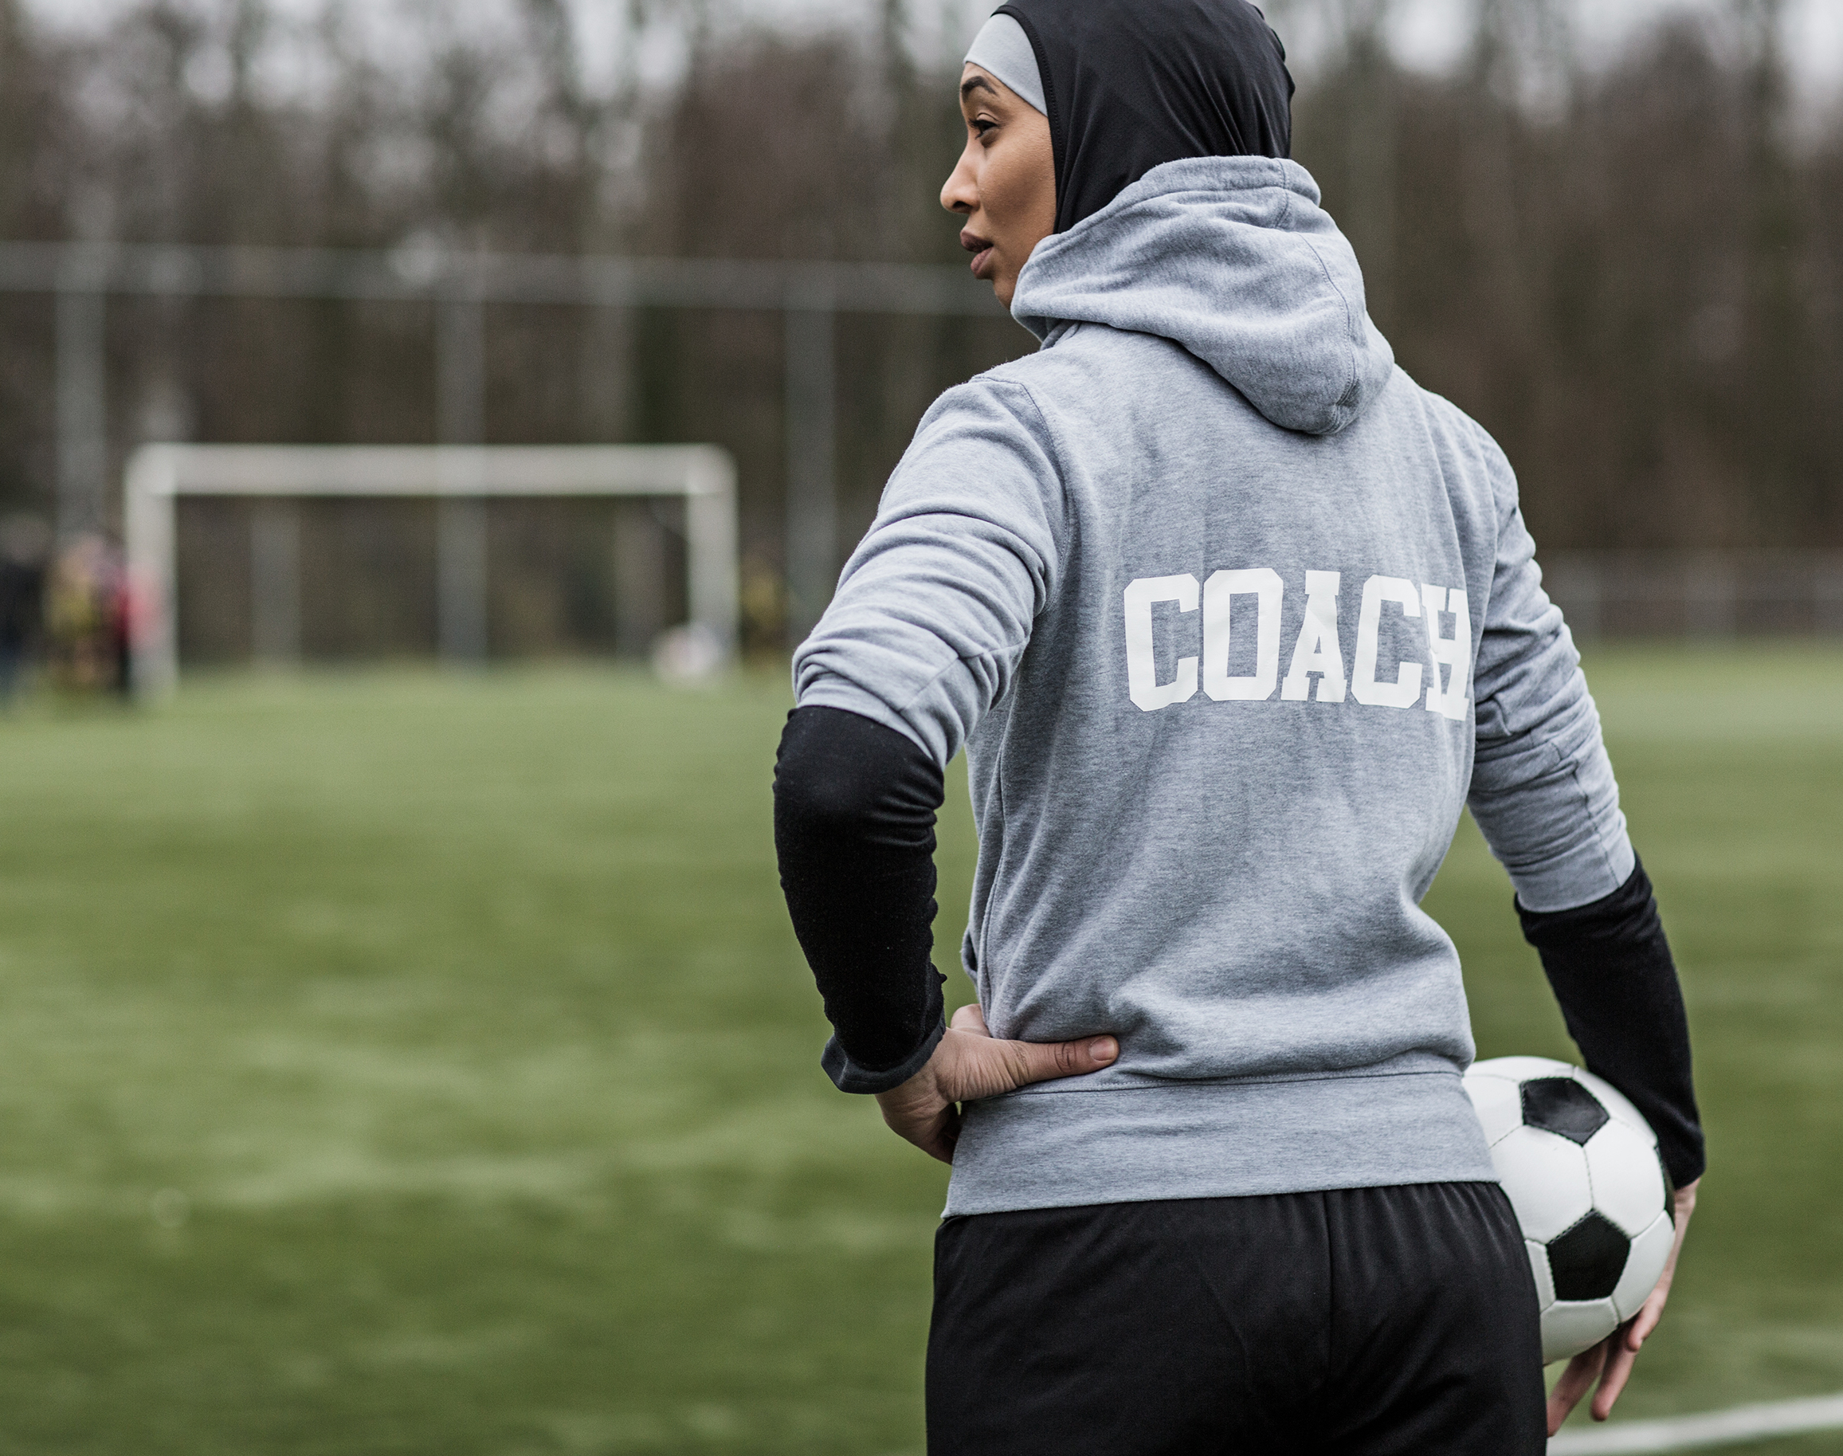
… and then support during the activity…
Notes:
Photo credit: Microsoft 365 stock images

Slide 18
Challenge: Teams face an obstacle in understanding and/or doing, so either pause their work or do work that is off-task. Circulate! Visit groups, passively observe, step in when necessary or solicited.
Your presence as you circulate around the room is essential during small group work. You need to be easily accessible when groups have questions for you, and to be listening in on small group conversations to ensure that the instructions were clear, and the groups are progressing in the right direction.
But also, unfortunately, some participants will feel freer to disengage in group work if they feel like none of the facilitators are watching them.

Slide 19
Challenge: Rarely, a participant will not participate and will distract others. [When needed] Give a way to opt out.
Try to casually approach this group member and explain that you noticed his lack of participation and are concerned about both the group's well-being and learning and his individual well-being and learning.
Gently and non-judgmentally give two options:
Remember tone of voice!
2) Find a spot outside or on the edges of the room until the small group work session has ended
1) Stay sitting with the group and be an active participant
Notes:
In very extreme circumstances, there will be a group member who is not participating and cannot be convinced otherwise, but whose presence is a distraction to the members of the group who are working and learning.
Try to casually approach this group member and explain that you noticed their lack of participation and are concerned about both the group's well-being and learning and their individual well-being and learning.
Gently and non-judgmentally give two options: 1) stay sitting with the group and be an active participant, or 2) find a spot outside or on the edges of the room until the small group work session has ended. (The tone of your voice is super important here! You are not shaming; you are simply recognizing that this individual has challenges participating and are trying to make this experience the best possible for everyone in the room.) While ideally this participant would choose Option 1, they might just go for Option 2. Sometimes we have something else going on - an emergency email from a boss, a hectic and loud evening with the family, a serious relational challenge with the group, who knows! - that will make us want to opt out of small group engagement on that particular day.

Slide 20
Image sources:
Slide 5: Soccer players discussing game strategy standing in a huddle on the ground by Jacob Lund Photography from Noun Project (CC BY-NC-ND 2.0)
Slide 6: Footballer doing cone dribbling drill on field by Jacob Lund Photography from Noun Project (CC BY-NC-ND 2.0)
Slide 13: Cropped shot of soccer player’s foot on top of soccer ball by Jacob Lund Photography from Noun Project (CC BY-NC-ND 2.0)
Slide 16: Microsoft 365 stock images
Slides 17 & 18: People Sitting in a Circle by Gan Khoon Lay from Noun Project (CC BY 3.0)
Slides 3, 7, 11, 12, 14, & 15: Icons from Microsoft 365 stock images

