Slide 1
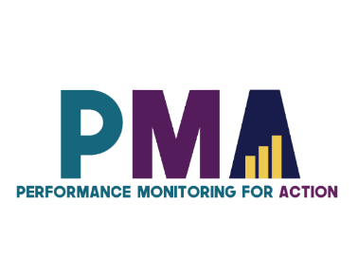

www.pmadata.org/stlr
We invite you to use and adapt PMA STLR tools!
Whatever tool you discover and intend to try out, you will need to adapt these tools to
your context. This may include:
Changing questionnaire question text: Some tools contain questions from our questionnaires (publicly available here), along with their numbering. Note that, in some cases, question numbering has changed across phases, but any questions cited in a tool use consistent numbering within that tool.
Considering appropriate pronouns: We use female pronouns quite often, as PMA worked with female enumerators – and as a bonus, we are happy to use a feminine pronoun by default for a change!
TIP: Use our hashtag system!
As we used these tools across various country contexts, we developed a simple system of using hashtags as placeholders for information that will need to be updated based on the country, context, culture, and program.
  For example, information in a tool that was country-specific is noted with the hashtag placeholder, #countryspecific – or possibly an even more specific placeholder like #districtlevel or #localpartner.
Information that required a change in date is noted with hashtags such as #todaysdate or #lastyear.
These hashtags allow those adapting the tool to use the Find&Replace function to quickly identify and update all instances of a hashtag within seconds.

Slide 2

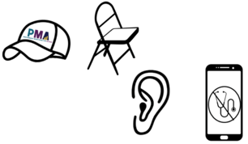
The Art of Being a Resident Enumerator
This presentation explains the important but sometimes intangible skills that an enumerator should possess, including: the roles they play in the areas they work, how to avoid refusals when possible, how to stay neutral when asking questions, and strategies for collecting complete and accurate answers.
When adopting, adapting, and sharing this tool, please use this suggested citation:
“The Art of Being a Resident Enumerator”, created by PMA (Performance Monitoring for Action) with Sarah Nehrling. Released June 2024. CC BY-NC 4.0.

Slide 3

The Art of Being a Resident Enumerator
Notes:
Note that there are activities in the Notes sections of this presentation that you can do throughout the presentation.

Slide 4

The Art of
Positive Representation and Relationships

Slide 5
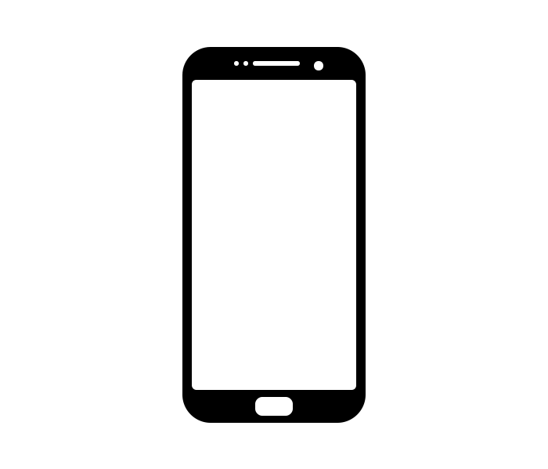





ACTIVITY: 4 volunteers, please!

Slide 6
A GOOD RE PLAYS 4 MAIN ROLES…
A representative of PMA and #partners
A guest in the community
A confidante for her respondents
An interviewer, not a health worker
Notes:
The following slides have scenes related to each of these 4 roles of an RE, with more details in the notes below each slide.
Ask a volunteer to go through each scenario.

Slide 7

A representative of PMA
Roleplay Activity
Masters and correctly explains the objectives of the study
Masters and properly uses the Smartphone and the questionnaires
Talks with community leaders
What if I don’t know the answer to a question?
Do not make it up!
  Call your supervisor. If needed, tell the respondent that you will get back to her later with an answer.
Notes:
SCENE: *wear a [PMA] hat*
The RE tells the local leader, “I don’t want to talk with you. Your house is not on my list.”
She says to the participant, “If you participate, someone will come back and give you free medicine.”
The RE uses her smartphone incorrectly and stumbles on questions.

Slide 8
A guest in the community
Roleplay Activity
Talks with community leaders
Wears appropriate clothes
Notes:
SCENE: *sit in a ’guest’ chair, incorrectly, wearing a short skirt*
The RE orders people in the household around with her own commands.

Slide 9
A confidante for her respondents
Dialogue
Builds good relationships
Answers all questions
Is attentive and patient
Trust
Is honest and straightforward
Practices asking for consent and reminding of it at key moments
Roleplay Activity
Notes:
SCENE: *with phone, first with the respondent and then just a few meters away*
The RE starts without consent.
She looks at her phone and not at the respondent, rushing through the questionnaire and not answering questions.
Then, the RE steps just a few meters away calls her sister to tell her all about the interview.

Slide 10
An interviewer, not a health worker
Roleplay Activity
Focuses entirely on her responsibilities as an interviewer
Does not give any advice on other issues than taking part in the current survey
What if they ask me about family planning ?
I attended a PMA session on FP and I would like to help my respondent!
Tell her that she may want to see a health provider.
You are not qualified to provide counselling, and you may cause more harm than good by giving advices.
Notes:
SCENE: *sitting with respondent*
The RE asks about contraception, and then begins to give medical advice – to the point of offering to bring an IUD and put it in!

Slide 11
The Art of
Questionnaire Communication

Slide 12
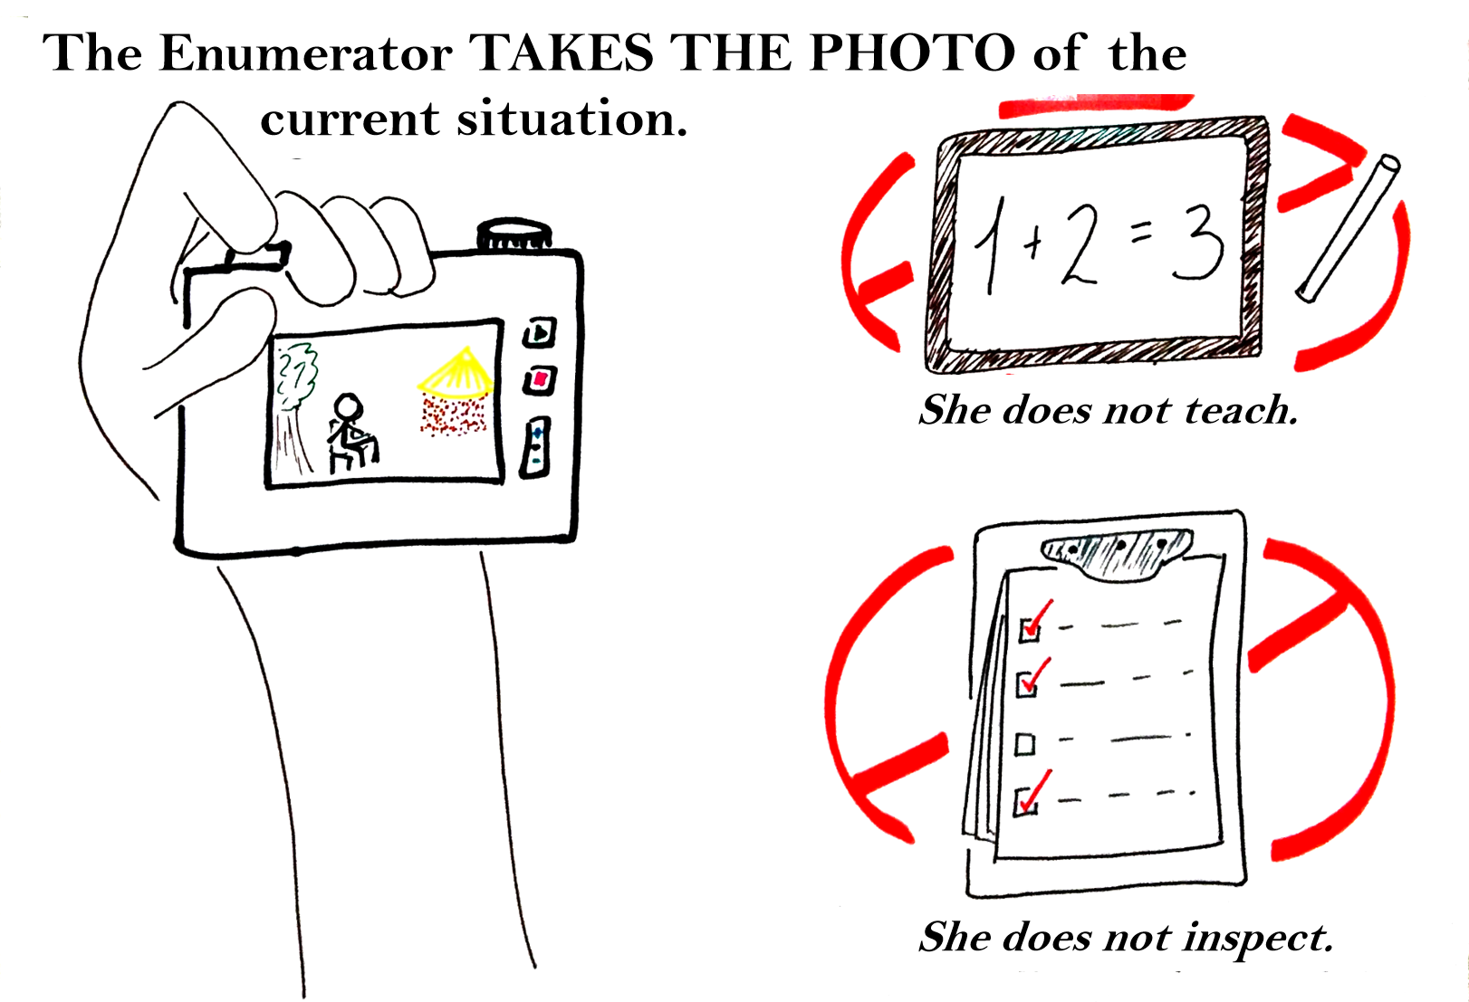

Slide 13
A GOOD RE SHOWS ON A DAILY BASIS 5 QUALITIES AS SHE ADMINISTERS THE QUESTIONNAIRE…
At ease with the questionnaire
Clear communication
Faithful to the question,
as it is written
Neutral voice,
words and body language
Careful in completing and
categorizing responses

Slide 14
ACTIVITY: Let’s create an acronym!
A – C – F – N – C

Slide 15
A GOOD RE SHOWS ON A DAILY BASIS 5 QUALITIES AS SHE ADMINISTERS THE QUESTIONNAIRE…
At ease with the questionnaire
Practice using the instruments thoroughly
Clear communication
Translate as needed
Listen actively and stay engaged
Faithful to the question,
as it is written
Ask one question at a time
Stay focus, do not digress
Clarify questions that the
respondent does not understand

Slide 16

A GOOD RE SHOWS ON A DAILY BASIS 5 QUALITIES AS SHE ADMINISTERS THE QUESTIONNAIRE...
Faithful to the question,
as it is written
A few challenging situations
Hypothetical cases
FQ 214b | If you got pregnant now, how would you feel?
Any tips?
Long questions
CQ 205 | Just before this visit, were you using the same method, did you switch from another method or were you using no method?
Any tips?
Questions including different time periods
FQ 301g | Have you used emergency contraception at any time in the last 12 months? PROBE: As an emergency measure after unprotected sexual intercourse women can take special pills at any time within three to five days to prevent pregnancy.
Any tips?
Notes:
Ask: do you want to list the tips or discuss them together? I would suggest discussing them together.
E.g., Facilitator could play the role of the respondent who is having difficulties with understanding the question, and then REs take turns trying to clarify the question using different techniques; group review of the most effective techniques, and potential listing on a Padex/flip chart

Slide 17
A GOOD RE SHOWS ON A DAILY BASIS 5 QUALITIES AS SHE ADMINISTERS THE QUESTIONNAIRE…
At ease with the questionnaire
Do not give your opinion, do not imply anything, do not judge
Avoid biased questions
Do not encourage the respondent to provide a specific answer
Clear communication
Faithful to the question,
as it is written
Neutral voice,
words and body language

Slide 18

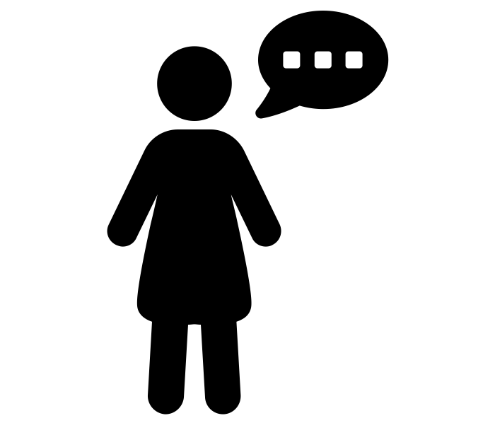


A GOOD RE SHOWS ON A DAILY BASIS 5 QUALITIES AS SHE ADMINISTERS THE QUESTIONNAIRE...
Neutral voice,
words and body language
A practical exercise
“He never told me that he loved me.”
In order to COMPARE answers between respondents, time periods, countries, etc.
the wording needs to be exactly the same – and consequently, neutral.
Notes:
ACTIVITY:
VOICE (=TONE): Ask a participant to read the sentence aloud. Ask another. If no change in tone, model another reading with a significant tone change. Talk about the different meanings with different tones.
BODY [LANGUAGE]: Ask a participant to read the sentence standing up with a wide and open body. Ask another to read the sentence with a low and closed body. Talk about the different meanings with different body positions.
WORDS: Ask a participant to make a very small change in the wording (e.g. “that he WILL love me”, “He never told HER”, “He never SHOWED me”, etc.). Talk about different meanings with very subtle wording changes.

Slide 19
A GOOD RE SHOWS ON A DAILY BASIS 5 QUALITIES AS SHE ADMINISTERS THE QUESTIONNAIRE...
Neutral voice,
words and body language
How to stay neutral?
You use family planning, right?
ASSUMPTIONS/SUGGESTIONS: Avoid biased questions or questions that suggest a specific answer
  “Are there any other members – ?”
  “… is that right ?”
  “You do this, right?”
JUDGMENT: Avoid sentences that sound judgmental
  “Good answer”
  “I agree”
  “It’s not true”
Do you use family planning?
It took you a lot of time to get to the clinic today, right?
How much time did it takes you to get to the clinic today?
You currently use TWO methods? That’s great!
It sounds like you use two methods. Is that correct?

Slide 20
A GOOD RE SHOWS ON A DAILY BASIS 5 QUALITIES AS SHE ADMINISTERS THE QUESTIONNAIRE…
At ease with the questionnaire
Clear communication
Probe to get more information if needed
Do not categorize a response for the respondent, even if she/he insists
Faithful to the question,
as it is written
Neutral voice,
words and body language
Careful in completing and
categorizing responses

Slide 21
A GOOD RE SHOWS ON A DAILY BASIS 5 QUALITIES AS SHE ADMINISTERS THE QUESTIONNAIRE...
Careful in completing and categorizing responses
Who should decide and categorize answers : the RE or the respondent?
Resident Enumerator: All observational questions
Examples:
  Type of floor material covering most of the house
  Others?
Respondent: All questions directly asked to the respondent
Examples:
  “Exclusive breastfeeding” (LAM) – if the woman reports using it as a contraceptive method, but you think that she only does it for the child’s health.
  Marital status – the woman says she is not married, but you know her in the community as being married.
You may need to probe to clarify or to slightly insist –
  but, in the end, you should record the final answer provided by the respondent

Slide 22
The Art of
Arriving at the
Clear and Complete Answer

Slide 23
“What if there is an answer that is missing?”
The respondent does not wish to answer?
You don’t hear the whole answer?
The answer is incomplete or unclear?

Slide 24


THREE TIPS TO COLLECT BETTER ANSWERS
Asking for clarification
Probing
An unexpected answer
Notes:
Ask for more information if necessary.
Probe further to obtain more information if necessary.
Do not categorize or judge for the respondent, if he/she insists.

Slide 25
Ask for clarification
I am sorry, could you repeat? I didn’t hear correctly.
Could you explain what you mean by…
Make sure that the respondent does not feel that he/she gave a wrong answer.
What you are saying can’t be right!
You need to tell me the truth!

Slide 26

Probe
Using a neutral question, sentence, wording or body language that encourage the respondent to elaborate on his/her answer.
The 3 Approaches of Mrs Probe
DIRECT
To clarify what was already said in order to understand, complement or categorize.
INDIRECT
To stir the conversation
Mmmh mmh
Interesting…
I see…
A body language or gesture that encourages conversation
What do you mean when you say…?
Why do you think…?
Could you explain?
Could you elaborate?
I am not sure I understood
X… Could you explain me that?
Could you give me an example of X?
SILENCE
I
D
S
Stay calm and wait for the respondent to speak
Try not to break the silence.
If the silence becomes awkward, tell the respondent to take her/his time to think about the question.

Slide 27
An unexpected answer: “Other”
Causes
Select if…
OTHER
A very clear answer, but not included in the response choices
The answer does not fall under any of the response choices
Notes:
The answer given is very clear but is not taken into account by the modalities listed.
***The list of modalities corresponds to the majority of answers given by respondents in the past.

Slide 28
An unexpected answer: “Does Not Know”
Causes
Select if…
The respondent is getting bored, wants to finish the interview quickly
Take a break, talk about something else
Offer to come back later to complete the interview
[Only after probing]
The respondent insists that she/he does not know
”Does not know" is a valid answer to the question
DOES NOT KNOW
The respondent does not have an exact answer
Help estimate
  Ex: date – identify events such as elections, holydays, s(historical calendar)
  easons, etc.
The respondent does not want to share some pieces of information
Remind her of the survey’s confidentiality

Slide 29
An unexpected answer: “No response”
Causes
Select if…
NO RESPONSE
The respondent is getting bored, wants to finish the interview quickly
Categorical refusal from the respondent to respond
Take a break, talk about something else
Offer to come back later to complete the interview
The respondent does not have an exact answer
Help estimate
  Ex: date – identify events such as elections, holydays, seasons, etc.
  (historical calendar)
The respondent does not want to share some pieces of information
Remind her of the survey’s confidentiality

Slide 30
The respondent does not have an exact answer
Help estimate
  Ex: date – identify events, such as elections, holydays, seasons
  (historical calendar)
I know the year I started using family planning… but honestly, I don’t remember the month …
…?
My younger child is big now. He works in the city. I don’t remember when he was born.
…?
Notes:
Present both questions, then ask participants to talk in pairs about potential ways to probe.

Slide 31
What about refusals and sensitive questions?

Slide 32
Avoiding Refusals
Creating a relationship with the respondent
Make a good first impression
Have a positive but confident approach
Some people may refuse to participate – for a variety of reasons outside of the RE’s control
Never force an individual to participate
Always respect informed consent procedures and protocols
Notes:
Below are a few tips for creating a relationship with your respondent:
Make a good first impression
Greet all members of the household as appropriate
Try to make the respondent comfortable. Discuss subjects unrelated to the interview briefly if need be but be careful to not let this distract from the interview for too long.
Have a positive but confident approach
Avoid an apologetic manner or asking questions such as, “Are you too busy?”. These questions make it extremely easy for a respondent to refuse to participate.
Master the ethical and scientific protocols
Informed consent – practice asking for consent completely and correctly
Confidentiality – maintain confidentiality; remind the respondent of confidentiality if at any point s/he is hesitant to participate or to share certain information
Honesty – do not lie to anyone, and do not input incorrect data

Slide 33
Asking Sensitive and Emotional Questions
While you have familiarized yourself with asking these questions, this may the first time your participant has been asked about their wealth or sexual encounters
Be patient
Be empathetic without judging or giving advice
Remind the respondent about confidentiality
Remind them about the study
They may be shocked, embarrassed, or even suspicious by sensitive or emotional questions
Notes:
Be patient – Let the respondent have his or her reaction or tell the story. Do not rush them.
Be empathetic without judging or giving advice – Listen and be supportive.
Remind the respondent about confidentiality – If the respondent does not want to share, before moving on, first give a gentle reminder of the confidentiality protocol as it was described in the Informed Consent text.
Remind the respondent about the study – Remind the respondent that he or she is not being singled out; the same information is being collected of individuals all around that country. Explain that PMA is trying to make sure that the information collected is representative of the entire country, and so needs to hear from everyone.
A respondent can always refuse to answer or skip a particular question, even after using the strategies above

Slide 34
What questions do you have?
Thank you!

Slide 35
Image sources:
Slides 3, 10, & 21: Blue paint splattered with palette and tubes on bright background by Alina Kholopova from Noun Project (CC BY-NC-ND 2.0)
Slides 4, 5, & 6: Baseball cap by Grégory Montigny from Noun Project (CC BY 3.0)
Slides 4, 5, & 7: Folding chair by Nandini Gupta from Noun Project (CC BY 3.0)
Slides 3, 4, & 8: Ear by anam from Noun Project (CC BY 3.0)
Slides 4, 5, & 9: Stethoscope by Simon Sim from Noun Project (CC BY 3.0)
Slides 4, 5, & 9: Smartphone by Mundo from Noun Project (CC BY 3.0)
Slides 6, 7, 8, & 9: Theatre by WEBTECHOPS LLP from Noun Project (CC BY 3.0)
Slide 17: Man Singing by Gan Khoon Lay from Noun Project (CC BY 3.0)
Slide 17: Relaxed by Adrien Coquet from Noun Project (CC BY 3.0)
Slide 17: Talk by Alice Design from Noun Project (CC BY 3.0)
Slides 23 & 24: Flashlight by Design Circle from Noun Project (CC BY 3.0)
Slides 23 & 25: Shot Put by Gan Khoon Lay from Noun Project (CC BY 3.0)
Slide 25: Hat by Alena Artemova from Noun Project (CC BY 3.0)

