Slide 1
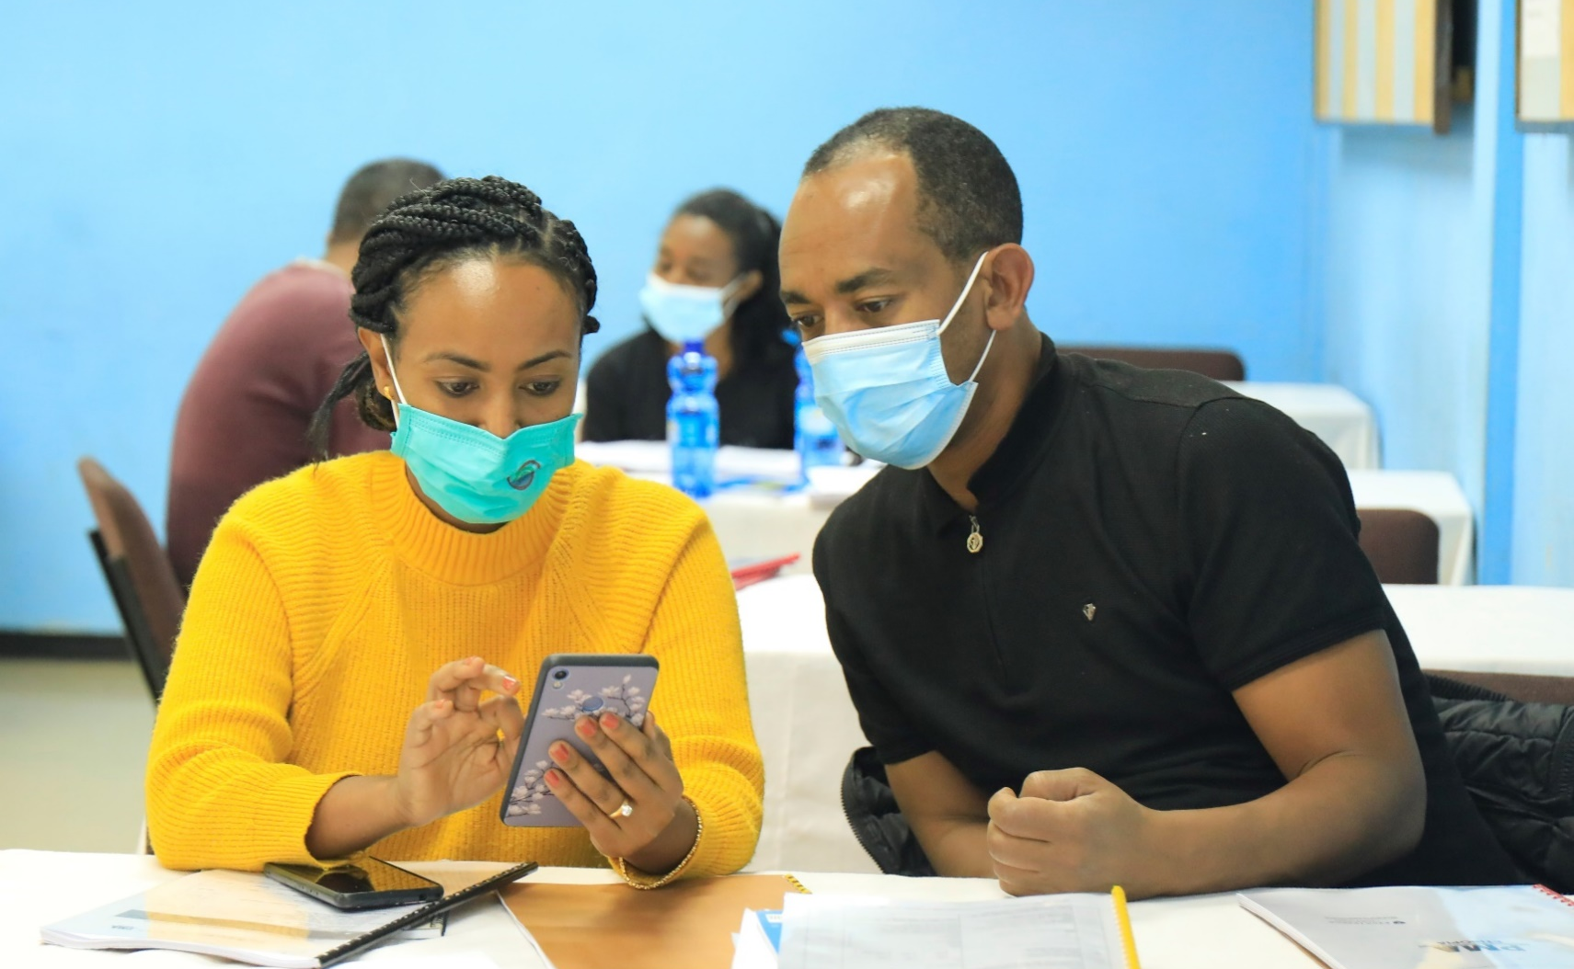






Performance Monitoring for Action- Ethiopia
Findings from
Cohort-1 (6-months and 1-year postpartum) and
Cohort-2 (baseline and 2021 Cross-section) surveys
PMA Ethiopia
June, 2022

Slide 2
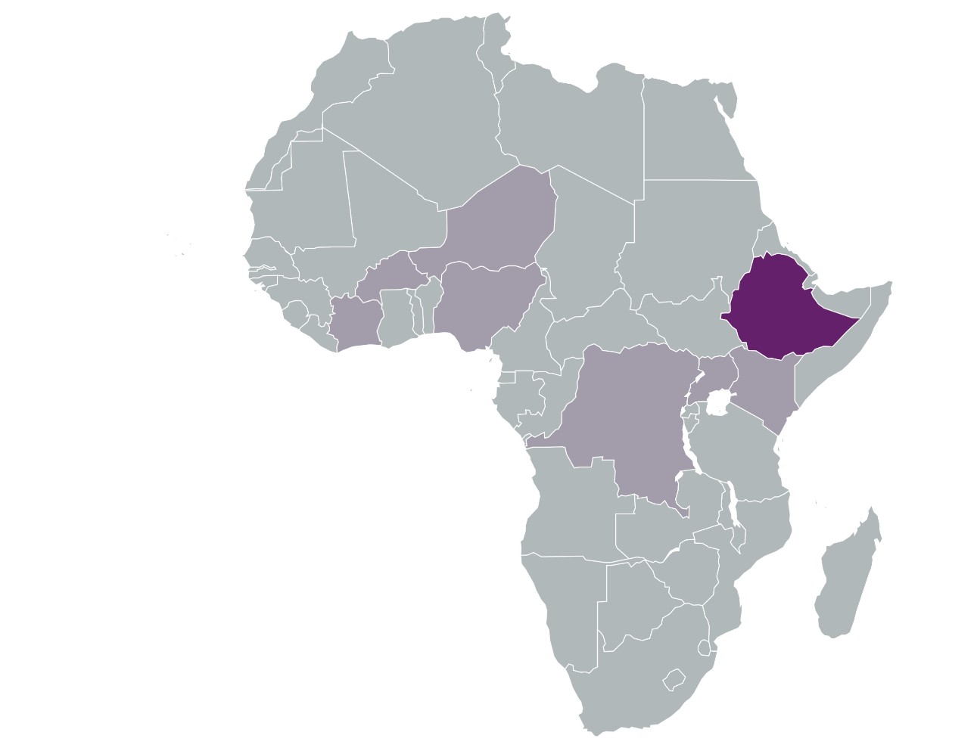
Presentation Outline
PART ONE: Cohort 1, six month & 1 year postpartum survey results
About PMA Ethiopia
Summary of key findings
Results
  Continuum of care
  Infant immunization, illness, care seeking and nutrition
  Postnatal care
  COVID-19 effects on care seeking
  Postpartum family planning
Discussion
PART TWO: Cohort 2, baseline & 2021 cross section survey results
Overview of Study Design
Summary of key findings
Results
  The panel baseline survey
  The cross-section household and female surveys
  The service delivery point (SDP) survey
Discussion and next steps

Slide 3

PART ONE: Cohort 1- Six month & One Year Postpartum Survey Results

Slide 4

What is PMA Ethiopia?
PMA Ethiopia is a five-year project implemented in collaboration with Addis Ababa University, Johns Hopkins University, and the Federal Ministry of Health.
Nationally representative survey measuring key Reproductive, maternal and newborn health (RMNH) indicators including:
    Antenatal, delivery, and postnatal care
    Vaccination coverage
    Modern contraceptive prevalence
    Reproductive empowerment and fertility intention
    Health facility readiness and quality of care
    Effect of COVID-19 on RMNCH services
Light fonts show sections already presented in previous disseminations

Slide 5
Survey Implementation and Participants
This presentation summarizes data from the 6-months and 1-year postpartum follow-up surveys from Cohort-one PMA Ethiopia
6-months postpartum survey:
Data collection: March 2020 to January 2021, with a pause due to COVID-19 lockdowns from April to late July 2020; due to this delay, some women (1,171/48.5%) were interviewed later than the planned 6-months postpartum interview follow-up window
  The analytic sample comprised of 2,414 women aged 15-49
  These women had a total of 2,460 live births – of whom 2,369 (96.3%) were alive at time of the 6-months interview
  Questions on COVID-19 were only asked to the 2,179 women who were interviewed after July, 2020

Slide 6
Survey Implementation and Participants (2)
1-year postpartum survey:
Data collection: July 2020 and August 2021
  The analytic sample comprised of 2,094 women aged 15-49.
  These women had a total of 2,132 live births - of whom 2,055 (96.4%) were alive at the time of the 1-year interview.
  Children-level analyses included in this report were restricted to all children still living at the time of interviews.
Data collection was stopped in the Tigray region from November 2020 onwards due to security concerns.

Slide 7
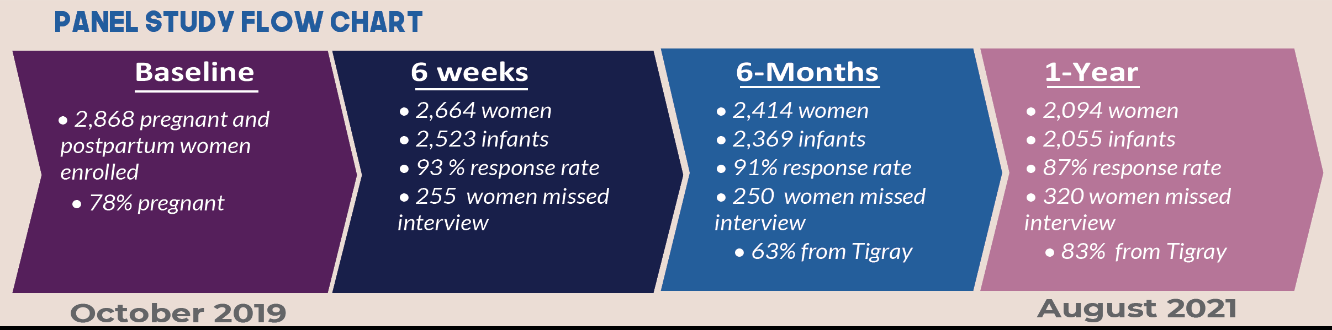
Enrollment and timeline for panel study
Notes:
Response rates for Tigray
6- month = 83%
1-year = 22%

Slide 8
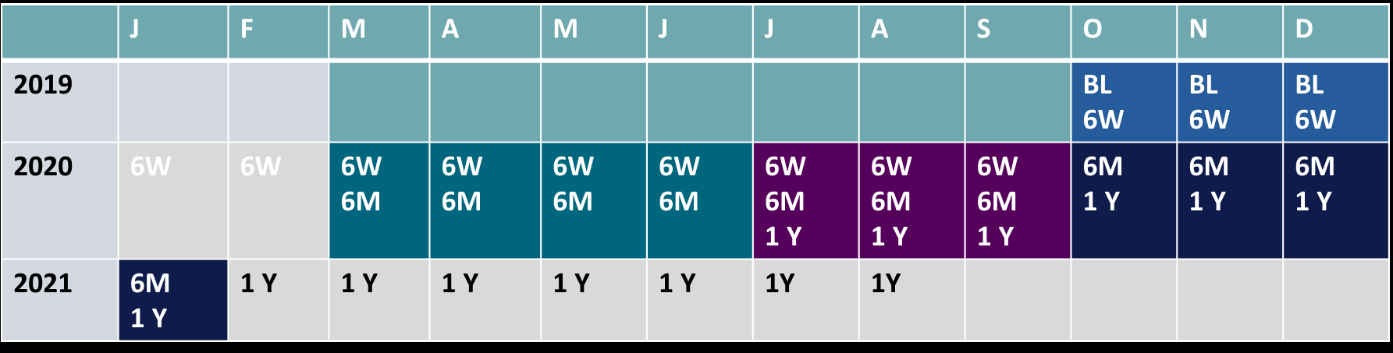
Overall Cohort One Survey Implementation Timeline
BL : Baseline interview
6W : Six week postpartum interview
6M : Six month postpartum interview
1Y : One year postpartum interview

Slide 9
Key summary findings from Cohort one
(6 months and 12 months follow-up interview)

Slide 10
What our results show: Maternal and Newborn Health
Despite increases in the coverage of RMNH services in recent years, the continuity of services remains low. Initiatives to improve coverage of services must be matched with initiatives to improve continuity.
  Less than one in five (17%) panel women received all the 4 key maternal and child health care services (ANC 4+, delivery, PNC at 6 weeks and full immunization) across the continuum of care
  Nearly one-sixth of the women interviewed at 6 weeks postpartum went to a maternity waiting home before going into labor
Notes:
*

Slide 11
What our results show: Infants
More work needed to improve routine immunization and sick infant care
  Only one-third of infants were fully vaccinated (8 vaccine doses) by their first birthday
  Less than one in ten (6%) infants with diarrhea received both ORS and zinc as treatment.
  Close to half of mothers who reported that their infant(s) suffered from fast breathing or difficulty breathing at 6-months and 1-year postpartum sought care for their reported breathing problem
Notes:
Delete footer text if not needed.

Slide 12
What our results show: Postpartum Family Planning
Postpartum women are a key population to target for family planning services, with many opportunities for contact. However, few opportunities are currently being utilized. Greater attention to integration of services is needed
  Though unmet need for family planning decreased from 29% at 6-month to 26% at 1-year postpartum, it is substantially higher than unmet need among the general population of women 15-49
  Only a quarter (25%) and less (20%) women were informed about family planning information, referral or services during any of the routine immunization visits for their babies during 6-months and 1-year postpartum, respectively
  A higher percentage of women (23%) who went to a maternity waiting home before going into labor used family planning compared to non-users (15%) at six week postpartum period

Slide 13
What our results show: COVID-19
  Covid-19 has affected care seeking for vaccination (difficulty in accessing immunization services and missing routine vaccination appointments) although its impact decreased over time
Notes:
COVID-vaccination
The percentage of women who reported difficulty accessing vaccination services for the index child decreased from 12% in July 2020 to 0% in June 2021
The percentage of women who reported missing vaccination decreased from 19% in July 2020 to 2% in June 2021.

Slide 14
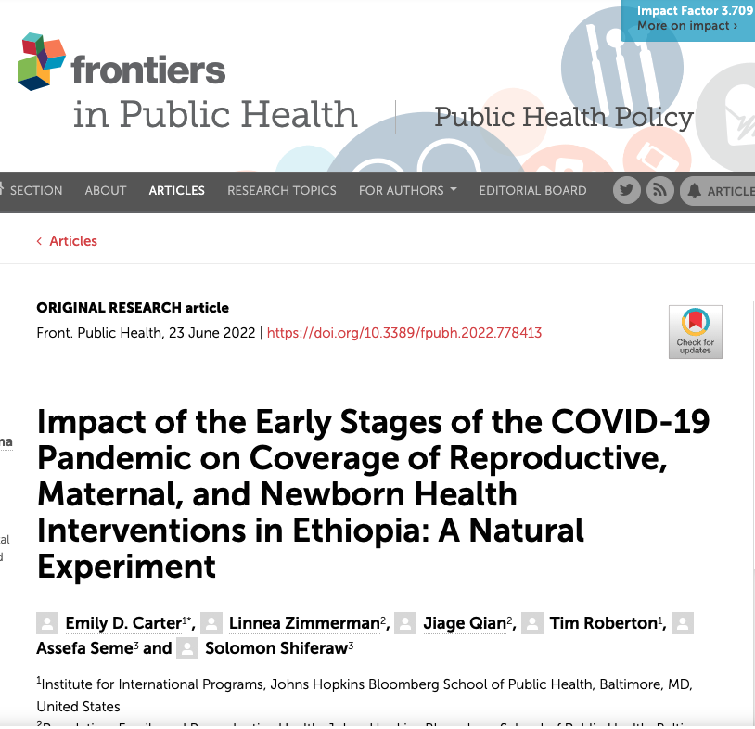
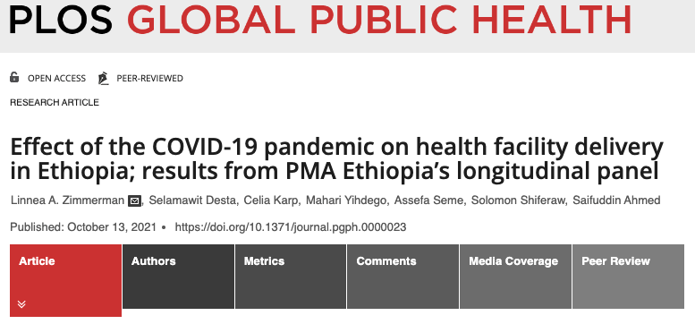
Additional details on COVID-19
Open access publications exploring the early impact of COVID-19 on RMNH indicators
  Carter et al - Found no significant reductions in health seeking or content of services across a range of RMNH indicators
  Significant reductions in BCG vaccination and chlorohexidine only in urban areas
  Zimmerman et al – Found shifts away from hospital deliveries in first months of COVID-19, but only in urban areas
  Woods et al – Intimate partner Violence (IPV), particularly physical IPV has increased in urban areas during Covid-19
Notes:
COVID-vaccination
The percentage of women who reported difficulty accessing vaccination services for the index child decreased from 12% in July 2020 to 0% in June 2021
The percentage of women who reported missing vaccination decreased from 19% in July 2020 to 2% in June 2021.

Slide 15

A closer look at results:
Continuum of Care

Slide 16
Continuum of care
Percentage of women and infants who received each service

Slide 17
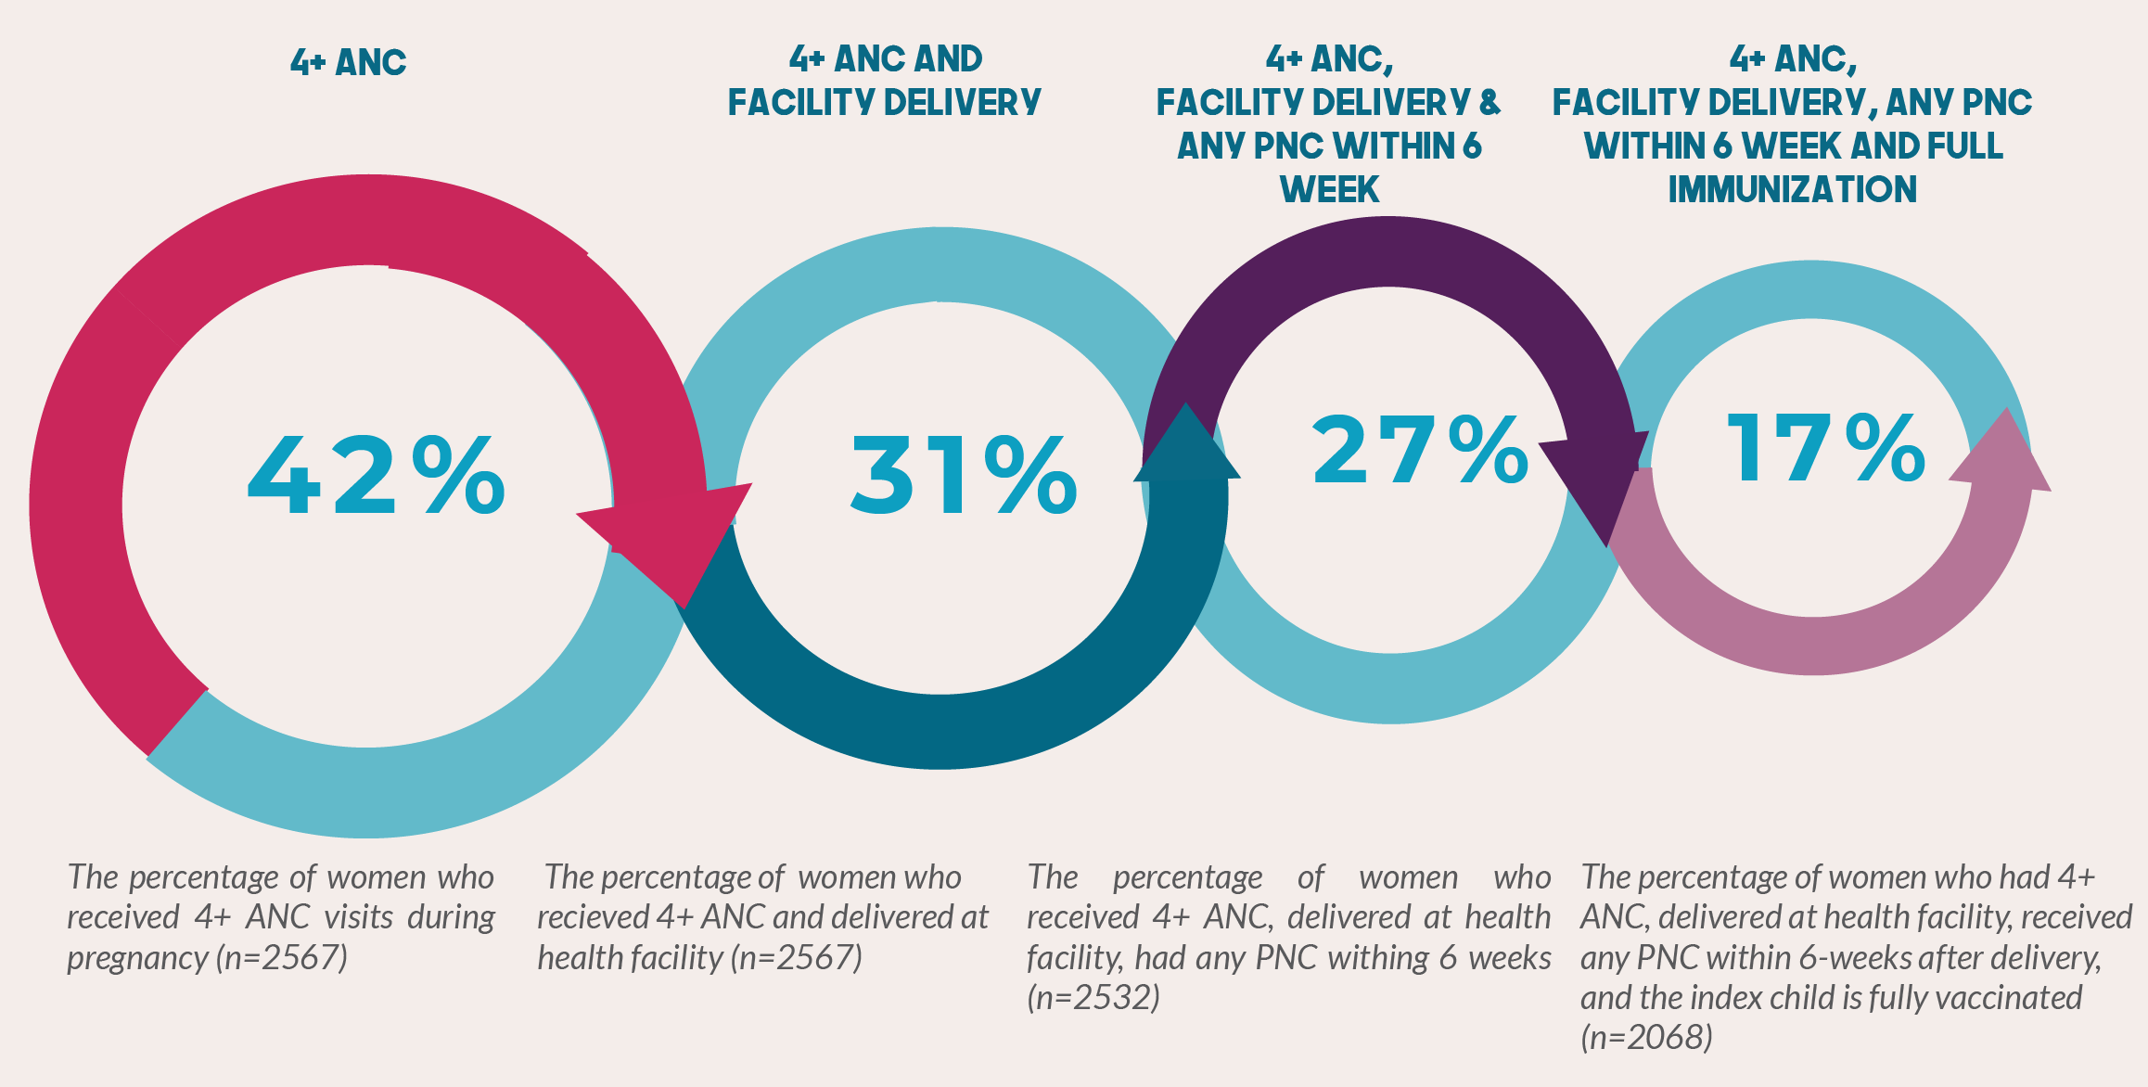
Continuum of care
Despite better coverage for individual services, fewer than one in five (17%) women completed all the four key maternal and child health care services in the first year postpartum
Notes:
Output for breakdown of 5 questions used for the continuum of care indicator
Question 1 : The percentage of women who delivered at health facility and had a PNC check after delivery while she was still in the facility : 62.8 % (n=1551)
Question 2: The percentage of alive babies who had PNC check while she/he was still in the facility : 53.3 % (n=1585)
Question 3: The percentage of women with alive who were visited by HEW after delivery : 8.3 % (n=2523)
Question 4: The percentage of women with alive who visited HEW for herself or the baby : 7.3 % (n=2523)
Question 5: The percentage of women with alive who visited professional healthcare provider other than HEW for herself or the baby : 19.6 % (n=2523)

Slide 18

Infants
(Immunization & care seeking)

Slide 19
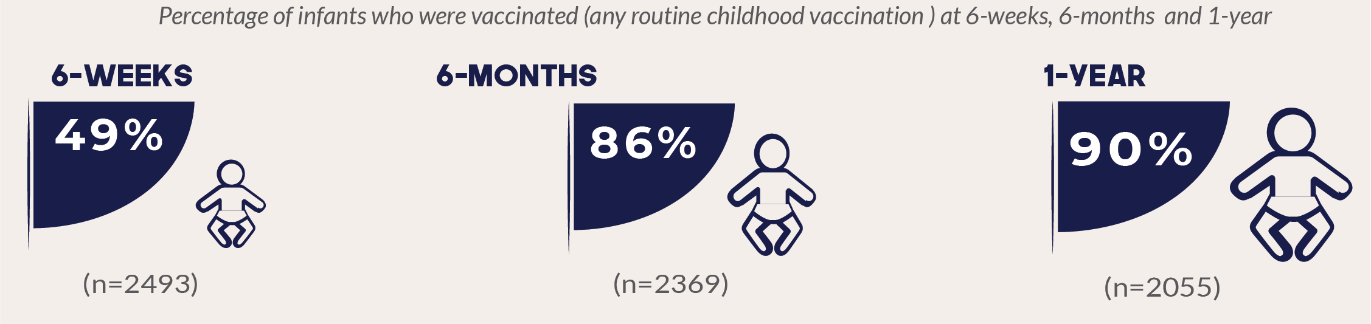
Vaccinated infants
Infants who received at least one recommended vaccine nearly doubles for infants 12 months old, compared to those two months old (49% to 90%)

Slide 20
Infant immunization: BCG coverage
6 months
1 year
Three quarters of infants received BCG vaccine by their first birthday, by card or self reported by the mother. Nearly four out of ten infants received BCG vaccine by their first birthday, by card.
Notes:
EDHS 2016
Percentage of children age 12-23 months vaccinated at any time before the survey
BCG – 69%

Slide 21
Infant immunization: Penta 1 coverage
6 Months
1 Year
Four out of five infants received first Pentavalent vaccine by their first birthday, by card or self reported by the mother. Nearly half infants received first Pentavalent vaccine by their first birthday, by card
Notes:
EDHS 2016
Penta 1 – 73%

Slide 22
Infant immunization: Penta 3 coverage
6 months
1 year
More than half (55%) of the infants received three shots of the pentavalent vaccine by their first birthday by card or self-report
More than a quarter (28%) of infants who received Penta-1 did not receive penta-3 at 1-year by card or self report, making the drop-out rate at 34%
Notes:
EDHS 2016
Penta 3 – 53%

Slide 23
Infant immunization: Measles vaccination
1 year
  More than half of infants received measles vaccine by their first birthday by card or self-report.
  Three out of ten infants received Measles vaccine by their first birthday, by card
Notes:
EDHS 2016
Measles - 54%

Slide 24
Fully vaccinated by 1 year
Only one third of infants were fully vaccinated (8 vaccine doses) at their first birthday, by card or self reported by the mother. Only one quarter of infants were fully vaccinated (8 vaccine doses) at their first birthday, by card
Note: 8 Vaccine doses are - BCG, Pentavalent-1(DPT-Hep B-Hib1), Polio-1, Polio-2, Pentavalent-2 (DPT-Hep B-Hib2), Polio-3, Pentavalent-3 (DPT-Hep B-Hib3) AND Measles-1
13 Vaccine doses are – 8 Vaccine doses and, PCV-1, Rota-1, PCV-2, Rota-2 AND PCV-3
Fully vaccinated child is one who received 8 or 13 vaccines at the age of 1 year as recommended by MoH

Slide 25
Fully vaccinated, by region
Infants who were fully vaccinated by their first birthday was the highest in Addis Ababa, and the lowest in Afar
*n refers to the weighted n

Slide 26
Care seeking: Fast breathing
Close to half of mothers who reported that their infant(s) suffered from fast breathing or difficulty breathing at 6-months and 1-year postpartum sought care for their breathing problem

Slide 27
Care seeking: Diarrhea
6 months
1 year
Few mothers sought care for their infants with diarrhea, three in ten at 6-months and four in ten at 1-year
Only one fifth of infants with diarrhea received ORS for their diarrhea at 6 months, while only a quarter of infants got at 1- year
Very few (6%) infants with diarrhea received both ORS and zinc for their diarrhea

Slide 28
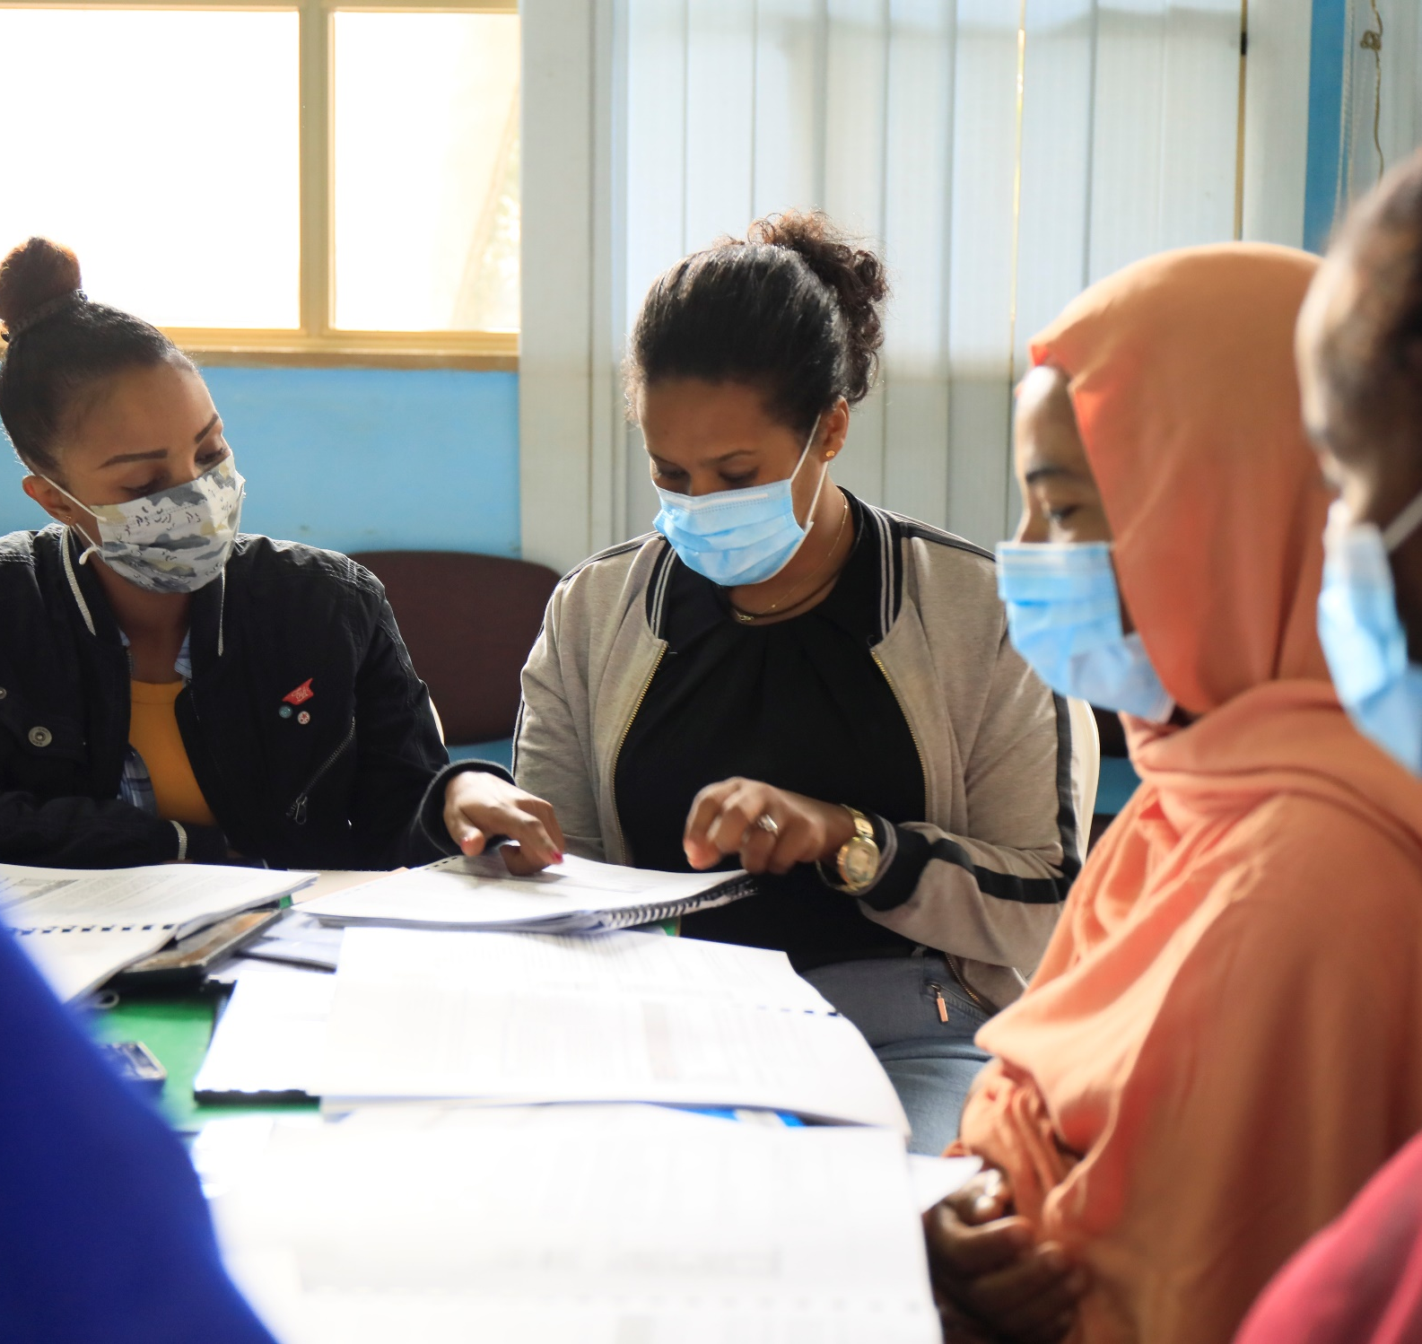
Postnatal care

Slide 29
Maternity waiting home use before labor
Among women who women interviewed 6weeks postpartum
Nearly one-sixth of the women interviewed at 6 weeks postpartum went to a maternity waiting home before going into labor

Slide 30
Maternity waiting home use after delivery
Among women who delivered in a health facility
More than one in three women stayed at maternity waiting home in the health facility after delivery.

Slide 31
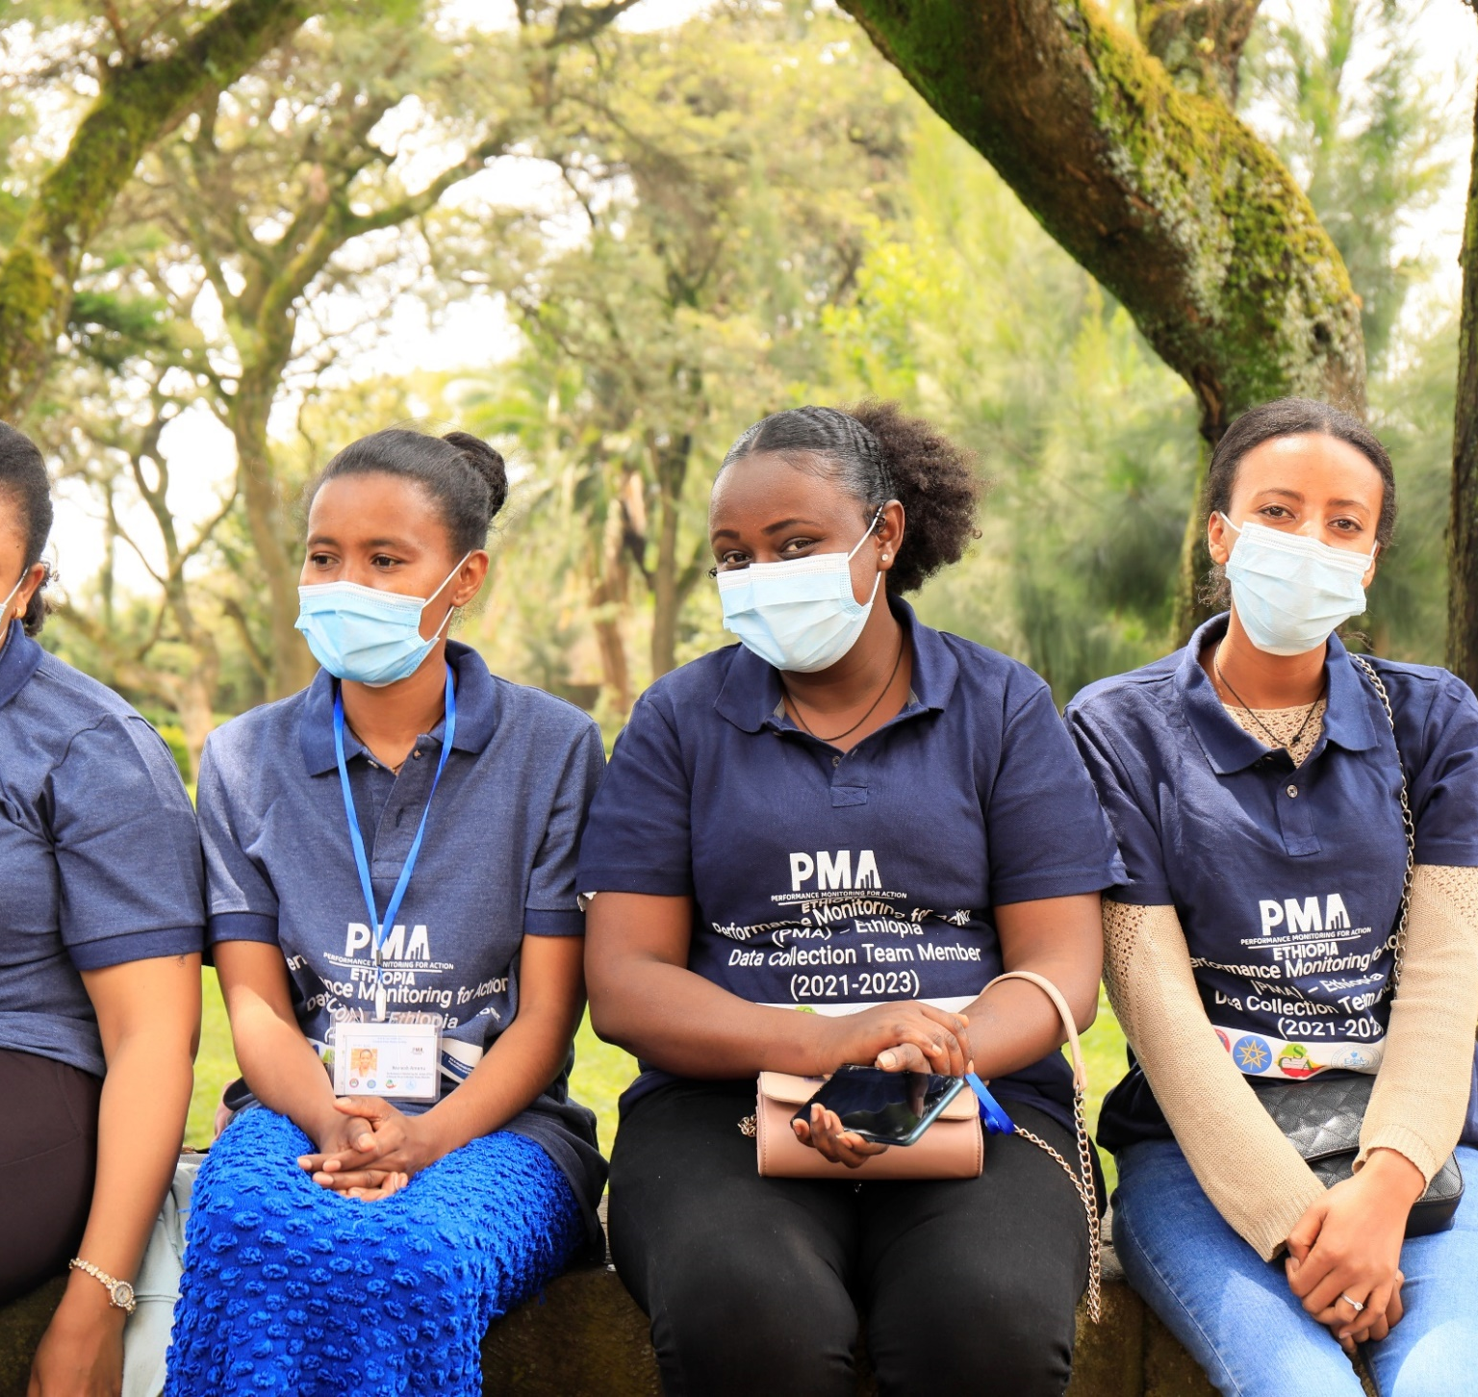


COVID-19 effect on care seeking

Slide 32
Note on COVID-19 data
COVID-19 related data were collected at 6-months and 1-year postpartum from the same panel women.
The timing of data collection was respondent-specific and depended on the delivery date of respondents.
Interview Period
  6-month interview: March 2020 to January 2021
  1-year interview: July 2020 to August 2021
Date when COVID-19 restrictions began: March 16, 2020
The COVID-19 analysis only includes women who were interviewed after July, 2020.

Slide 33

Difficulty accessing immunization services
The percentage of women who reported that they experienced difficulties in accessing vaccination services for the index child decreased from 12% in July 2020 to 0% in June 2021
Notes:
On average 11.5% of mothers with alive infant, experienced difficulties of getting vaccination service for their infant during COVID pandemic by calendar-month

Slide 34
COVID-19 effect on routine infant vaccinations
Nineteen percent of mothers interviewed in July 2020 reported that their child/ren missed a vaccination since COVID-19 restriction began which later dropped to 2% in June 2021
Notes:
On average 18.8% of mothers with alive infant reported missing a vaccination for their infant during COVID pandemic by calendar-month

Slide 35

Contraceptive use, partner dynamics and unmet need – at 6-months and 1-year postpartum

Slide 36
Postpartum family planning
Percentage of women who are using any method to delay pregnancy at 6-months and 1-year postpartum
Percentage of women who are using a method to delay pregnancy increases from 1% with in 48hrs of delivery to 15% at 6-weeks and 38% at 6-months and 43% at 1-year postpartum
*Data collection for the six-week postpartum interview occurred between October 2019 and September 2020, with a pause due to the COVID-19 pandemic from April 2020 to July 2020. Details on this survey can be found at: 6-week MNH technical report, 2019-2021

Slide 37
Maternity waiting home use before labor and Postpartum Family Planning use
Among women who women interviewed 6weeks postpartum
A higher percentage of women (23%) who went to a maternity waiting home before going into labor used family planning compared to non-users (15%) at six week postpartum period

Slide 38
Postpartum contraceptive use, by method type
Modern contraceptive use increased from 15% at 6-weeks to 42% at 1-year
Long-acting method use increased from 4% at 6-weeks to 12% at 1-year

Slide 39
Family planning counseling during PNC
• Significant missed opportunities for family planning service integration were observed during PNC
  Among women who received immunization services for their babies, only a quarter (25%) and less (20%) women were informed about family planning information, referral or services during 6-months and 1-year, respectively
Notes:
Right-click on chart and select “Edit Data” to copy and paste in your own data.

Slide 40
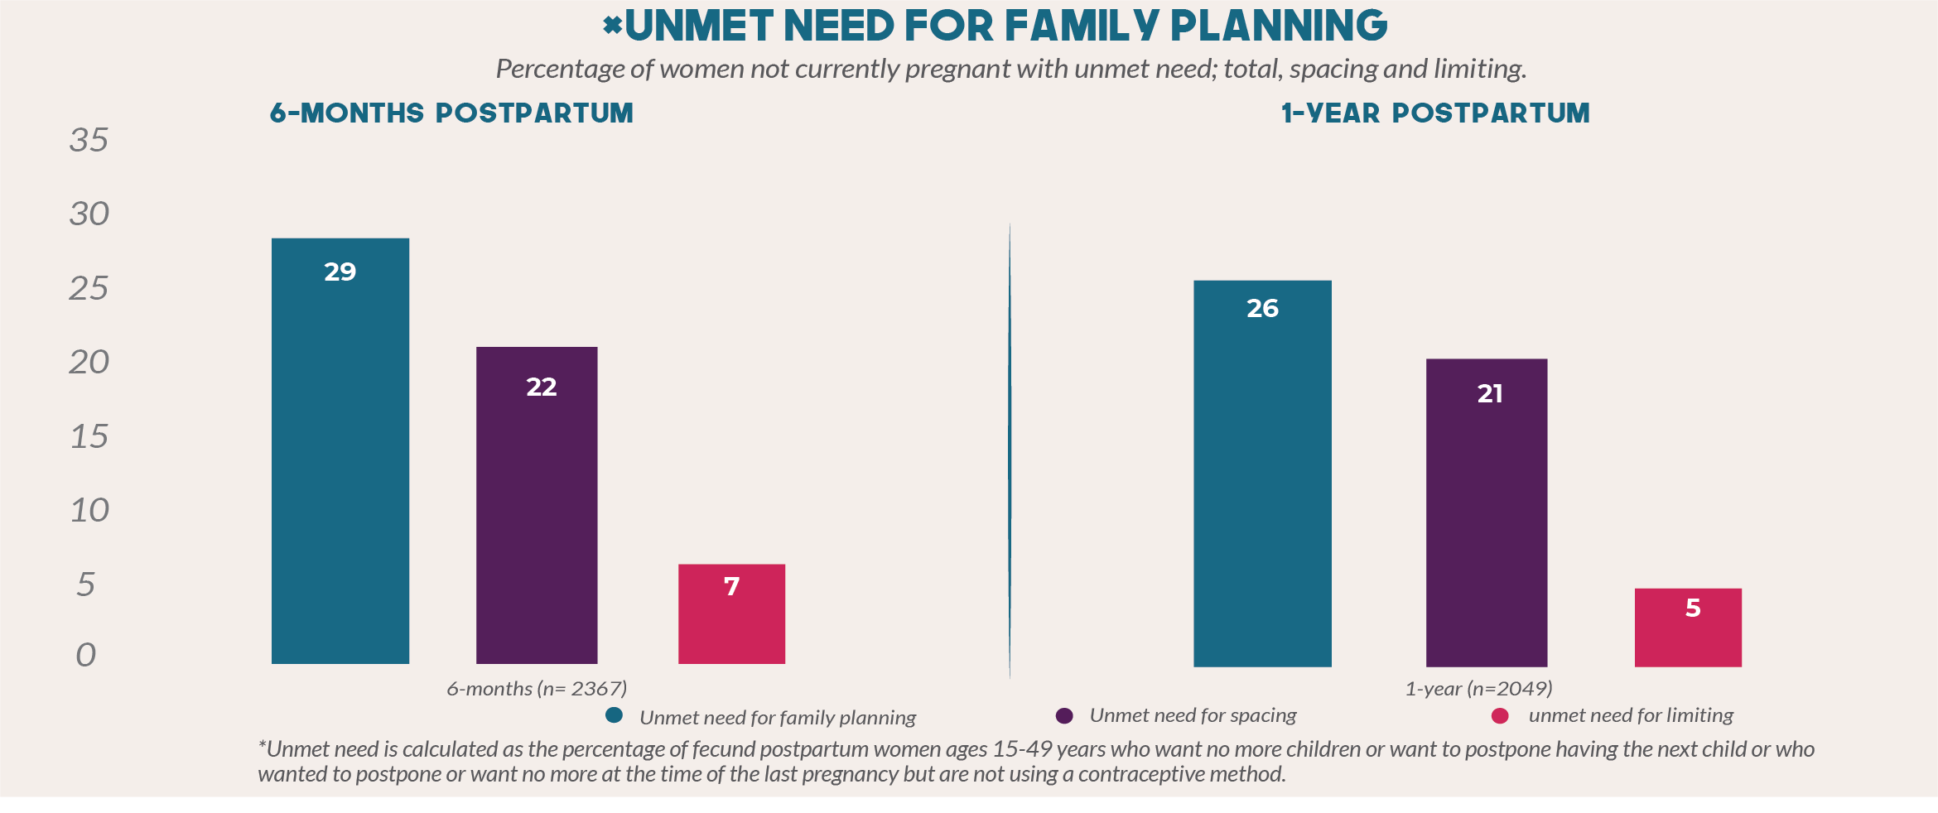
Unmet need for family planning is 29% at 6-months and 26% at 1-year postpartum
Unmet need for limiting is 7% at 6-months and 5% at 1-year postpartum

Slide 41
PART TWO: Cohort 2- Baseline and 2021 Cross-sectional Survey Results

Slide 42
Objectives
Present summary results from PMA Ethiopia’s second baseline panel and third annual cross-sectional surveys on key Reproductive and Maternal Newborn Health (RMNH) indicators
Present trends in key family planning indicators from 2014 to 2021
Identify regional variations in coverage and quality of selected RMNH indicators

Slide 43
Presentation outline
  Antenatal and postnatal care
  Vaccination coverage
  Modern contraceptive prevalence
  Reproductive empowerment, fertility intention, and community norms
  Health facility readiness and quality of care
    Light fonts show sections that will be presented in the coming follow-up result disseminations

Slide 44
PMA Ethiopia:
Overview of Cohort 2 /2021 Cross section Survey Design

Slide 45
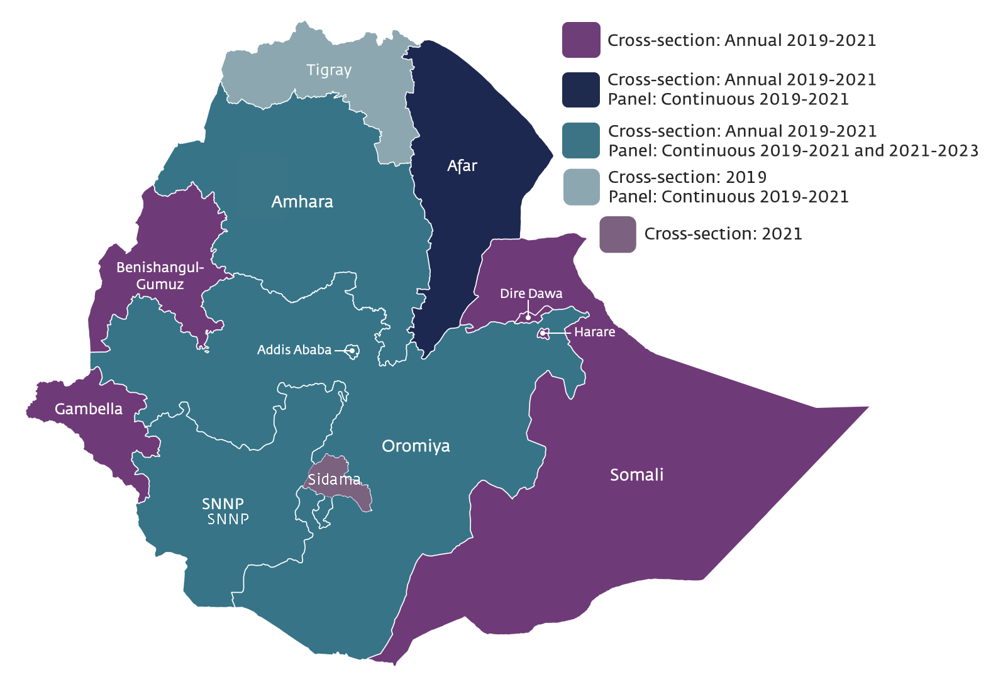
PMA Ethiopia: Survey Design
Cross-sectional survey of women ages 15-49
Panel survey that follows pregnant women from pregnancy through first year postpartum, covering 85% of population. It also includes women <6 weeks postpartum women
Annual health facility survey (SDP)
PMA Ethiopia included 243 enumeration areas (EAs) (243 CS,162 panel EAs)
Cohort 2 Baseline, 2021 Cross-section and SDP data collection period: October 2021– January 2022

Slide 46

PMA Ethiopia: Panel Survey Design
In panel regions:
Field staff completed a census of all households in the EA. The census was used to identify and enroll currently pregnant or recently postpartum women
After enrollment and baseline interviews:
Field staff will return to interview women who consented to participate in the study at three different times:
6 weeks postpartum
6 months postpartum
One year postpartum
Baseline interview

Slide 47

PMA Ethiopia: Cross-section Design
The design for the cross-sectional survey is similar to what was used for PMA2020/Ethiopia:
A listing frame was created from the census or listing activity
Supervisors then randomly selected 35 households per EA
At each of the 35 households, REs conducted:
  The Household Questionnaire
  And Female Questionnaire for all women ages 15-49 in the household at time of interview

Slide 48


PMA Ethiopia: Service Delivery Point
Provides health system trends annually
Survey includes all levels of public facilities (Health Posts, Health Centers, Hospitals) that serve the EA as assigned by the local government
Up to three private facilities included in a Kebele
The list of health facilities was obtained from the local district health office of the selected EA.

Slide 49


Overview: PMA Ethiopia Panel and Cross-Section
Panel Enrollment (Cohort 2) & Cross-Section
Second (2022) Cross section ??
Panel Enrollment (Cohort 2) & Cross-Section
End of second cohort
2021
Follow-up of pregnant and postpartum women
2022
2023
6-weeks, 6-months and one year postpartum
Individual
Panel
Panel results
6-week and preliminary 6-month results
X-section results
SDP 2021
SDP 2022
Private
2021
2022
2023
Public
SDP

Slide 50
Panel Survey: Response Rates
Data collection: October 2021- Ongoing through 2023
Census
25,360 households completed census
Screening
25,132 women ages 15-49 completed screening
Panel enrollment
2,313 eligible to enroll in study
2,298 consented to enroll
2,297 completed Baseline (98.7% response rate)
1796 (78.2%) pregnant & 501 (21.8%) postpartum
Notes:
78.2% were pregnant and 21.8% were postpartum at the time of enrollment

Slide 51
Cross-Section and SDP Surveys
Data collection: October 2021-January 2022
Sample weights applied
Unit | Total submitted number | Response Rate (%, n)
Households | 8,461 | 98.9% (8,365)
Eligible women 15-49 | 8,082 | 98.8% (7,988)
Health Facilities | 770 (public and private) | 96.6% (744)
Notes:
Note to Addis- to share the updated excel output with the JHU team

Slide 52
Key summary from Cohort 2 Baseline & 2021Cross -sectional Surveys

Slide 53
What our panel survey results show: Maternal health
There is a high rate of unintended pregnancy, as well as a missed opportunity to meet the needs of high-parity women who want to limit or space their pregnancies
    More than one third (36%) women had an unintended pregnancy, ranging from 19% in Addis Ababa to 41% in Oromia region
    The percentage of women with unintended pregnancy increases with parity – from 24% to 53% in cohort 1 and 27% to 49% in cohort 2; for women with 0-1 child and those with 4 or more, respectively

Slide 54
What panel survey results show: Maternal health(2)
ANC coverage and quality are low. As a result, interventions to increase ANC coverage should also focus on high-quality ANC
  Early ANC is low; however, the coverage increases with gestational age
    ANC components are reported being received late in pregnancy. However, more women received ANC components in cohort 2 than cohort 1
    Fewer than 20% of women at any gestational age have received all the components of ANC in cohort 1 and cohort 2
    Majority of pregnant women do not get counseling on birth preparedness and complication readiness throughout their pregnancy

Slide 55
What our cross-section survey results show: Family planning
Despite various challenges in the past few years, there was no significant change in the national mCPR. Moreover, the share of long-acting methods has been increasing. However, substantial regional variations in mCPR and method-mix persisted. Effort is needed to improve coverage, quality and equity of family planning services
  Growth in mCPR among all women in all regions is not uniform; while Oromia and Addis Ababa showed an increase since the baseline (2014), the reverse is true in the Amhara region
  There has been a consistent increase in the share of modern long-acting/permanent methods from 17% in 2014 to 39% in 2021
  Only 19% of women receive "high-quality“* contraceptive counseling, which includes information on side effects and alternative methods
  There is some improvement in quality of family planning counseling since 2019 although the level of counseling is still suboptimal.
  *Yes to all MII+ items

Slide 56
What our cross-section survey results show: Family planning (2)
It is encouraging to note that unmet need for modern contraceptives decreased from 25% in 2014 to 19% in 2021 nationally, however there are substantial regional variations. Effort is needed to narrow the gap across regions
        The biggest decline in unmet need was in Addis (7 percentage point) while the smallest decline was in SNNP (4 percentage point) during the same period
      Unmet need was higher in Harari, followed by Oromia and SNNP regions, in 2021
      Demand for family planning is low in Afar and Somali regions, in 2021

Slide 57
What our cross-section survey results show: Family planning (3)
Covert contraceptive use rate is common and efforts should be made to strengthen partner involvement in order to increase contraceptive use
      Close to 1 in 10 women who use female controlled method reported that their husband/partner does/did not know they are using a FP method, meeting the definition of covert use
      Majority of non-contraceptive users made the decision not to use on their own, as opposed to joint decision with their partner or a decision made solely by their husband

Slide 58
What our cross-section survey results show: SDP
There is limited readiness (in terms of trained human resources and services) in health facilities to provide comprehensive long-acting family planning services, including removal of implants
  Of all health posts who reported that they provide implants as a method of FP, only 25% had at least one staff member trained to provide implant removal services on regular basis
  Percentage of health centres which reported providing two long-acting FP methods and three short-acting FP methods declined from 87% to 79% from 2017 to 2021
  Stock availability of essential medicines for labor and delivery is lower in health centers and the private sector

Slide 59
What our cross-section survey results show: COVID-19
Despite limited facility readiness to manage Covid-19, there was no significant effect on provision of key maternity services at the country level
  COVID-19 did not appear to cause significant impacts on contraceptive use at the national level
  There was a slight increase in both client volume for delivery services and the number of CS deliveries in public hospitals, during the month of April 2021 compared to April 2019
  Availability of COVID -19 prevention and management services was lower in health centers and in the private health facilities

Slide 60
What our cross-section survey results show: COVID-19 (2)
The community risk perception about getting infected is relatively low. However, it was encouraging to note that a significant majority of women 15-49 years are willing to accept Covid-19 vaccines
  Close to four in ten women 15-49 years were not concerned about getting infected with Covid-19
  Seven out of ten women 15-49 years were willing to accept COVID-19 vaccination if offered
Continuous awareness raising and building resilience are needed to address the remaining challenges of the pandemic and improve preparedness for the future

Slide 61
PMA Ethiopia Baseline survey findings:
Priority Indicators for Maternal and Newborn Health

Slide 62
Priority Indicators: Baseline Panel Survey
Indicators include:
Antenatal Care (ANC)
  Receipt of ANC
  Components of ANC care and service provision
  ANC Counseling
  Postpartum Family Planning Counseling during ANC
Results are among women who were pregnant at baseline (n=1,796)
Presented by self-reported month of gestational age to give a snapshot of the services women receive throughout pregnancy
Results from 6-week postpartum survey will show cumulative services received during pregnancy (to be presented in the future)
Notes:
Delete footer text if not needed.

Slide 63
Panel Survey: Respondent characteristics of currently pregnant women who completed the baseline survey (n=1,796), weighted
Respondent characteristics | Weighted (n) | Percent
Gestational age at enrollment
≤ 3 months | 561 | 31.2
4 months | 218 | 12.1
5 months | 256 | 14.2
6 months | 230 | 12.8
7 months | 205 | 11.4
8 months | 196 | 10.9
9+ months | 130 | 7.2
Notes:
Don’t this number add to 100%? I see 31.2% were less than three months pregnant, 39.1% were in the 2nd trimester, 29. 5 were in the 3rd TM

Slide 64
Respondent characteristics of currently pregnant women who completed the baseline survey (n=1,796), weighted
Respondent characteristics | Weighted (n) | Percent
Age group
15-19 | 225 | 12.5
20-24 | 432 | 24.3
25-29 | 492 | 27.2
30-34 | 353 | 19.7
35+ | 292 | 16.4
Residence
Urban | 438 | 24.4
Rural | 1,358 | 75.6
Total | 1,796 | 100.0
Notes:
Why bold?

Slide 65
Respondent characteristics of currently pregnant women who completed the baseline survey (n=1,796), weighted
Respondent characteristics | Weighted (n) | Percent
Region
Amhara | 378 | 21.1
Oromia | 944 | 52.5
SNNP | 394 | 21.9
Addis Ababa | 81 | 4.5
Total | 1,796 | 100
Notes:
Note that the unweighted numbers are higher for Addis, Afar and Tigray allowing for more regional analyses. Shown here demonstrates that the weighted estimates reflect the general population distribution of the country

Slide 66
Pregnancy Timing by Region
Results presented for all currently pregnant women (Total n=1,572 for cohort 1 , n= 1,796 for cohort 2)
At the time you became pregnant, did you want to become pregnant then, later, or not at all?
Nationally, the percentage of women who reported “not at all” decreased in cohort 2 by 4 percentage point
The percentage of women who wanted their pregnancy later or not at all remained the same between cohort1 and cohort 2 for all regions except SNNP where the proportion decreased by 10 percentage point in cohort 2.
Region-1 and 2 refers to cohort 1 and cohort 2 studies of the specific region
* SNNP -1 & -2, for comparison purpose, Sidama is excluded in both Cohort 1 & 2 analysis.
** Total -1 & 2 : includes the four regions only – Oromia, SNNP, Amhara and Addis Ababa. For comparison purpose, Tigray, Afar and Sidama regions are excluded.

Slide 67
Pregnancy Timing by Parity
Results presented for all currently pregnant women (Total n=1,572 for cohort 1 , n= 1,796 for cohort 2)
The percentage of women who did not want their current pregnancy increases with parity – from 25% to 55% in cohort 1 and from 27% to 49% in cohort 2 for women with 0-1 child and those with 4 or more, respectively.
The pattern of pregnancy timing was similar between cohort 1 and 2
There is a missed opportunity to meet the needs of high parity women who desire to limit or further space their pregnancies.

Slide 68
Receipt of any ANC
Results presented for all pregnant women by gestational age (n=1,572 for cohort 1 , n= 1,796 for cohort 2)
ANC coverage was similar in both cohorts
ANC coverage increases with gestational age, early ANC care is low
About a quarter of women who are 8 months pregnant have not received any ANC care in both cohorts
Notes:
About a quarter of women who are 8 months pregnant have not received any ANC care in both Cohorts.

Slide 69
Components of ANC
Results presented for pregnant women with ANC visit by gestational age (n=843 for cohort 1 , n= 950 for cohort 2)
Gestational age | Blood Pressure measure taken (%) |  | Weight taken (%) |  | Urine Sample Taken (%) |  | Blood Sample Taken (%)
 | Cohort - 1 | Cohort - 2 | Cohort - 1 | Cohort - 2 | Cohort - 1 | Cohort - 2 | Cohort - 1 | Cohort - 2
≤ 3 months | 66 | 61 | 55 | 49 | 42 | 65 | 57 | 63
4 months | 65 | 79 | 58 | 65 | 50 | 62 | 62 | 76
5 months | 73 | 74 | 69 | 69 | 40 | 57 | 67 | 66
6 months | 74 | 78 | 69 | 73 | 48 | 60 | 72 | 71
7 months | 79 | 79 | 63 | 76 | 40 | 58 | 58 | 78
8 months | 78 | 91 | 71 | 78 | 44 | 53 | 67 | 78
9 + months | 79 | 82 | 84 | 85 | 59 | 63 | 71 | 78
TOTAL | 74 | 78 | 67 | 71 | 45 | 59 | 65 | 73

Slide 70
Components of ANC
Results presented for pregnant women with ANC visit by gestational age (n=843 for cohort 1 , n= 950 for cohort 2)
Gestational age | Stool Sample Taken (%) |  | Tested for Syphilis (%) |  | Tested for HIV (%) |  | Iron Supplement Taken* (%)
 | Cohort - 1 | Cohort - 2 | Cohort - 1 | Cohort - 2 | Cohort - 1 | Cohort - 2 | Cohort - 1 | Cohort - 2
≤ 3 months | 15 | 20 | 14 | 12 | 44 | 41 | 48 | 15
4 months | 24 | 20 | 17 | 17 | 58 | 56 | 52 | 31
5 months | 23 | 19 | 22 | 17 | 57 | 43 | 61 | 40
6 months | 23 | 20 | 14 | 15 | 59 | 55 | 65 | 59
7 months | 17 | 21 | 17 | 19 | 43 | 60 | 71 | 63
8 months | 29 | 24 | 15 | 17 | 53 | 59 | 77 | 74
9 + months | 25 | 37 | 14 | 25 | 51 | 60 | 84 | 75
Total | 22 | 23 | 16 | 17 | 52 | 53 | 67 | 42
In general, ANC care components are reported being received late in pregnancy, in both cohorts.
*Iron supplementation was measured as whether the respondent reported taking an iron supplement, not whether it was received at ANC

Slide 71
Composite indicator* of receipt for selected ANC components of care
Fewer than 20% of women at any gestational age have received all the components of ANC in cohort 1 and 2.
*Composite indicator among women who received ANC and who have had their BP taken, took iron during pregnancy, had urine and blood sampled and tested for syphilis and HIV at ANC

Slide 72
Receipt of ANC
Majority of pregnant women do not get counseling on birth preparedness and complication readiness through their pregnancy
*Topics include place of delivery, delivery by skilled birth attendant, arrangement for transport for delivery, where to go if pregnancy danger signs are experienced, and the following danger signs in pregnancy: severe headache with blurred vision, high blood pressure, edema/swelling, convulsions/fits, and bleeding before delivery.

Slide 73
Additional Indicators from Baseline Panel Survey
  Pregnancy intention
  Intention to use contraception
  Additional components of counseling received by gestational age
  Iron supplementation and other nutritional information by gestational age
  Experience of complications

Slide 74
PMA Ethiopia: Cross-sectional survey findings:
Priority Indicators for Reproductive Health

Slide 75
Priority Indicators: Cross-Sectional Survey
Indicators from data gathered among all women ages 15-49, including:
  Contraceptive use nationally and by region
  Method mix
  Unmet need
  Reasons for non-use
Notes:
Delete footer text if not needed.

Slide 76
Family Planning Indicators
Select Family Planning and Fertility Indicators (All and Married Women, Age 15-49)
Contraceptive Prevalence (CPR) (%) | All Women (n=7,988) | Married Women (n=5,088)
All Methods CPR | 25.1 (22.9, 27.5)* | 36.2 (33.0, 39.4)*
Modern Method CPR | 24.1 (21.9, 26.4)* | 34.7 (31.6, 37.9)*
Long Acting/Permanent CPR | 9.3 (8.0, 10.7)* | 13.5 (11.7, 15.6)*
Total Unmet Need | 13.2 | 19.1
For Limiting | 4.3 | 6.3
For Spacing | 8.9 | 12.8
Total Demand | 38.3 | 55.3
Demand Satisfied by Modern Method (%) | 62.9 | 62.8
* Confidence intervals

Slide 77
Family Planning Indicators
by region among married women
Select Family Planning and Fertility Indicators (Married Women Age 15-49, by region, n=5,088)
Region | AA | Amh | Oro | SNNP | Sida | Gam | Som | BG | Har | Afa | DD | National
All Methods CPR | 61 | 40 | 36 | 31 | 59 | 48 | 0 | 55 | 27 | 3 | 34 | 36
Modern Method Use | 54 | 39 | 34 | 30 | 57 | 47 | 0 | 55 | 23 | 3 | 33 | 35
Long Acting/ Permanent CPR | 27 | 11 | 14 | 15 | 15 | 7 | 0 | 22 | 3 | 2 | 18 | 14
Total Unmet Need | 7 | 14 | 24 | 21 | 13 | 14 | 16 | 9 | 25 | 12 | 19 | 19
For Limiting | 4 | 6 | 7 | 7 | 5 | 7 | 6 | 4 | 10 | 2 | 8 | 6
For Spacing | 3 | 8 | 17 | 14 | 8 | 8 | 11 | 6 | 15 | 10 | 11 | 13
Total Demand | 68 | 53 | 59 | 52 | 73 | 62 | 16 | 64 | 52 | 15 | 53 | 55
Demand Satisfied by Modern Method (%) | 80 | 73 | 57 | 58 | 78 | 75 | 0 | 85 | 45 | 20 | 62 | 63
Regional disparities in key family planning indicators continue to persist, with modern contraceptive use being higher in Sidama, followed by Benishangul-Gumuz and Addis Ababa.
Unmet need was higher in Harari, followed by Oromia and SNNP regions

Slide 78
Trends in mCPR among all women
by region, 2014-2021
Growth in mCPR among all women in all regions is not uniform; while Oromia and Addis Ababa showed increasing trend from the first PMA survey (2014), the reverse is true in the Amhara region
* Include Sidama

Slide 79
Trends in mCPR among married women
by region, 2000-2021
Growth in mCPR among married women between 2020 and 2021 was seen in Addis and SNNP while Amhara and Oromia regions have shown decreases

Slide 80
Trends in unmet need among married women
by region, 2014-2021
A decreasing trend in unmet need among married women between 2014 and 2021 was seen in all regions
The biggest decline in unmet need was in Addis while the smallest was in SNNP by 7 and 4 percentage points respectively
Notes:
Percentage decline:
Addis Ababa – 48.1%, Amhara - 25.8%, Oromia – 23.1%, National – 21.7%, and SNNP – 1.9%

Slide 81
Statistical significance of changes in regional mCPR among all women, 2020-2021
Select family planning and fertility indicators (All Women ages 15-49, by region)
 | 2020 |  |  | 2021
Region | mCPR all women | [95% Conf. Interval] |  | mCPR all women | [95% Conf. Interval] |  | Absolute difference
Amhara | 30.8 | 28.5 | 33.3 | 27.6 | 23.6 | 31.9 | -3.2
Oromia | 24.8 | 22.8 | 27.0 | 23.7 | 19.6 | 28.3 | -1.1
SNNP + Sidama | 23.4 | 21.3 | 25.7 | 24.2 | 22.3 | 26.1 | 0.8
Addis | 25.4 | 22.4 | 28.7 | 30.0 | 27.2 | 33.0 | 4.6
Total | 25.0 | 23.8 | 26.2 | 24.1 | 21.9 | 26.4 | -0.9
There was a decreasing pattern in mCPR across all regions except in Addis and SNNP in 2021
However, the changes in mCPR were not statistically significant between 2020 and 2021

Slide 82
Trend in married women mCPR by age
An increasing trend in mCPR among younger age groups (15-34) from the baseline year (2014) through 2021
For the
older age groups
(35-49) however, there is a decreasing trend

Slide 83
Trends in Contraceptive Method Mix - Married Women
n= 1628 (for 2020) n=1793 (for 2021)
Method mix showed increased use of long-acting methods
Implant use increased from 30% to 35% of the total modern method mix among married women

Slide 84
Contraceptive Method Mix among Married Women by region (n=1793)
Long-acting methods (implants and IUDs) contribution to the total modern method mix among married women is low in Gambella, Sidama and Amhara regions
Notes:
Method mix for all regions

Slide 85
Share of Modern Long-acting/Permanent Method Users in Comparison to Total Modern Method Users
Among married women ages 15-49 years
There has been an increase in long-acting method use since 2014 in all regions
SNNPR showed the largest increase by 31 percentage point over this time period

Slide 86
Reasons for Non-Use of Family Planning
Reasons Mentioned for Non-Use Among All Women Wanting to Delay Next Birth (n=2,660)
Perceived Not-At-Risk/Lack of Need | 47
Not Married | 43
Method or Health-related Concerns | 12
Opposition to Use | 6
Lack of Access/Knowledge | 2
Other | 6
Among current non-users of family planning nearly half reported that they are not using because they do not perceive themselves as being at risk of becoming pregnant
About one in ten cited method or health concerns, which could include side effects – real or perceived – as a reason for non-use

Slide 87
Quality of family planning counseling
Notes:
Delete footer text if not needed.

Slide 88
Trends in percentage of family planning users ages 15-49 years who were informed about other contraceptive methods
Regional trends: counseling on other methods
The proportion of FP users ages 15-49 years who were informed about others contraceptive methods showed slight increase since 2019 nationally although there is regional variation

Slide 89
Trends in percentage of current modern family planning users ages 15-49 years who were counselled on side effects
Regional trends: counseling on side effects
There was a slight increase in the percentage of current FP users ages 15-49 years who were counselled on side effects in 2021 compared to 2020, ranging from the lowest in Amhara (23%) to the highest in Addis (42%)

Slide 90
Trends in percentage of current modern family planning users ages 15-49 years who were told what to do if side effects were to occur
Regional trends: counseling on what to do about side effects
The percentage of current modern FP users ages 15-49 who were told what to do if side effects were to occur has increased since 2019, both nationally and regionally

Slide 91
Method Information Index* - Quality of counseling
The Method Information Index (MII) is a composite metric that calculates an index as the proportion of respondents who answered “yes” to three equally weighted questions referring to counseling information given to the client when obtaining the contraceptive method
The questions are:
  1 “Were you informed about alternative contraceptive methods?”;
  2. “Were you informed about the side effects of each method?”; and,
  3. “Were you told what to do if side effects were to occur?”
  A fourth question “Were you told that you could switch to another method” is added to make the MII+

Slide 92
Method Information Index* - Quality of counseling
Quality of counseling
  “No Counseling” - zero/no information received across all three questions
  “Poor Quality Counseling” - being informed on only one of the three indicator questions,
  “Intermediate Quality Counseling” informed on two indicator questions
  “Good Counseling” informed on all three indicator questions

Slide 93
Method Information Index +
Percent of women who were told about side effects, what to do about side effects, of other methods, and the possibility of switching methods
Around 1 in 5 women received FP counseling on all of the above four elements

Slide 94
Trends in percentage of women who received "good counseling*“ about modern family planning methods
Regional trends: Good Counseling
Overall, the percentage of women receiving "good counseling" is increasing since 2019 nationally
*Good Counseling - informed on all three indicator questions

Slide 95
Partner involvement in FP decisions*
Does/did your husband/partner know that you are/were using a FP method?
Among users of female controlled method
(n= 1,922)
Close to 1 in 10 women reported that their husband/partner does/did not know they are using a FP method
Around 1 in 5 women discussed with their partner after using their current contraceptive method

Slide 96
Partner involvement in FP decisions (2)
Percent of women who are not currently using family planning and agree with the following statements
(n=5,254)
Largest percentage of women said 'it doesn't concern him’ (38%), and ‘there might be negative consequences in telling him’ (38%) as reasons for not discussing with partner
Majority of FP non-user women (68%) reported that not using family planning is mainly their decision

Slide 97
PMA Ethiopia Cross-sectional survey findings:
Priority Indicators for 2021 Health Facilities Survey
Notes:
Delete footer text if not needed.

Slide 98
Priority Indicators: Service Delivery Point Survey
Results from the health facility survey come from data collected from a range of facilities throughout the country
Priority indicators include:
  Stock availability
    Contraceptive commodities
    Life-saving maternal and reproductive health medicines
  Provision of FP services by selected health facilities:
    2 Long-acting family planning methods
    3 Short acting family planning methods
Notes:
Delete footer text if not needed.

Slide 99
Priority Indicators: Service Delivery Point Survey (2)
  Health posts provision of FP services:
    Offering at least four family planning methods
    Staffed with at least one trained staff on implant removal on typical days and on the day of interview
  Abortion services
    Availability of safe-abortion or postabortion care services on a regular basis
Notes:
Delete footer text if not needed.

Slide 100
PMA Ethiopia Health Facility Sample
 | Public (n) | Public (%) | Private (n) | Private (%) | Total (n)
Hospital | 140 | 27.9 % | 4 | 1.7% | 144
Health center | 212 | 42.2 % | 3 | 1.2% | 215
Health post* | 148 | 29.5 % | 0 | 0% | 148
Health clinic | 0 | 0 % | 139 | 57.7% | 139
Pharmacy | 2 | 0.4 % | 40 | 16.6% | 42
Drug Shop/Rural Drug Vendor | 0 | 0 % | 55 | 22.8% | 55
Total | 502 | 100% | 241 | 100% | 743
*119 Health posts has Level-IV HEWs
BILL & MELINDA GATES INSTITUTE FOR POPULATION AND REPRODUCTIVE HEALTH

Slide 101
Hospitals offering family planning with methods in stock on day of interview (N=143)
Majority of hospitals have a range of family planning methods in stock
Close to one-sixth of the hospitals were out of stock for most methods at some point in the past 3 months prior the survey.

Slide 102
Health Centers offering family planning with methods in stock on day of interview (N=213)
Majority of health centers reported having a range of family planning methods in stock
Approximately one third of these facilities reported being out of stock of Injectable at some point in the past three months

Slide 103
Health Posts offering family planning with methods in stock on day of interview (N=143)
Majority of health posts reported offering short-acting methods
Only 2% of Health Posts with Level 4 HEWs reported IUD available on the day of the interview
Health posts reported higher levels of stock out for emergency contraceptives, pills, male condom and injectables
HPs reporting IUD availability are those with Level-IV HEWs

Slide 104
Percentage of health centers providing two long-acting methods (Implants and IUDs), three short-acting methods (Injectable, Male condom and Pills of all types)
Availability of two long acting and three short acting methods showed a slight decline over the past five years nationally
* The 2021 data for SNNP Region include Sidama
BILL & MELINDA GATES INSTITUTE FOR POPULATION AND REPRODUCTIVE HEALTH

Slide 105
Percentage of health posts which reported providing at least four family planning methods
(Injectable, Implant, Male condom and Pills of all types by region)
Availability of at least four contraceptive methods at health posts increased between 2014 and 2016 and then plateaued
There is some regional variation in provision of at least four methods at health posts, but no clear pattern over the years
* The 2021 data for SNNP Region include Sidama
BILL & MELINDA GATES INSTITUTE FOR POPULATION AND REPRODUCTIVE HEALTH

Slide 106
Stock availability of life-saving maternal and reproductive health medicines
Among public and private facilities offering labor and delivery
The stock availability of at least *7 essential medicines at public facilities increased from 81% in 2019 to 86% in 2021, and from 28% in 2019 to 44% in 2021 in the private sector; however, stock availability of life-saving maternal and RH medicines in the private sector is lower compared to the public facilities
*Defined as at least one valid dose of oxytocin, magnesium sulfate, and any 5 other essential medicines located within the facility.
Notes:
Right-click on chart and select “Edit Data” to copy and paste in your own data.

Slide 107
Stock availability of life-saving maternal and reproductive health medicines
Among hospitals and health centers offering labor and delivery
There is some increase in the stock availability of at least *7 essential medicines at health centers from 72% in 2019 to 83% in 2021
There was a slight decline among hospitals in the same time period
*Defined as at least one valid dose of oxytocin, magnesium sulfate, and any 5 other essential medicines located within the facility.
Notes:
Right-click on chart and select “Edit Data” to copy and paste in your own data.

Slide 108
Health Centers Provision of Services
Provide Family Planning and Safe-abortion Services
Provide Post-abortion Care Services
Among the 215 health centers included in the survey, 69% reported that they offer family planning and safe abortion services, by report.
Among the 215 health centers included in the survey, 86% reported they offer post-abortion care services, by report.
Notes:
SDP910. Total number of patients who received safe abortion care services for the LAST COMPLETED MONTH (if abort_tot>0)

Slide 109
Health Posts Provision of Services – Implant Removal
Provider trained on implant removal services available on regular basis
Provider trained on implant removal services available on day of interview
Of all health posts who reported that they provide implant as a method of FP (n=111), only 25% had at least one staff member trained to provide implant removal services on typical days
Of all health posts surveyed who reported that they provide implant as a method of FP (n=111), 22% had at least one staff member trained to provide implant removal services present on the day of the interview
Notes:
SDP903. From family planning register for the LAST COMPLETED MONTH, record: The total number of family planning visits (new and continuing) in the last completed month, for each method (if method_tot_visits>0).

Slide 110
COVID-19 risk perception, vaccine hesitancy and its effect on health service delivery

Slide 111
COVID-19
The following subjects related to COVID-19 were explored from the Baseline/CS and SDP surveys
Risk perception on COVID-19
COVID-19 vaccine hesitancy
Economic impact of COVID-19
COVID-19 Services availability and readiness gathered from health facilities
Notes:
SDP903. From family planning register for the LAST COMPLETED MONTH, record: The total number of family planning visits (new and continuing) in the last completed month, for each method (if method_tot_visits>0).

Slide 112
Concern about community spread COVID-19
One third of the women reported that they were very concerned about the spread of COVID-19 in their community

Slide 113
Taking COVID-19 vaccination
Three in ten women from Addis and Harari women said they were willing to take a vaccination against the COVID-19 if offered to them

Slide 114
Availability of COVID-19 prevention and management services* -by facility type and sector
Nearly four out of ten hospitals and 14% of health centers had COVID prevention, management and referral services at their facility
Only one percent of private facilities have COVID prevention or treatment services
*Defined as availability of COVID-19 screening, testing, treatment, vaccination and referral services
Notes:
Right-click on chart and select “Edit Data” to copy and paste in your own data.

Slide 115
Average delivery volume & Caesarean Deliveries before and during COVID restrictions among Hospitals which offer labor and delivery care
There was a slight increase in both client volume for delivery services and the number of CS deliveries in public hospitals, during the month of April 2021 compared to April 2019
115

Slide 116
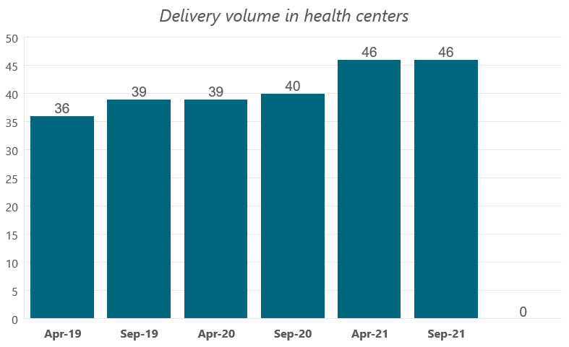
Average delivery volume before and during COVID restrictions among health centers which offer labor and delivery care
There is a slight increase in delivery volume at health centers from April 2019 (36) to April 2021 (46)
n=195
n=200
n=203
n=204
n=208
n=210
116

Slide 117
Acknowledgements
Federal Ministry of Health
Central Statistical Agency
Bill & Melinda Gates Foundation
Ethiopian Public Health Association
The REs ,supervisors and regional coordinators of PMA Ethiopia
Community members who welcomed PMA Ethiopia

Slide 118








Thank you!
pmadata.org
/pm4action
@pm4action
@pm4action
@pmaethiopia
Notes:
To change the photo, click on the photo and delete it. Then click on the icon and select a new photo from your computer.

